Slide 1
Reducing risk of water related disease through sustainable sanitation solutions in Bangladesh
Murray Burt, Senior WASH Officer, UNHCR
Emergency Environmental Health Forum
17-18 June 2019

Slide 2
THE CHALLENGE

Slide 3
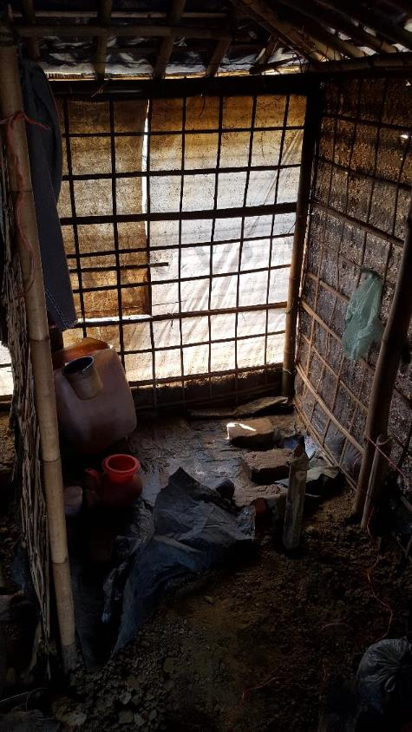
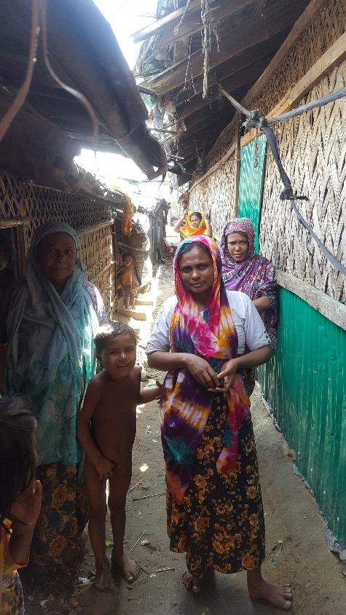

Women and Girls Toilet and Shower at Home
Social challenges for Sanitation

Slide 4
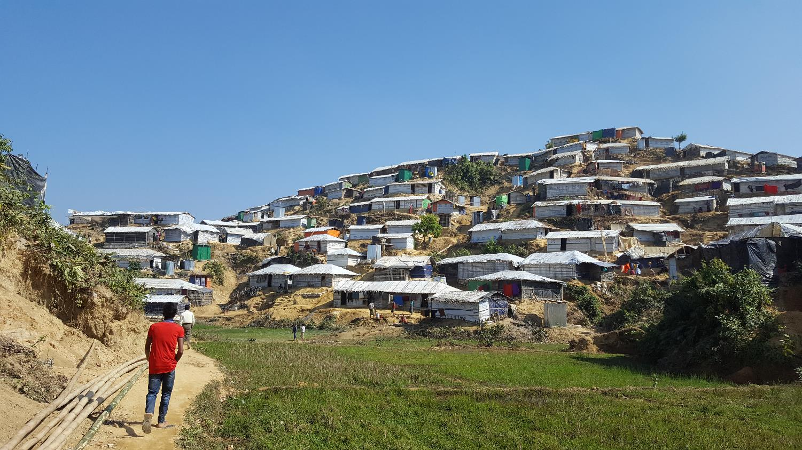
Steep terrain and High population density
Environmental challenges for Sanitation

Slide 5
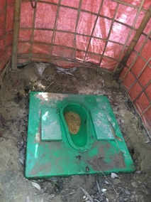
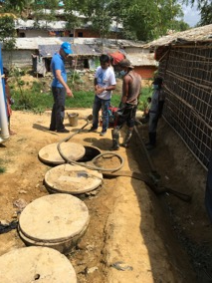
Challenges with Emptying & Transport of FS
Lack of emptying
Access difficulties
Notes:
Despite a focus on FSM, many gaps remained, due to the sheer scale of the operation and gaps in monitoring

Slide 6
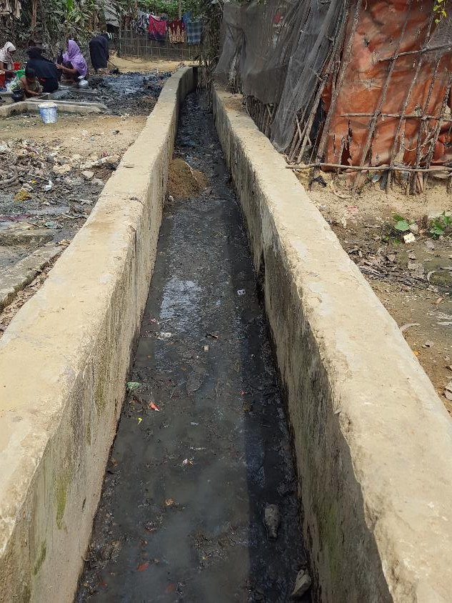
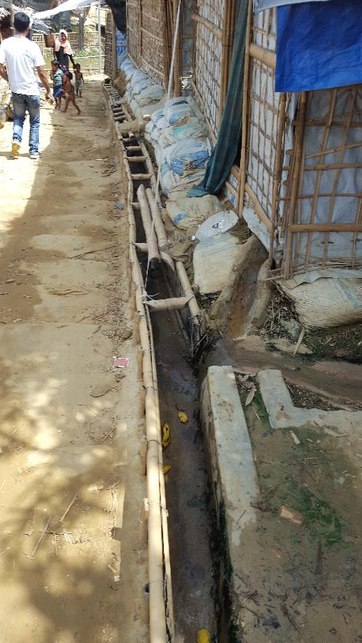
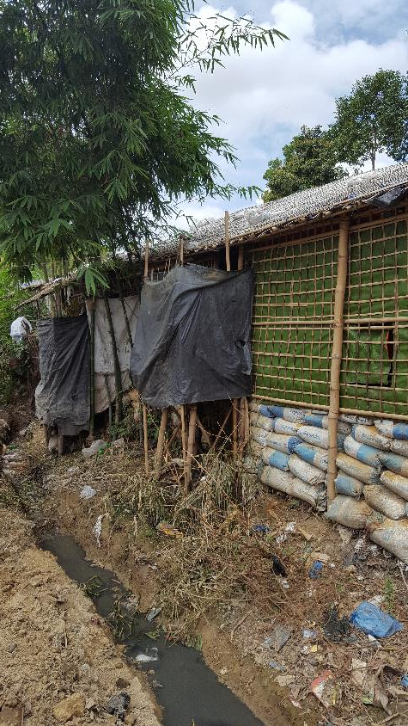
Direct disposal of FS into open drains

Slide 7
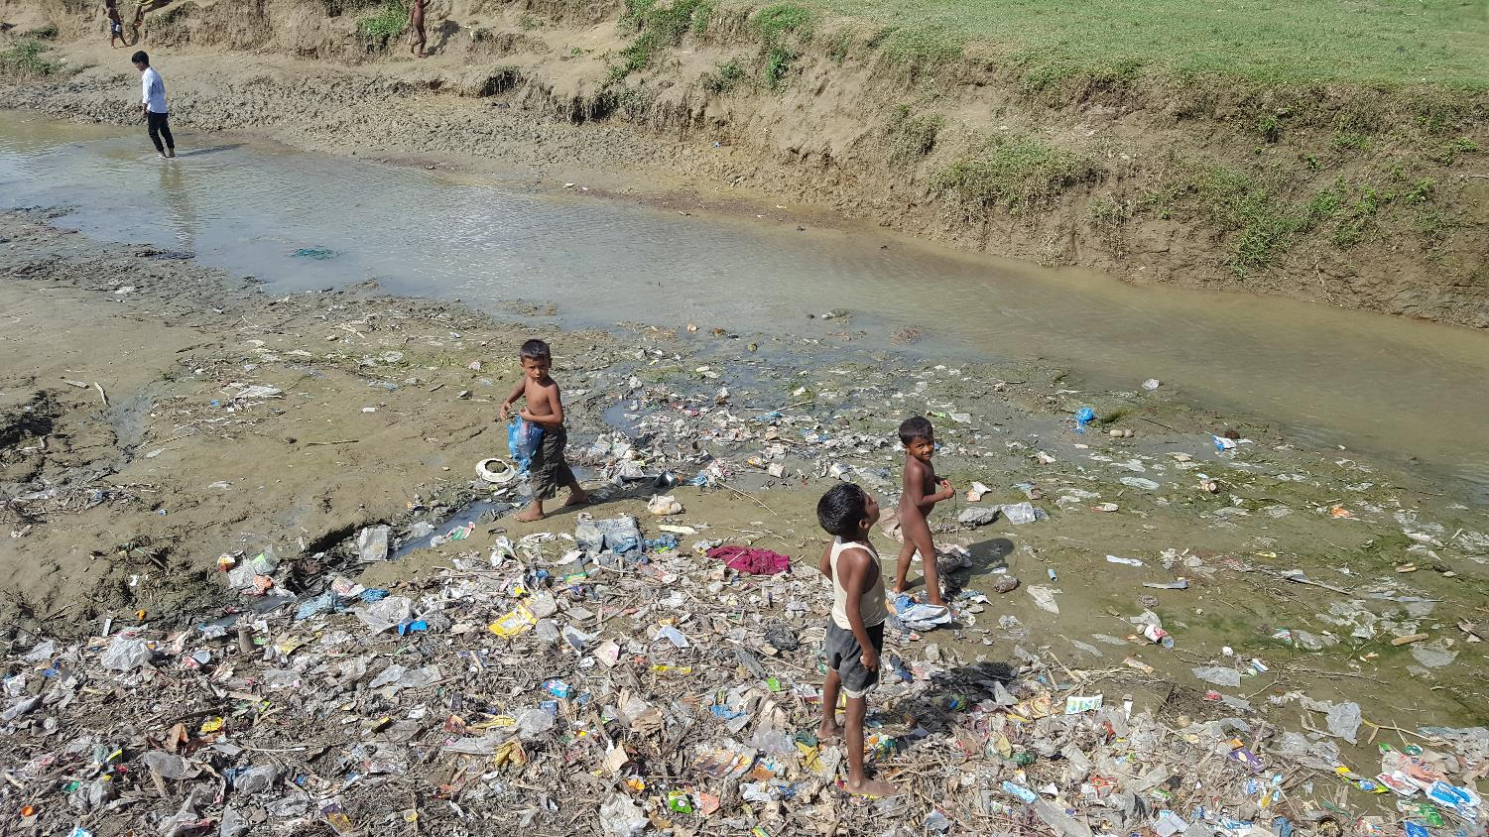
Drains flow downhill to streams

Slide 8
THE OPPORTUNITY

Slide 9
Opportunity to Achieve SDG 6
for refugees and host community
long term access to safely managed sanitation
environmentally sustainable solutions
inclusion of refugees within national services
long term low cost sanitation services
Humanitarian to Development Continuum

Slide 10
Humanitarian to Development
Planning and Financing
$
Humanitarian Financing
Development Financing
Asia Development Bank $200m
World Bank $400m
TIME
Possibility of High CAPEX, Low OPEX Solutions

Slide 11
THE
SOLUTION

Slide 12
Sanitation Masterplan
Multi-year investment plan for sanitation
Agreed technology and management models
Economic - lowest long term operation cost
Environmental – protection of environment, fit within limited space,
Socially acceptable, reduce public health risks, wastewater reuse,
Household/Family Latrines and Bathrooms where possible
Different solutions for different sites -Centralised, semi-centralized, decentralized

Slide 13
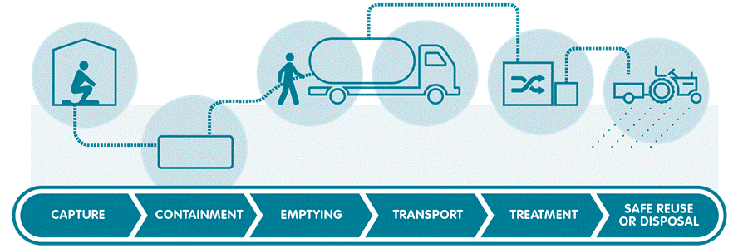
Full sanitation chain
Urban style sanitation solutions
PIPES
Solids free sewers
Fish Ponds

Slide 14
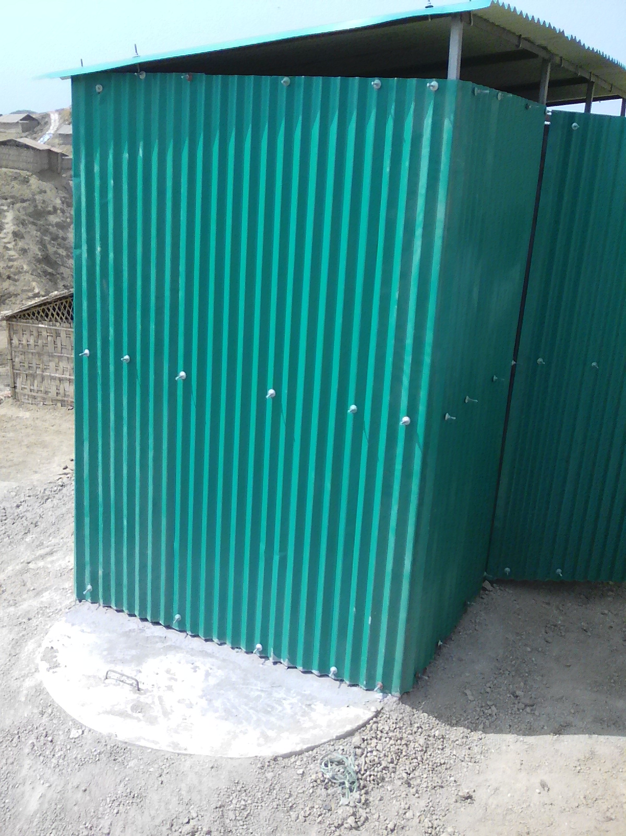
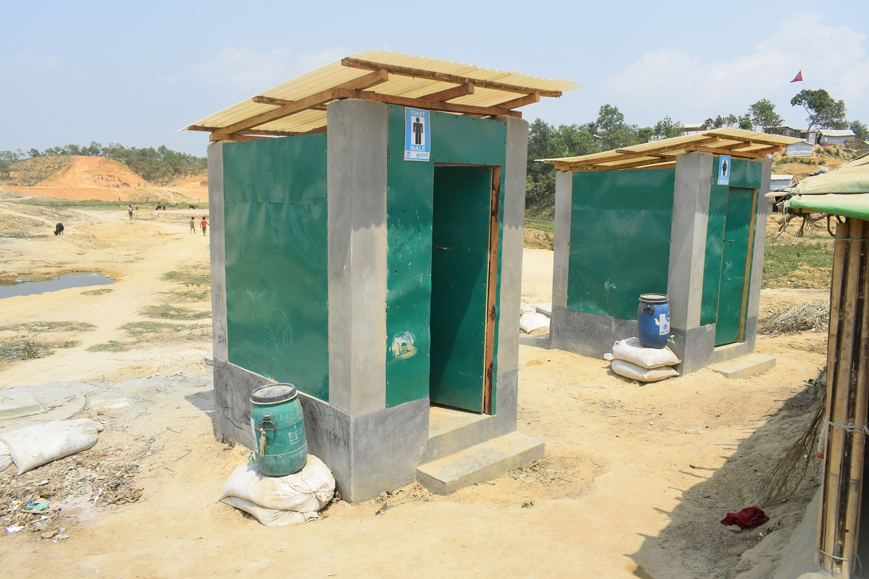
Sanitation Unified Designs

Slide 15
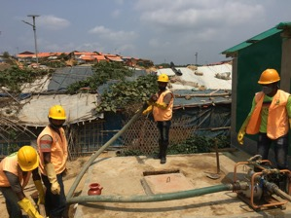
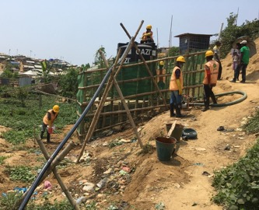
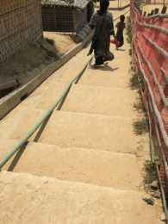
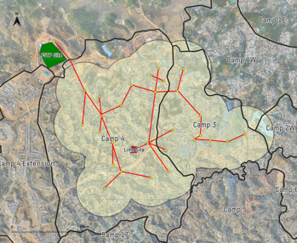
Manual/Truck Transport → Pipe Transport
‘Deployable’ system flexible to changing situation
System needs to be engineered/optimized:
Reduce/remove need for sludge trucking
Reduce time to pump from one stage/tank to next
Introduce gravity flow options where possible as situation stabilizes

Slide 16
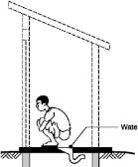
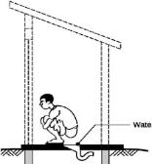




Reducing the emptying & transport cost in the long-term with gravity flow systems
Toilet. Blackwater
Bathroom. Greywater / Blackwater
Wastewater Box Channels or flexible pipes
Liquid Effluent 1% solids
Desludge every
6mths – 1 yr
Solids-free sewer preferred:
  Low water volumes
  Unknown user habits
  Potential to retrofit toilet pits as interceptors
Solids Separation
Settling Tank
(12-24hr residence time)
Effluent Treatment System
Wastewater reuse for Fish Ponds or Agriculture Irrigation
Primary Tmt
Secondary Tmt
Tertiary Tmt
Notes:
Toilets/Bathrooms – combine greywater/blackwater
Solids separation – using communal septic tank
Effluent transport- using solids free gravity sewer
Treatment – waste stabilization ponds (biogas)
Reuse – final effluent reuse for fish ponds /irrigation

Slide 17
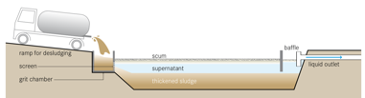

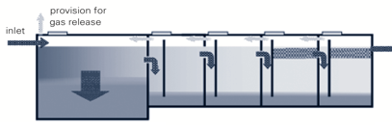
Sustainable Treatment
Centralised
Initial anaerobic settling/thickening step: high HRT to allow for initial start-up period
Need to substitute treatment function provided by facultative pond
Polishing ponds for pathogen reduction
Intermediate aerobic steps (trickling filter, coco-peat filter)
Partially decentralised
Anaerobic Baffled Reactor with 1-2
Up-flow Filter Reactor chambers
Maturation/polishing ponds
All 3 elements currently in use, but not in combination
Cost- and space-efficient, but performance needs careful monitoring – hydraulic regime at inlet can be adjusted (intermittent flow may improve performance of ABR)
Notes:
Trickling filter and coco-peat filter both use downward flow to draw in air and ensure aerobic micro-orgaanisms thrive

Slide 18
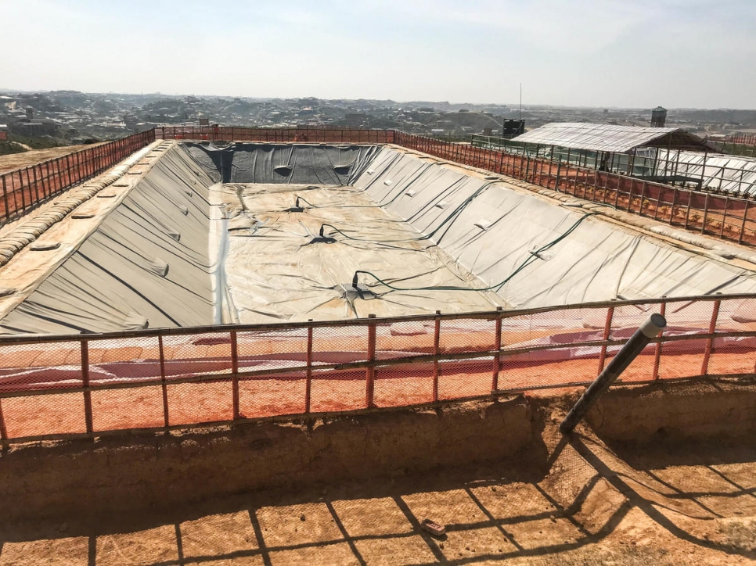
Centralised FS/WW treatment favoured where possible in the long run
Centralised
Decentralised
Waste is treated away from population Reducing Health Risks
Treatment close to population Poses Health Risks
Some units, notably constructed wetlands under-engineered due to space constraints
More space for cheaper and environmentally less damaging non-chemical pathogen destruction
DEWATS (ABR, AFR) cost-effective and low footprint, but treatment incomplete (e.g. nitrogen, pathogens)
More scope for pond-based treatment, which facilitates larger storage and HRT
Chemicals required for pathogen destruction (opex↑)

Slide 19
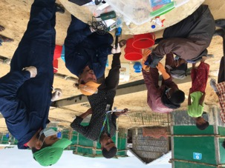
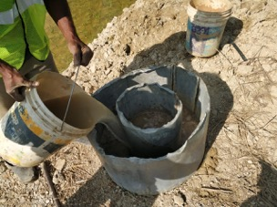
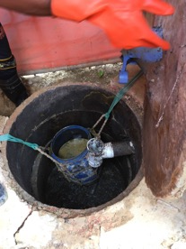
Need for systematic testing/data on key parameters of FS/WW Influent and Effluent Discharge
Photo credit: Roman Ryndin
Wastewater/FS characterisation
Infiltration rates
Wastewater/FS volumes

Slide 20
THE
FUTURE

Slide 21
Going Forward in Bangladesh
Focus on solving the FS/WW transport issue
Centralised treatment preferred
Flexibility of solutions (no holy grail)
Finalise and agree unified sector wide sanitation strategy/masterplan
Inform plans/activities of DPHE, ADB, WB.

Slide 22
Going Forward in the WASH Sector
Humanitarian WASH Sector needs new partnerships/ increased capacity for urban style FS/WW management
FS/WW discharge indicators need to be included in Sphere (BOD, COD, TSS)
Formation of global humanitarian sanitation technical working group.

