Slide 1
Sani Tweaks
Consult, Modify, Consult
Presenters Andy Bastable & Michelle Farrington

Slide 2
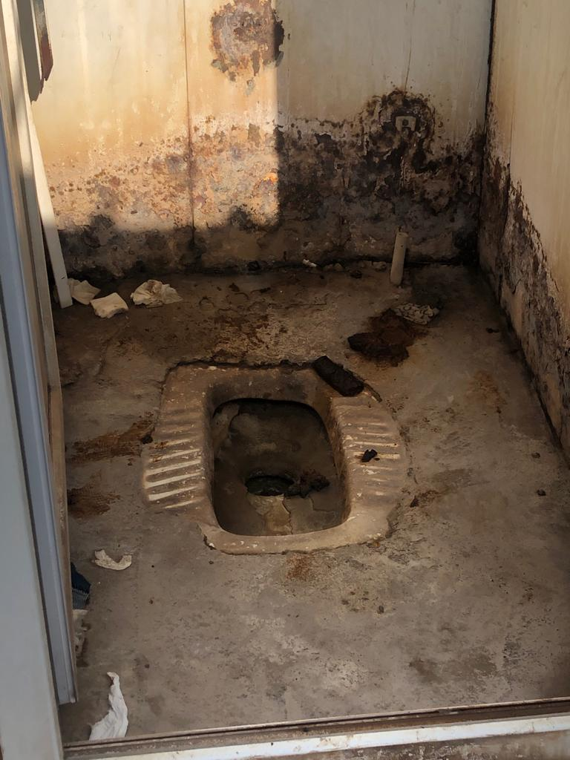
According to recent research, an average of 40% of women and girls do not use the communal or shared family latrines that agencies provide.

Slide 3
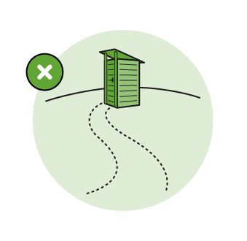
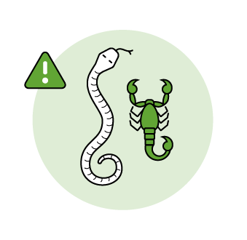
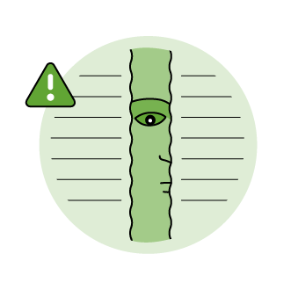
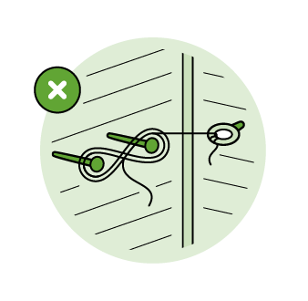
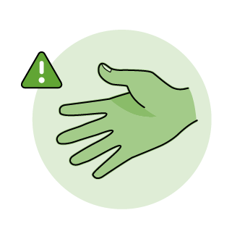
Reasons include
Not wanting to be seen going to the toilet
Lack of lighting at night
Fear of vermin
Lack of privacy (a fear of people peeping in)
Lack of locks on doors
Fear of sexual harassment
Lack of maintenance and cleanliness

Slide 4
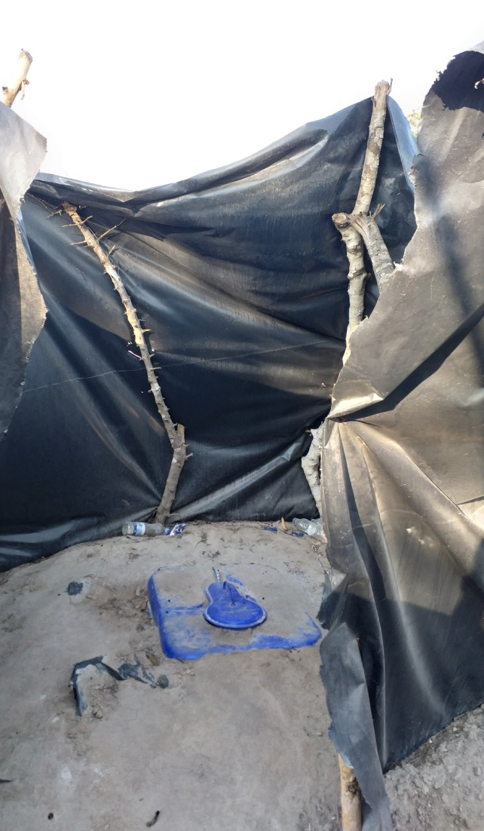
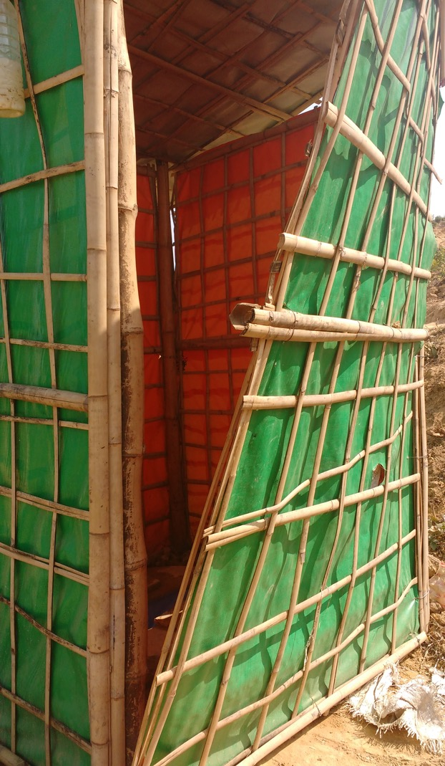
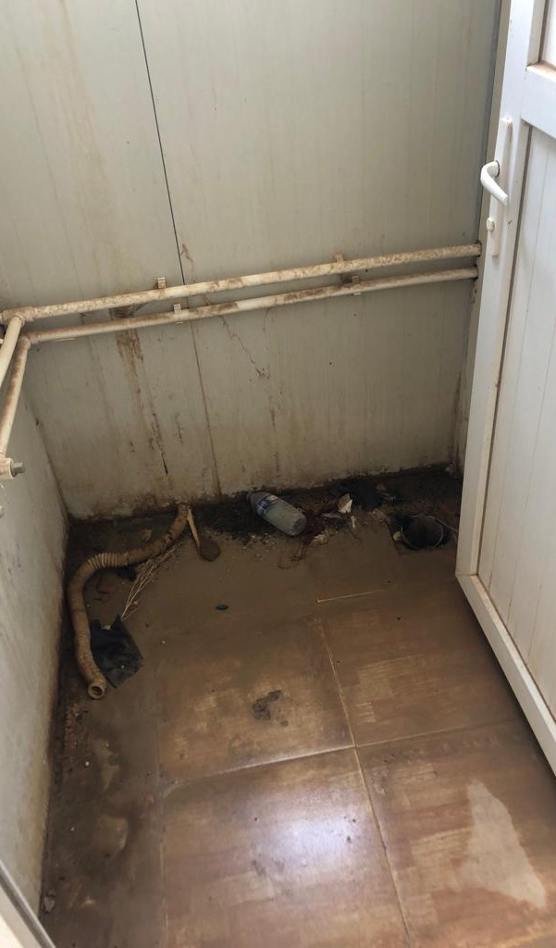

Slide 5
The goal of the Sani Tweaks Project
Consult
Modify the design
Consult again
Sani Tweaks’ aim is to ensure that, before the superstructure is designed, even in rapid onset emergencies, appropriate consultation with potential users happens and is acted upon.
Rapid Consultation – Rapid build consultation
modifications

Slide 6
Sani Tweaks Workshops Between January 2019 and March 2022
visited 5 countries: Mozambique, Ethiopia, Uganda, Bangladesh, Iraq
13 online Sani Tweaks workshops countries (2 in Yemen and Myanmar, one each in CAR, Burkina Faso, Jordan and South Sudan x2 and three in Bangladesh), A TOT was held for ACF and Solidarités and the Myanmar Cluster
Totalling 11 countries and 20 country workshops Approximately 570 people were trained and up to 225 agencies participated
They are interactive workshops with roleplays, quizzes, games and group debates aiming to put participants “in the shoes” of the latrine users. The focus was not only on women but on all groups who experience difficulties in accessing latrines

Slide 7
Sani Tweaks - Reflections from Visits to IDP and Refugee camps
Consultation process
Not enough (Gap results)
Cleaning regime
Protection issues / lighting /location
Broken locks on toilets
Lack of repair or speedy repair
Embarrassment – being seen going to the toilet /shower
Disability

Slide 8
Why?
Focus has shifted to “new” things …(back to basics not popular)
Sphere & indicators
Lack of good feedback loops
High turn over of field staff
Capacity & resources
What more can we do about it?
Wash Tweaks

Slide 9
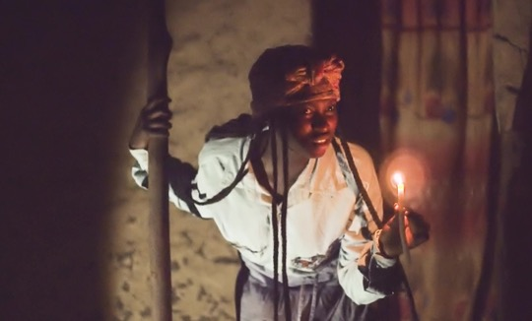
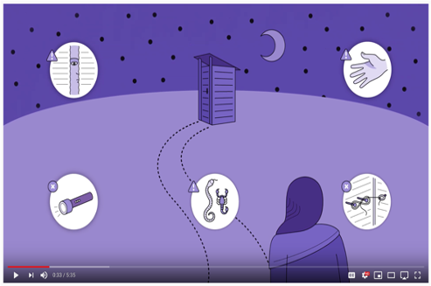
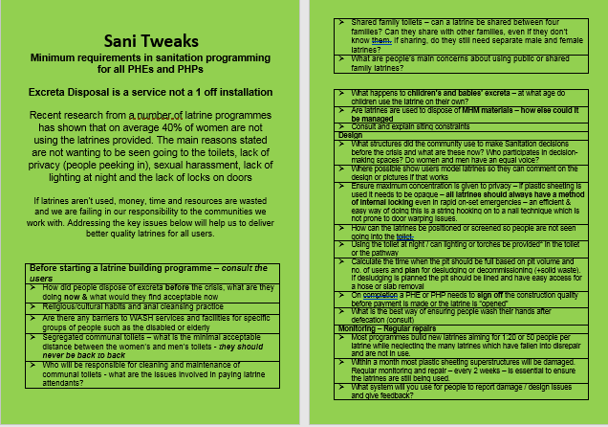
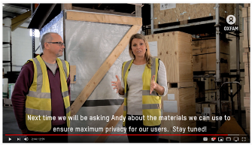
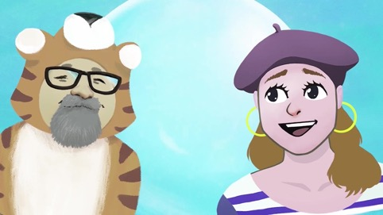
Sani Tweaks Resources
Available for download at https://www.oxfamwash.org/sanitweaks
(Available in English, French, Portuguese and Arabic)

Slide 11
Thank you!

