Slide 1
Challenges of Upscaling FSM Services in Unplanned Settlements
Notes:
starter

Slide 2
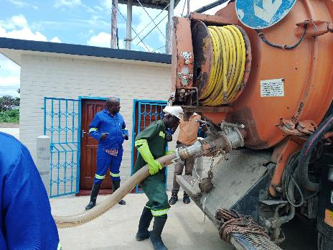
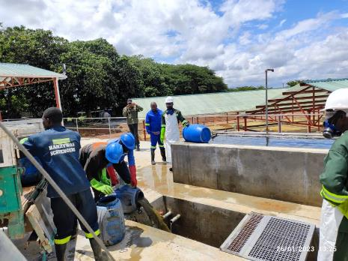
Challenges of FSM In Lusaka
FSM projects have been Initiated in Lusaka since 2011, and currently the utility is rolling CWIS.
Faecal sludge management projects have faced/are facing many operational challenges due to variable site dynamics
This study highlights challenges of faecal sludge management services along the sanitation service chain.

Slide 3
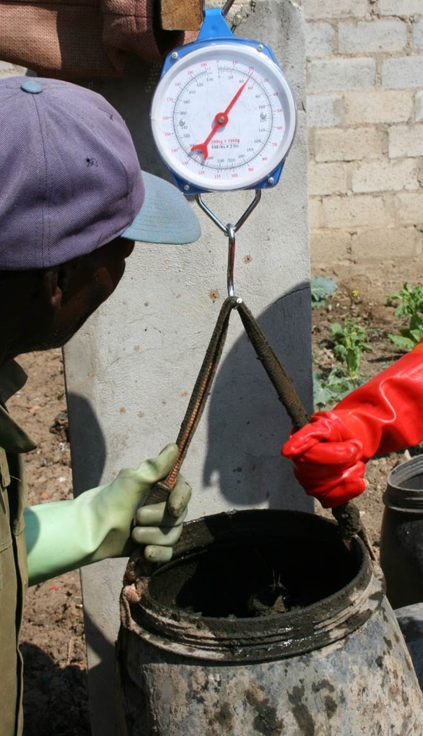
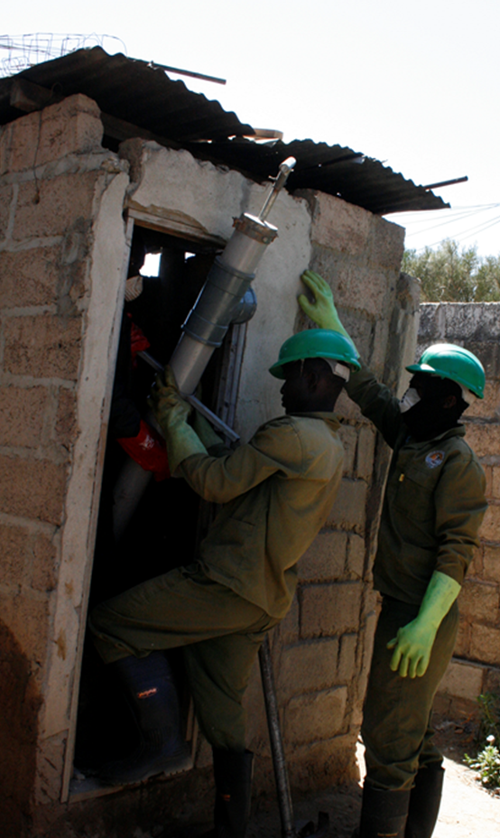
Study Design
The study adopts the case study approach through:
Analysis of 10004 surveys with data on OSS facilities and solid waste management at household level;
From three peri-urban areas of Lusaka Chazanga(4134), Chawama (4054) and George (1816)
Measuring physical and chemical content of sludge from household pits from peri-urban settlements
Analysis of field tests on four pit emptying equipment:
                Gulper
                Flex X
                eVAC _MK3
                Modified garden tools
Field observations and Surveys with Faecal sludge service teams and managers of faecal sludge treatment plants

Slide 4
Results: Waste management at HH Level

Slide 5
Results: Capture &Storage
About 80% of the studied peri-urban households rely on pit latrines and approximately 20% flush systems
A minimum 1 % solid waste generated in peri-urban areas end up in pit latrines
An average 150kg of solid waste is contained per cubic meter of pit latrine sludge in areas with poor solid waste management services –about 30% of solid waste could be thrown into pit latrines in areas lacking services

Slide 6
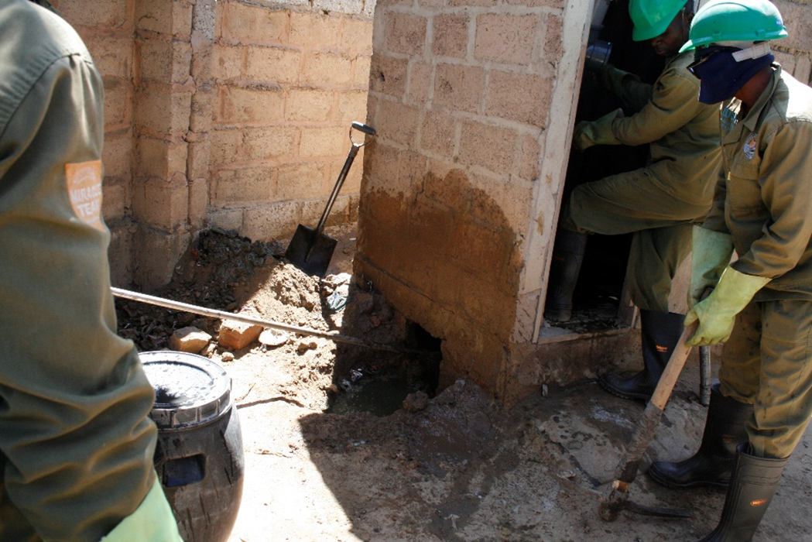
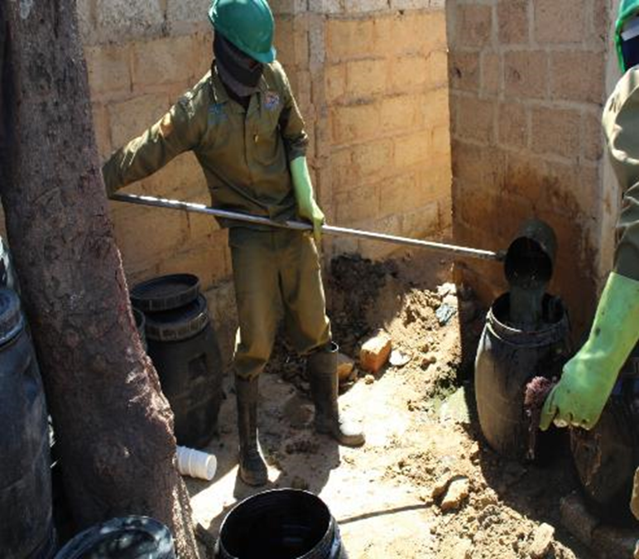
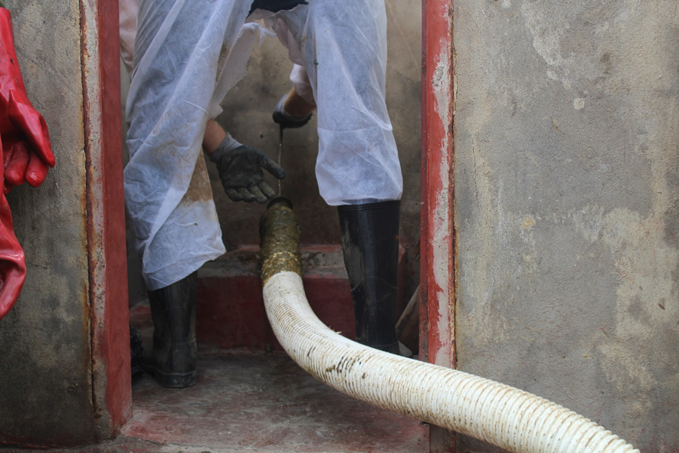
Results: Emptying & Transportation
Presence of inorganic material in sludge
              increases emptying time more than two times
              Increases Failure of emptying technologies
              Many emptying technologies fail many times due to clogging caused by waste
              Pumping technologies have a need of huge suction power.
              Sludge dilution in pits is necessary to allow for suction and pumping
Pits need to be punctured compromising the integrity of the structure- at least one OSS facility collapses every year

Slide 7
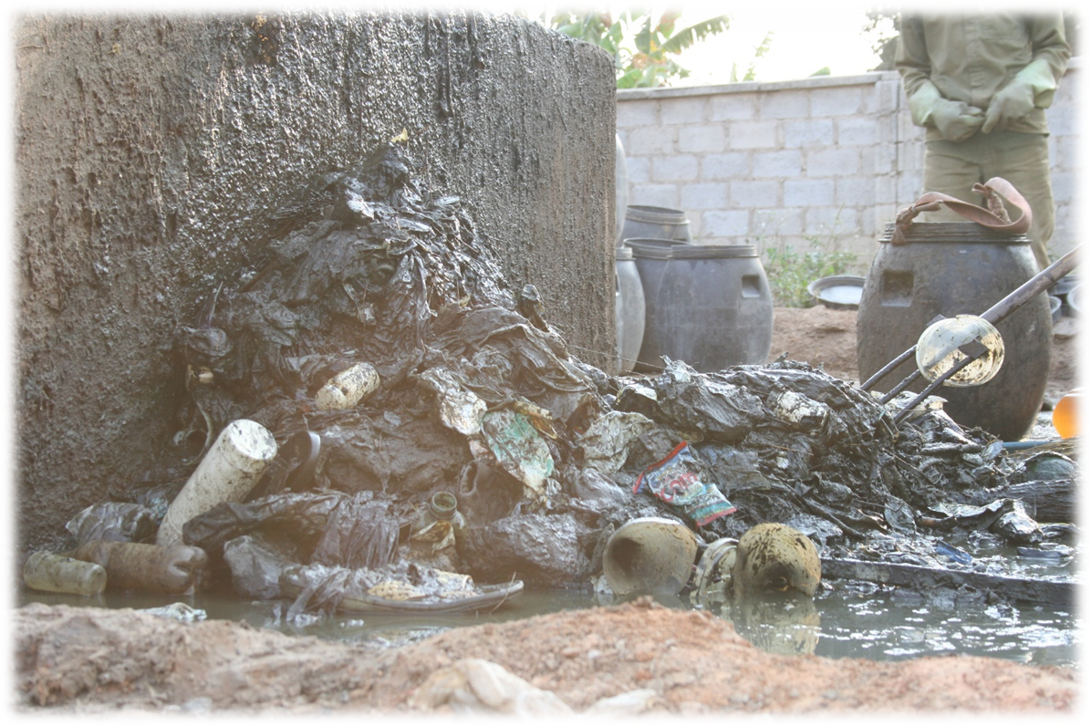
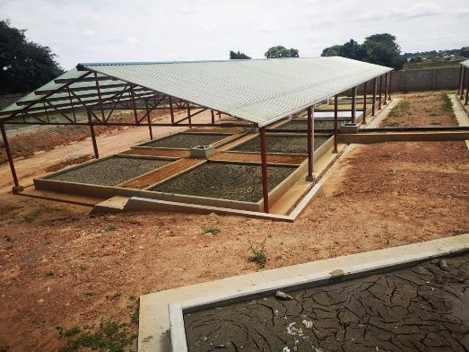
Results: Treatment, Enduse and Disposal
Inorganic substances in sludge increases cost of sludge treatment
Extra Personnel-There is need of at least one person to be washing out solids during feeding of the treatment plant
There is longer operation times at the plant treatment plant due to the need of waste separation and washing (3X)
About 5% of income from sludge services is used in managing inorganic solid waste at the treatment plant

Slide 8
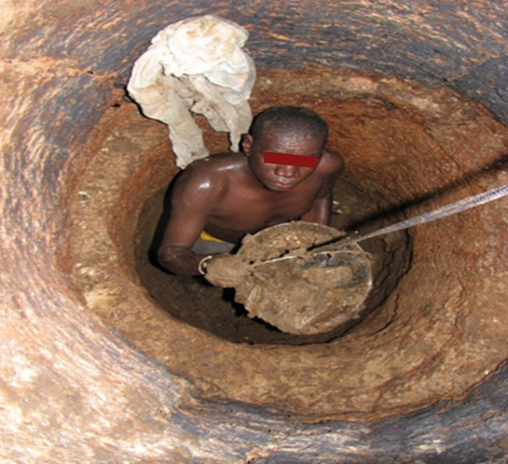
Lessons
Haphazard construction of inadequate unstandardized sanitation facilities slows the advancement of safe and hygienic sludge management services
Professionalization of safe sludge management services can be quickened from engagement of existing service providers before engaging new comers
Sludge management can be enhanced with the use of complimentary hygiene information, education, communication and complimentary service provision
Need to understand the community historic sanitation dynamics during OSS and FSM promotion

Slide 9
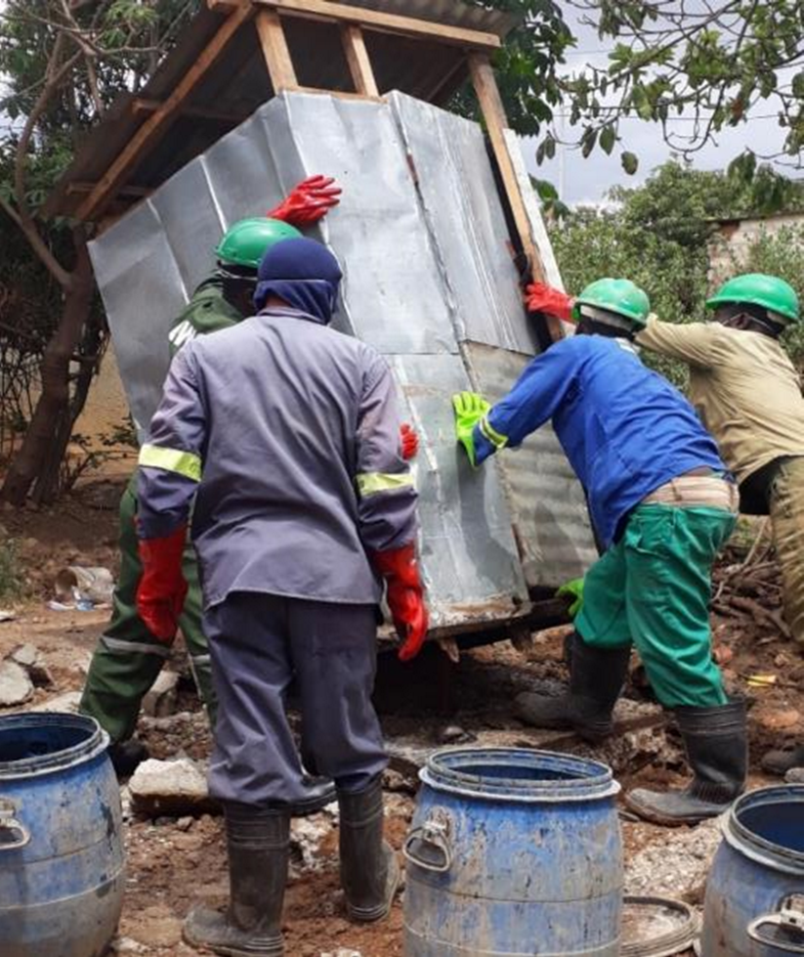
Recommendations
There is need to promote standards for all sanitation systems and the standards must be adequately enforced
FSM projects must be run with complimentary projects e.g
Community sensitization and awareness on solid waste management awareness campaigns
Solid waste management services must be advanced (Household menstrual Health and hygiene product management awareness)
Solid waste management must be planned for in future FSM projects:
Systems that enhance the promotion of sludge management complimentary services must be developed e.g tariff bundling of water and solid waste together
Capacity building measures and monitoring mechanisms for sludge service providers need to be enhanced
Promotion of facilities/ systems that discourage the dumping of inorganic materials into sanitation facilities

Slide 10

Simwambi etal, Effects of Poor Solid Waste Management on Faecal Sludge Emptying, Treatment and Disposal Services in Lusaka | European Journal of Applied Sciences (scholarpublishing.org)

