Slide 1
Evolvement of Fecal Sludge Management (FSM) at Rohingya Response, Cox’s Bazar
29th November, 2023

Slide 2
Presentation Outline
Overview of Cox’s Bazar Rohingya Response – Jafar, WASH Sector
Containment – Jafar, WASH Sector
Collection and Transportation – Mejbah, IFRC
Treatment and Reuse/Disposal – Niloy, Oxfam
Effluent Quality Monitoring – Jafar, WASH Sector
Innovation and Learning – Niloy, Oxfam
WASH Sector Resources Doc’s on FSM – Niloy, Oxfam

Slide 3
Overview of Cox’s Bazar Rohingya Response
Containment
Jafar Ikbal
WASH Engineer
WASH Sector, Bangladesh
jafar.ikbal@brac.net

Slide 4
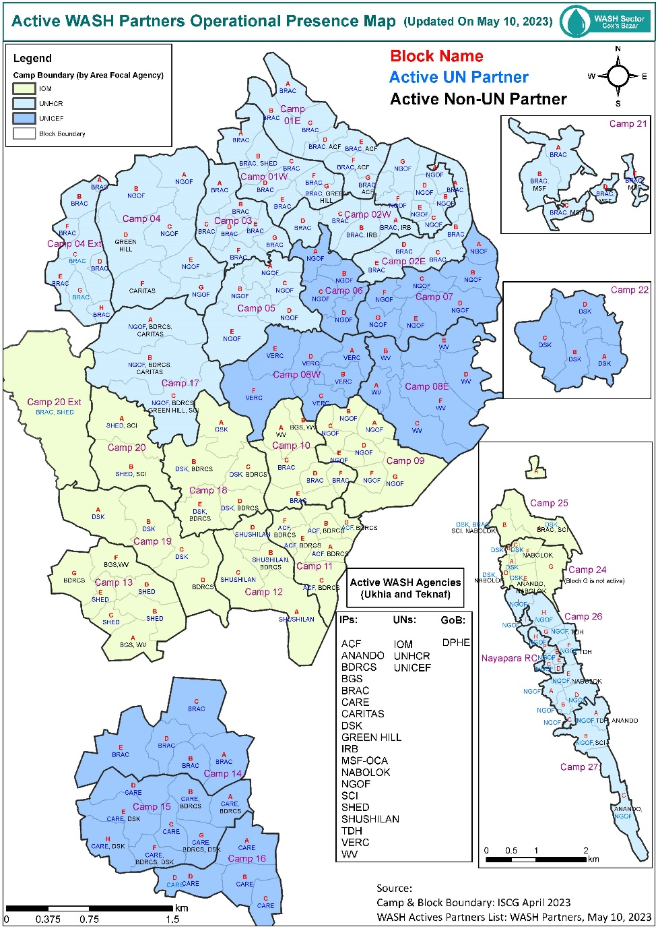
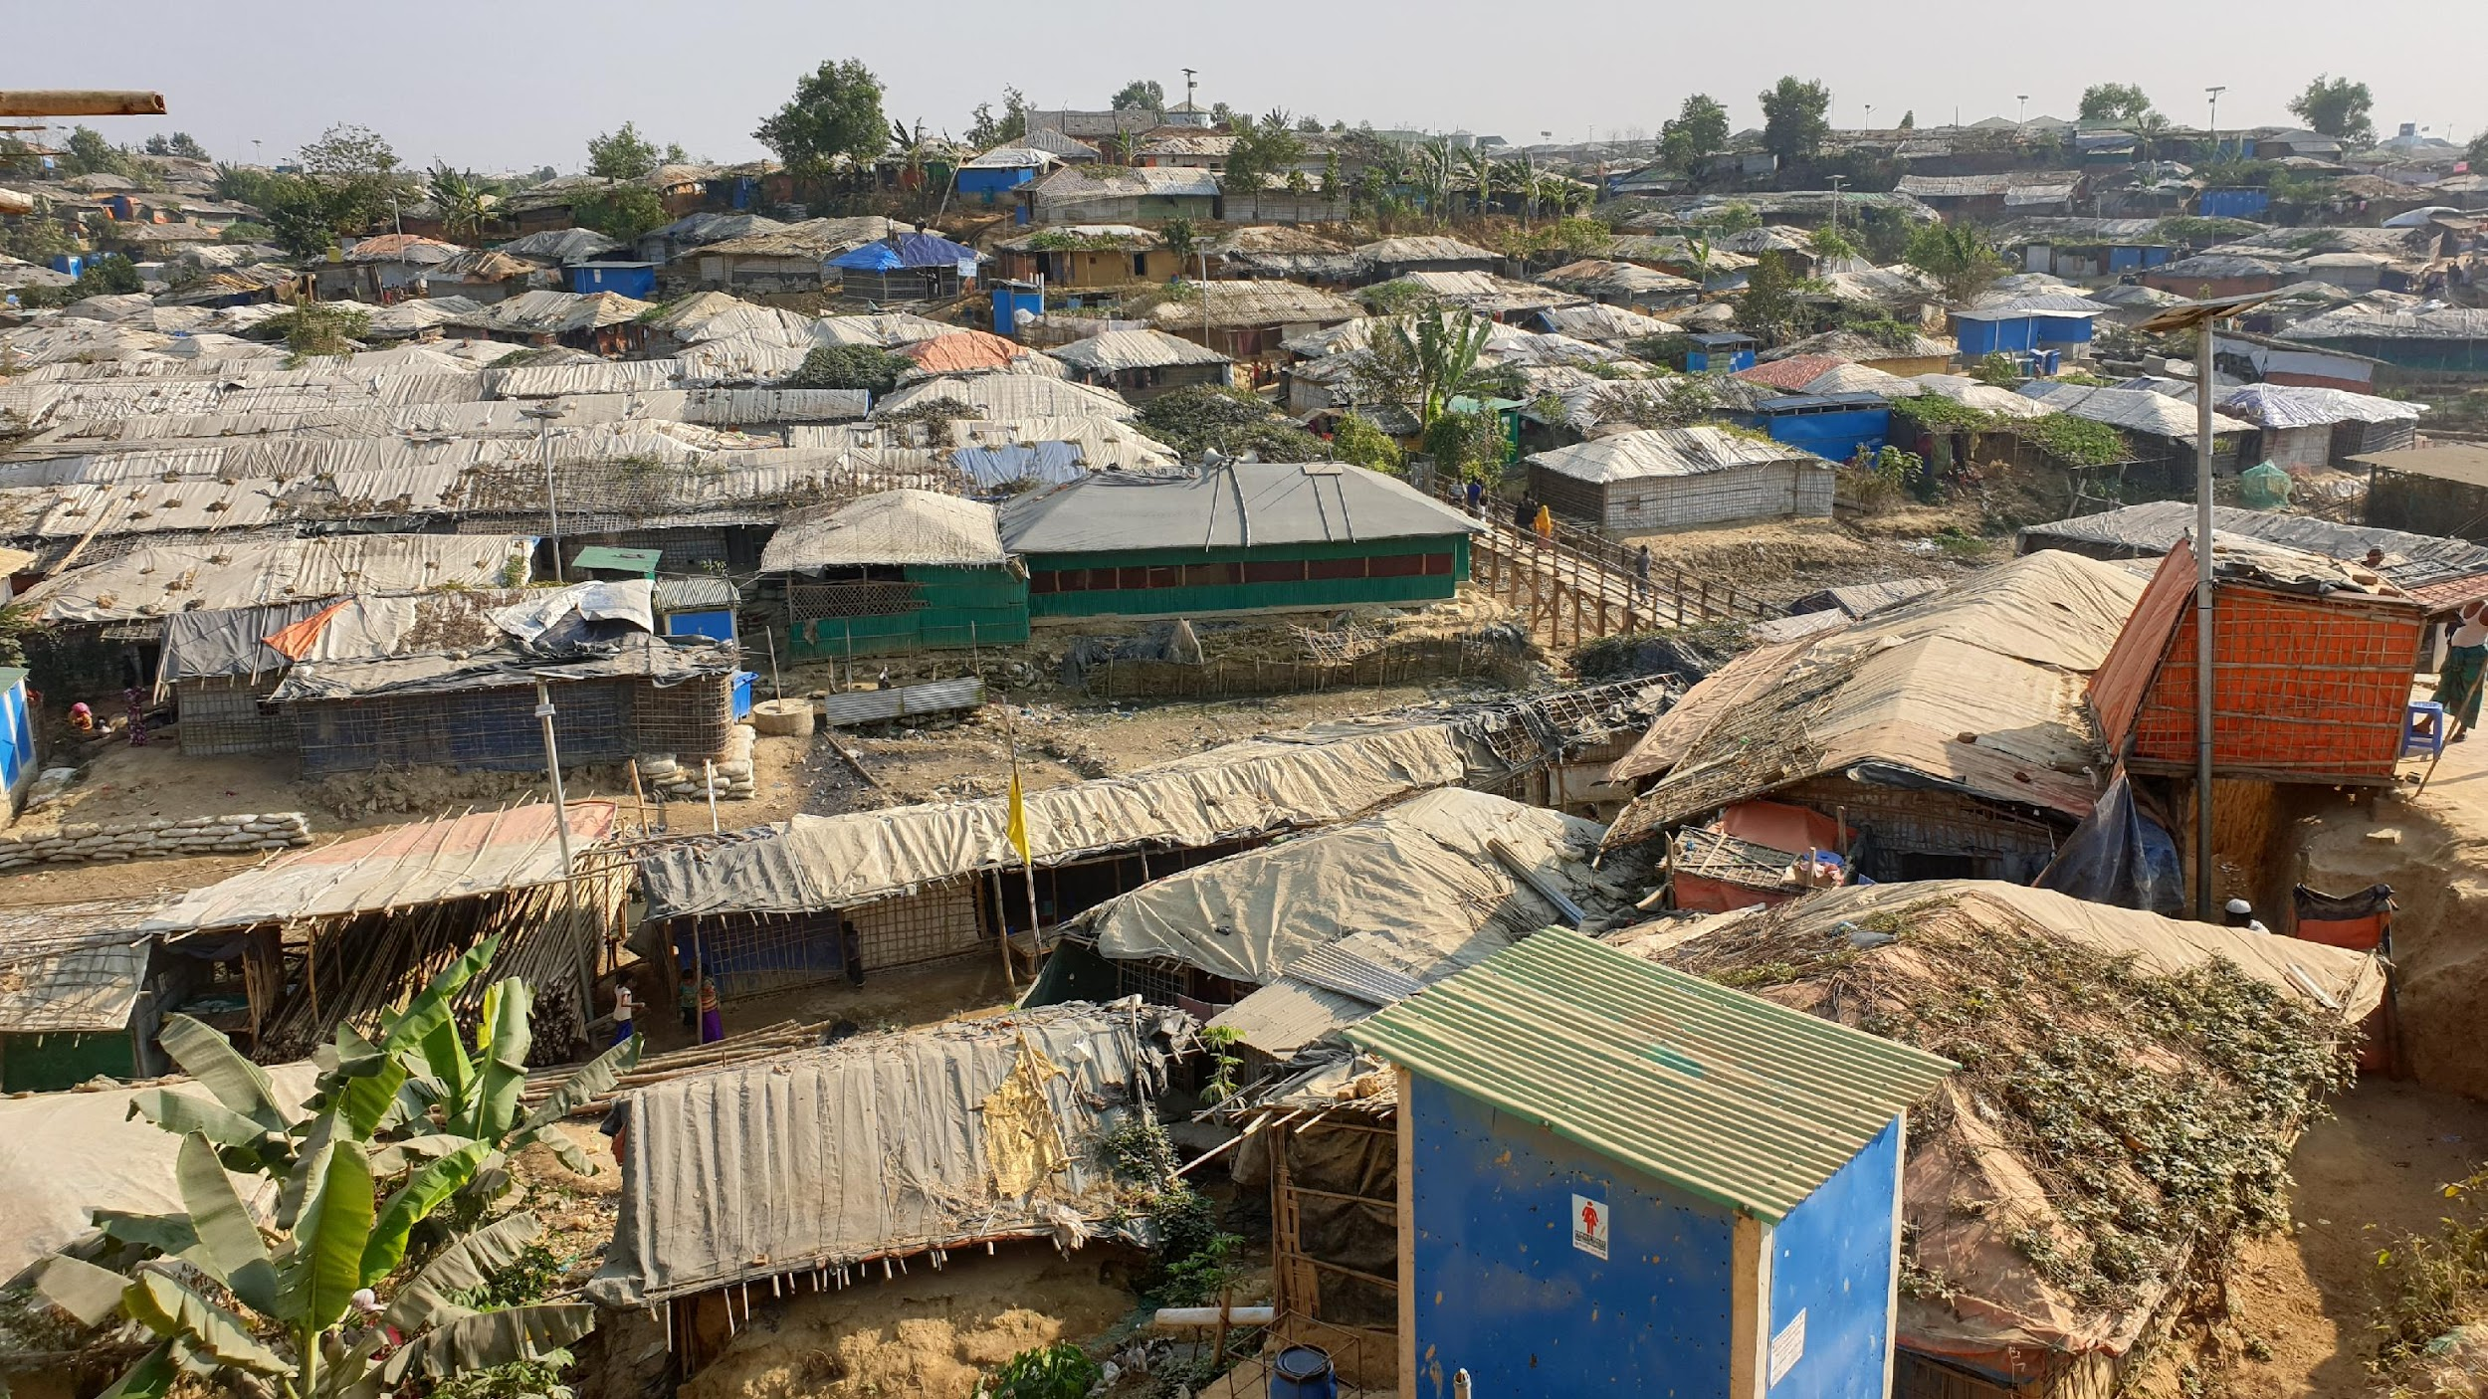
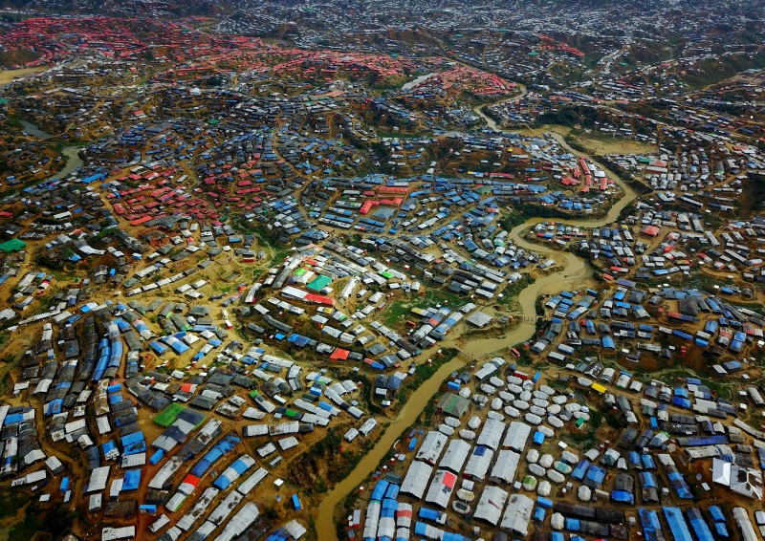
Overview of Cox’s Bazar Rohingya Response
August, 2017 – 0.76 M Rohingya community have arrived at Cox’s Bazar
Currently 0.97M population within 33 Camps
3 UN, 20 INGO and NGO are working
Tropical climate (monsoon season – May to September)
Hilly terrain
Coordination
Sanitation TWiG Formation (2017 to 2019)
Ad Hoc Group on Sanitation (2020 to 2022)
Technical Consultation Group Formation
(2023)

Slide 5
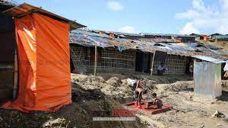
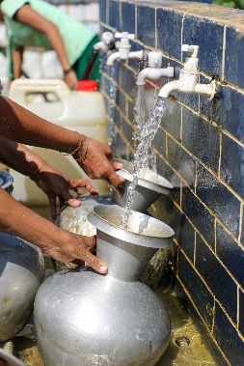
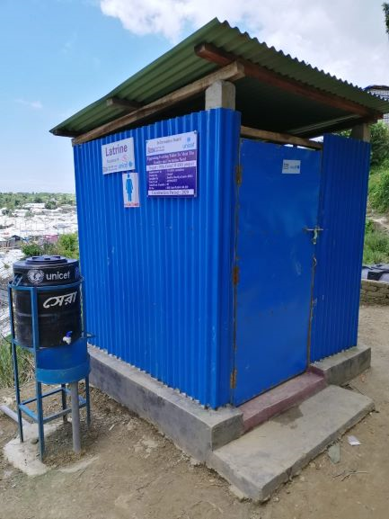
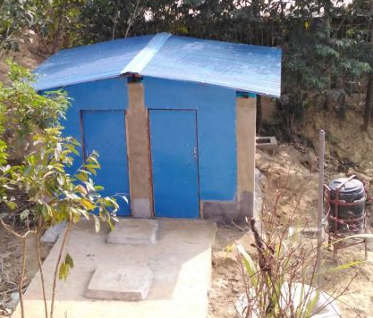
Containment
Emergency
In 2017 , the first priority:
Emergency Latrines Construction – dia 0.75m to 0.9m and depth 1m to 1.5m
Super Structure – bamboo and tarpaulin
Ensure Initial access to latrine
Reduce Open Deification
Tap Stand
Emergency
Phase
Gradual
upgradation
Deep Tube
Well
Post Emergency:
In 2018, unified latrine design have been developed & considered:
Community Needs and Desing Harmonization
Containment type - Single Pit, Twin Pit, Septic Tank, Bio Fill & Bio Gas
Super structure – wooden frame
Generation Rate
Gender and Person with Disability inclusion
Shallow Tubewell
Single Pit Latrine
Septic Tank Latrine
Twin Pit Latrine

Slide 6
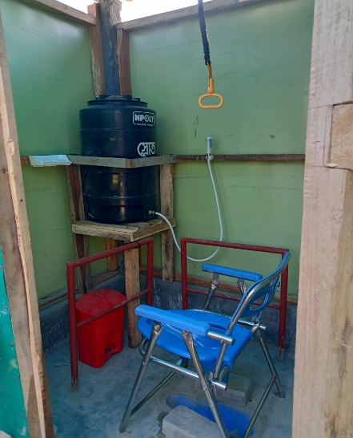
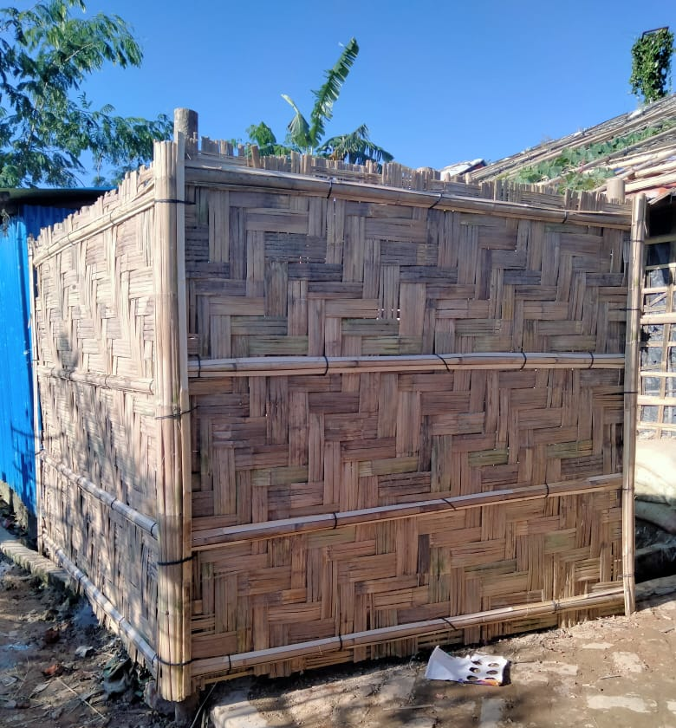
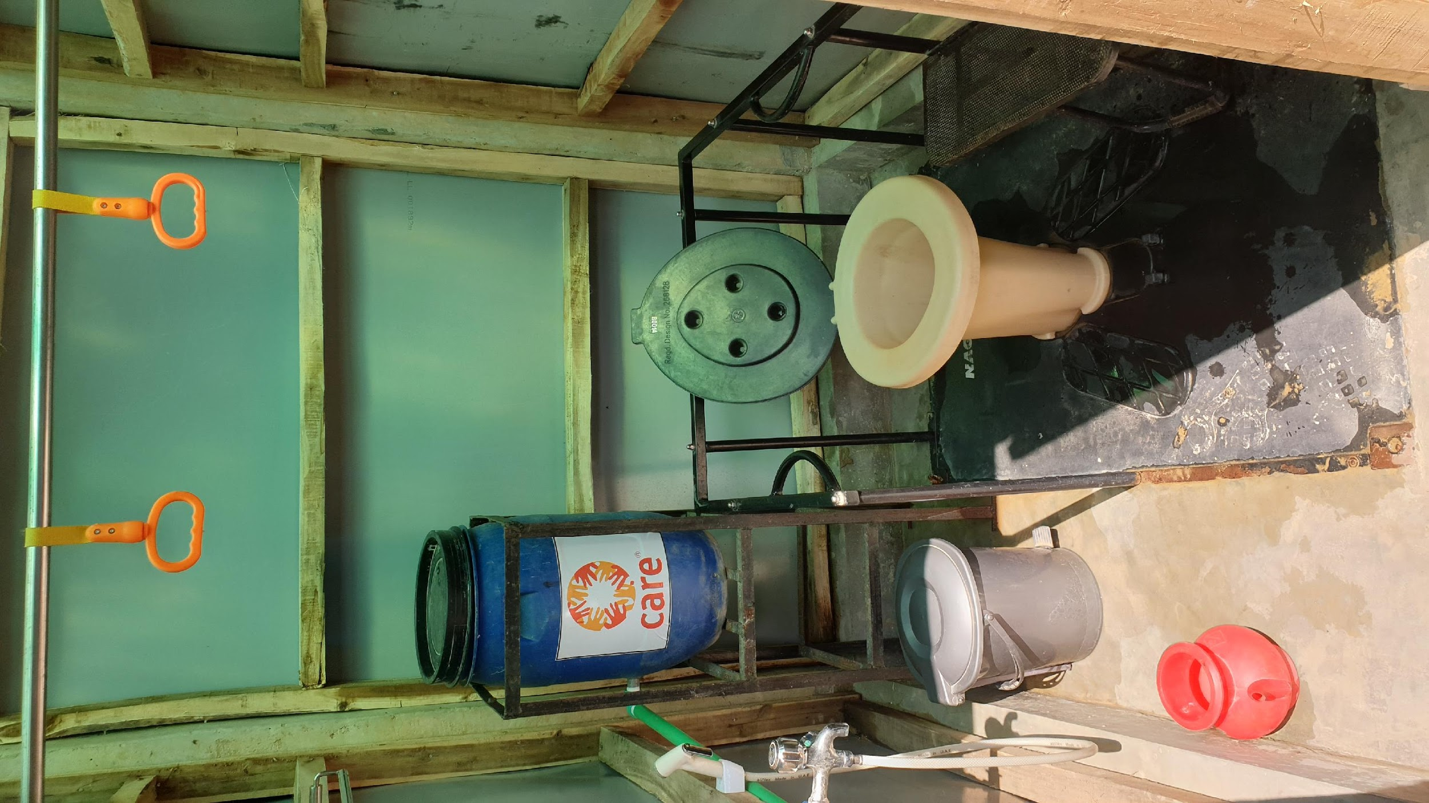
Containment
In 2023, unified latrine design have been updated with a comprehensive guideline & considered :
Community needs
Containment type - Single Pit, Twin Pit, Septic Tank
Super structure – wooden and steel frame
Generation Rate, Soil condition
Low O & M costs
Space Limitation
Disaster resistance (like fire, cyclone)
Community engagement for O & M and ownership
Gender and Person with Disability inclusion
User Committee Member List
Steel Framed Single Pit Larine

Slide 7
Collection and Transportation
Mejbah Uddin Chowdhury
Manager, Water, Sanitation & Hygiene
IFRC, Bangladesh
Mejbah.CHOWDHURY@ifrc.org

Slide 8
Collection and Transportation
Mode of Collection & Transportation
Manual
Mechanical
Collection
Bucket
Diaphragm Pump
Drainage
Pump
Robin
Pump
Vacutug
Transportation
Human + Drum
Pull/Push – Cart
Drum/Small Tank + Pickup
Vacutug/Truck Load with Tank
Intermediate Faecal Sludge Transfer Network

Slide 9
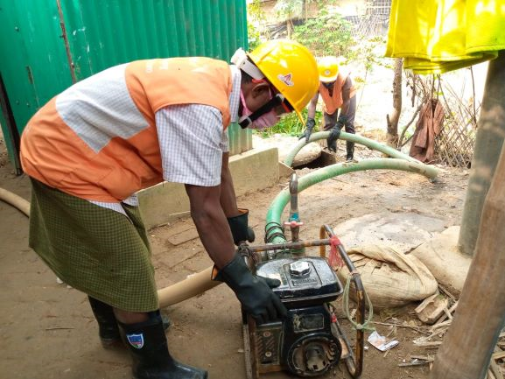
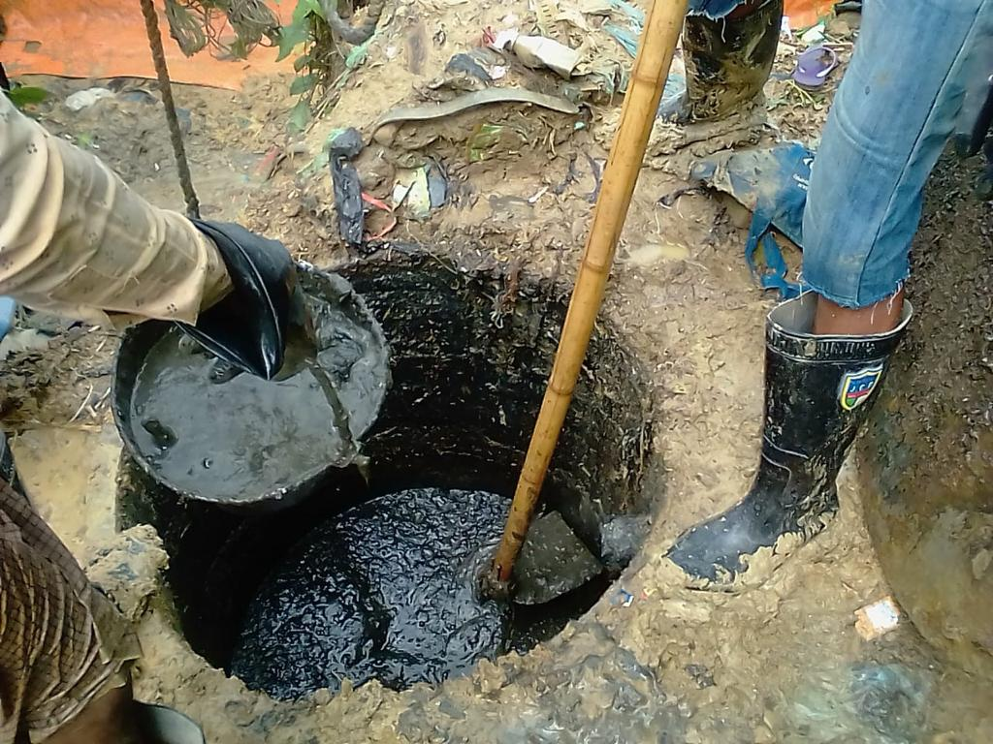
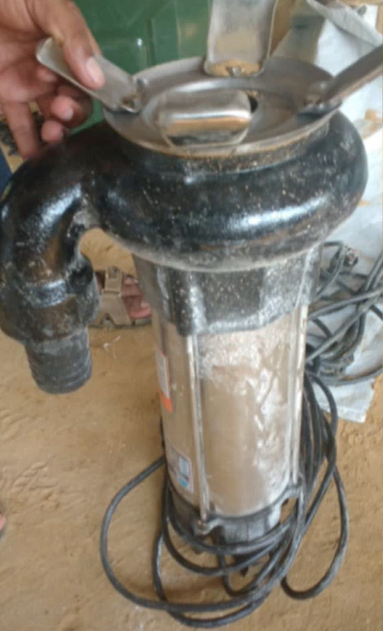
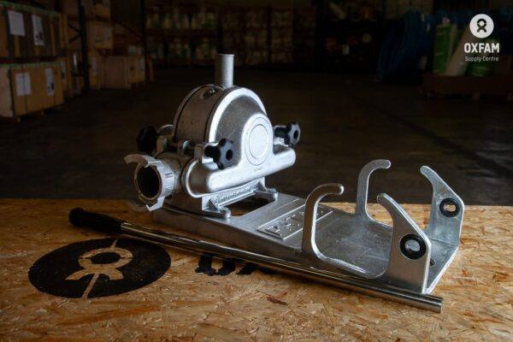
Emptying/Collection/Desludging

Slide 10
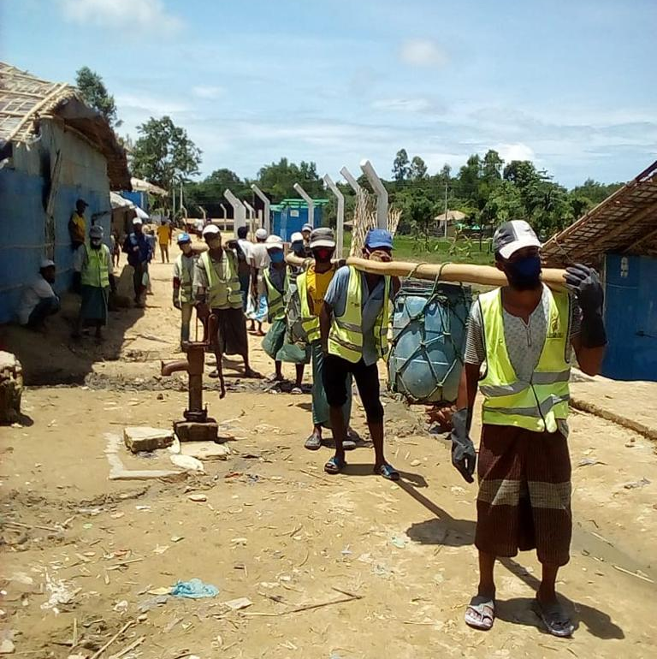
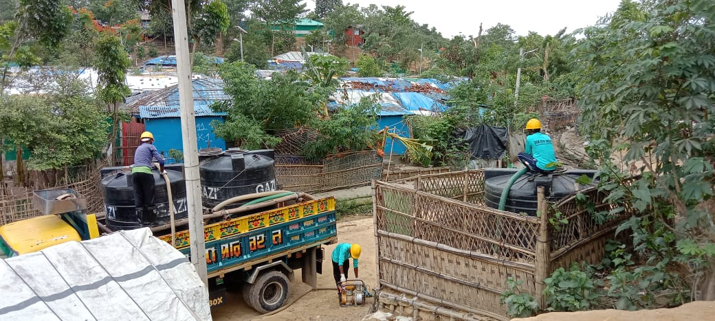
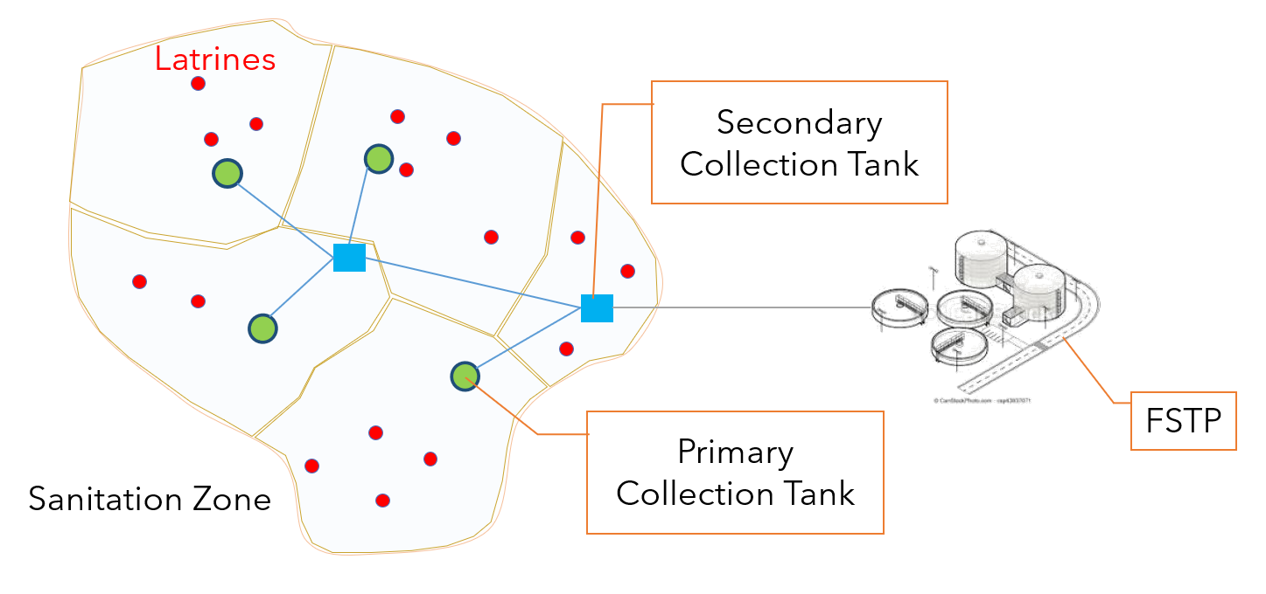
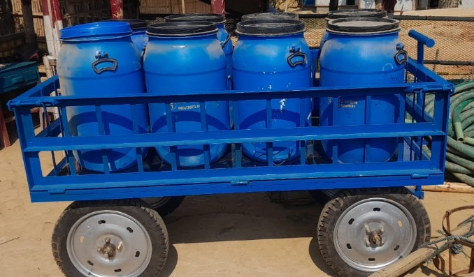
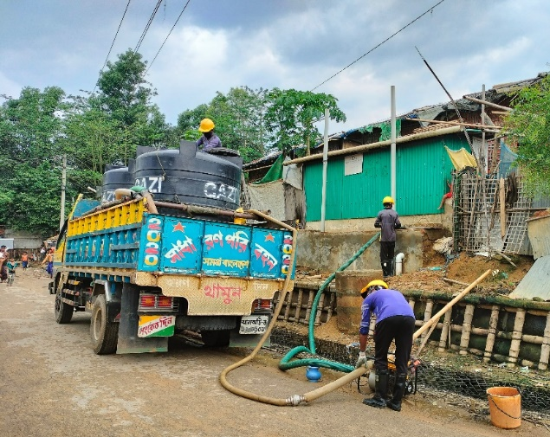
Transportation

Slide 11
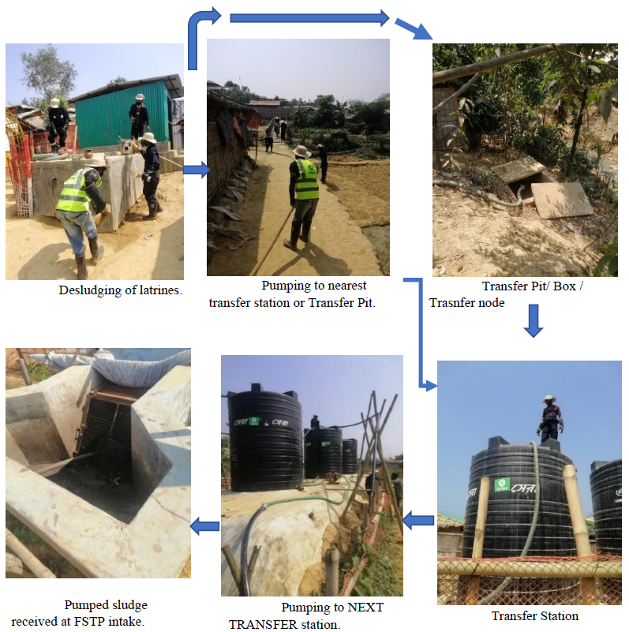
Transportation
Intermediate Faecal Sludge Transfer Network (IFSTN)

Slide 12
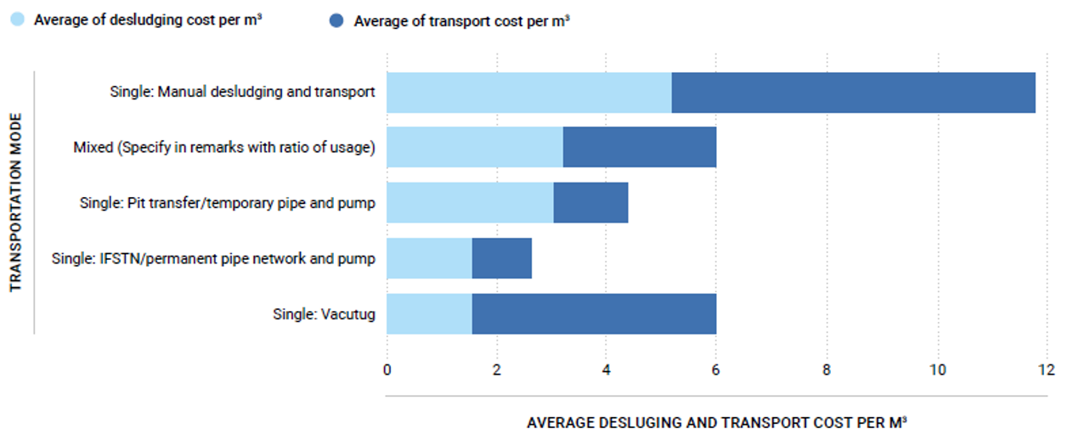
Collection and Transportation
29,718 m3 of FS is transferred per month (26% average increase in wet season)
The most used transportation mode is Pit transfer/temporary pipe and pump
Intermediate Faecal Sludge Transfer Network (IFSTN) as the most cost-effective (ARUP, 2022)
Recommendations, Challenges and Others:
Avoid Manual desludging (bucket)
Use desludging pump
Safety/health rules/Ensure PPE
Challenge: accumulative solid sludge in pits + solid waste creating blockage
Desludging rate every 2 months on average (based on volume/population/type of latrine)

Slide 13
Treatment and Reuse/Disposal
Safwatul Haque Niloy
Sanitation Coordinator
OXFAM, Bangladesh
SNiloy@oxfam.org.uk

Slide 14
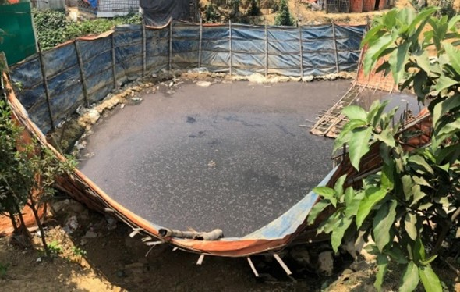
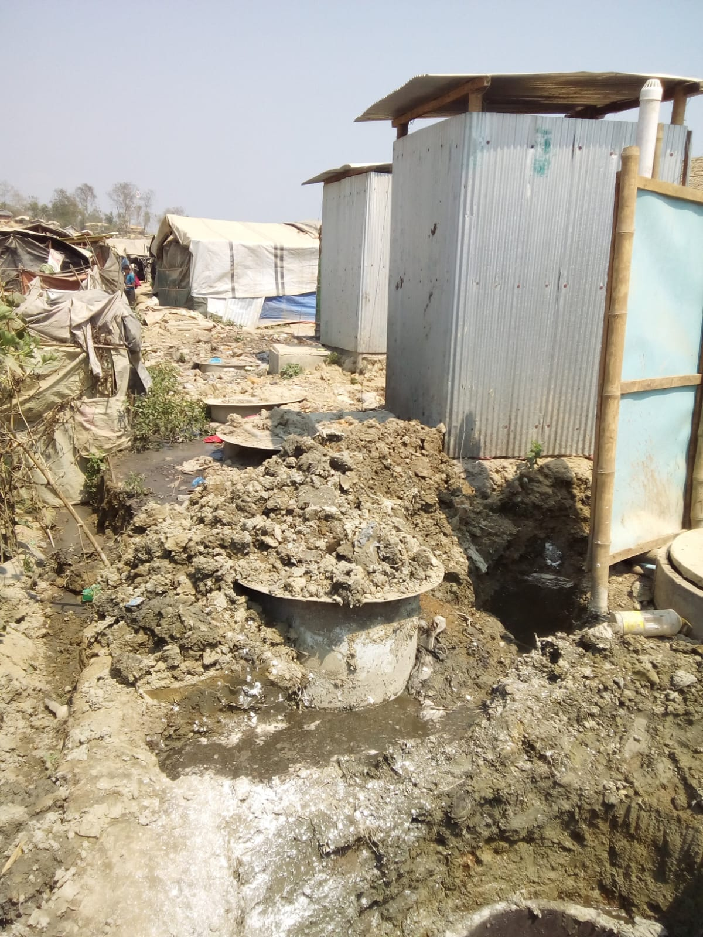
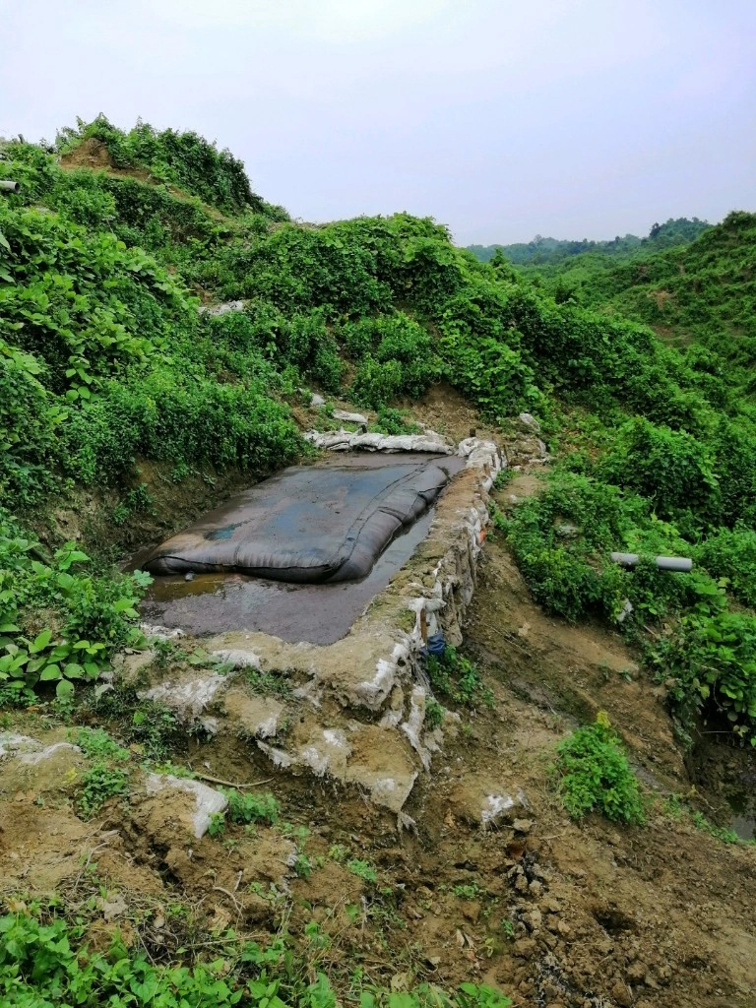
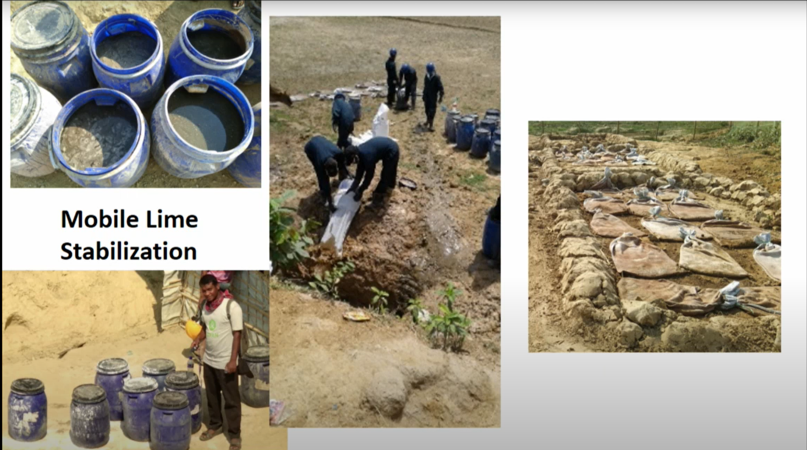
Treatment
First phase emergency, How FS was managed ! 1. Excavate another pit ,transfer & backfill. 2. Open Desludging ponds. 3. Geo bags , mobile lime stabilization.
ODP
Geo Tube

Slide 15
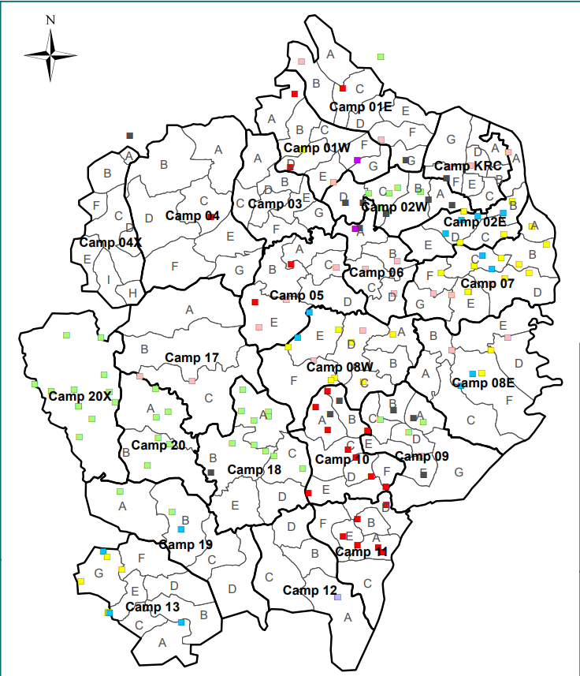
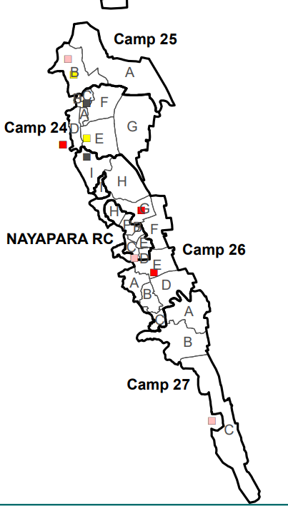
Treatment
Centralized vs Decentralized FSM approach
FSTP -1
FSTP -2
IFSTN -1
120,000 Population
IFSTN -2
150,000 population
FSTP -3
IFSTN -3
80,000 Population
Decentralized FSTP’s
Capacity 5 to 10 m3 ,
Each camp is served by avg. 8 to 12 unit
UKHIYA – Camps
Teknaf – Camps

Slide 16
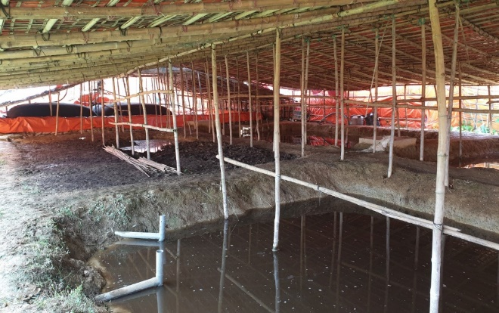
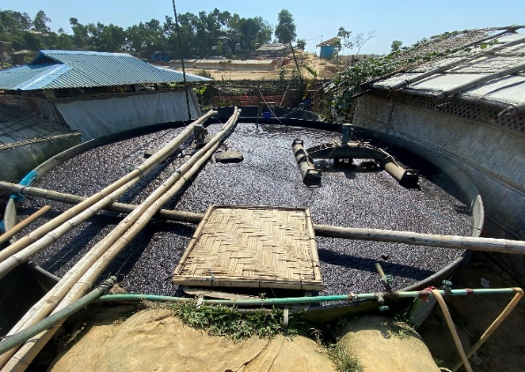
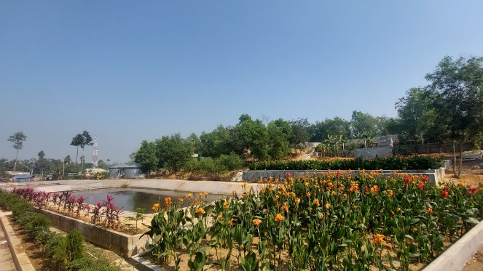
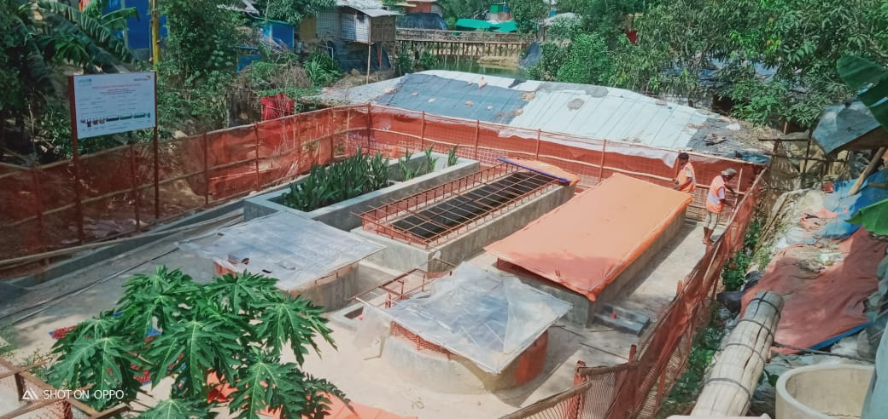
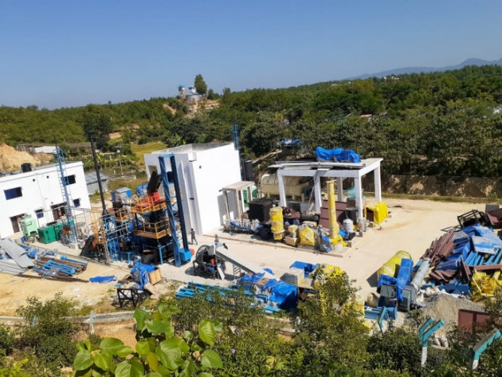
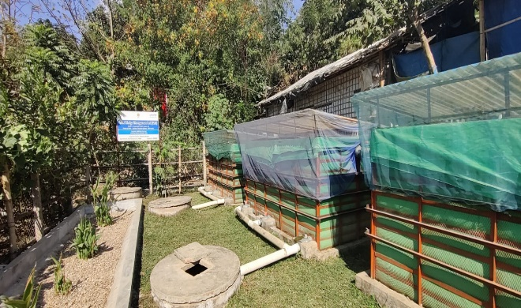
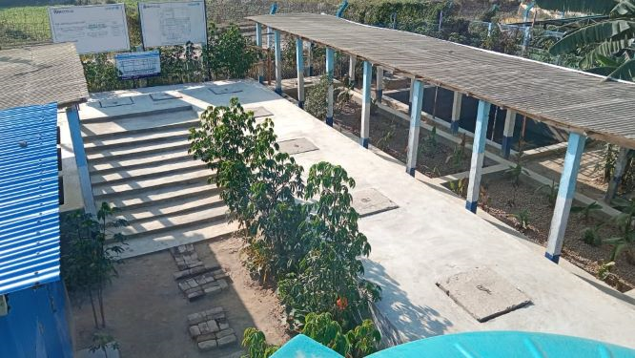
Treatment
Technologies
Biological
Anaerobic Baffled Reactor
Planted Drying Bed
Constructed Wetland
Up Flow Filter
DEWATS
Waste Stabilization Pond
Aerobic Treatment
Anaerobic Lagoon
Others
Chemical Treatment :
Lime Stabilization
High Tech : Omni Processor
Mega FSTP 1
Lime Stabilization
Aeration
Mega FSTP 2
DEWATS
WSP
Omni Processor
Up Flow Filter
ABR

Slide 17
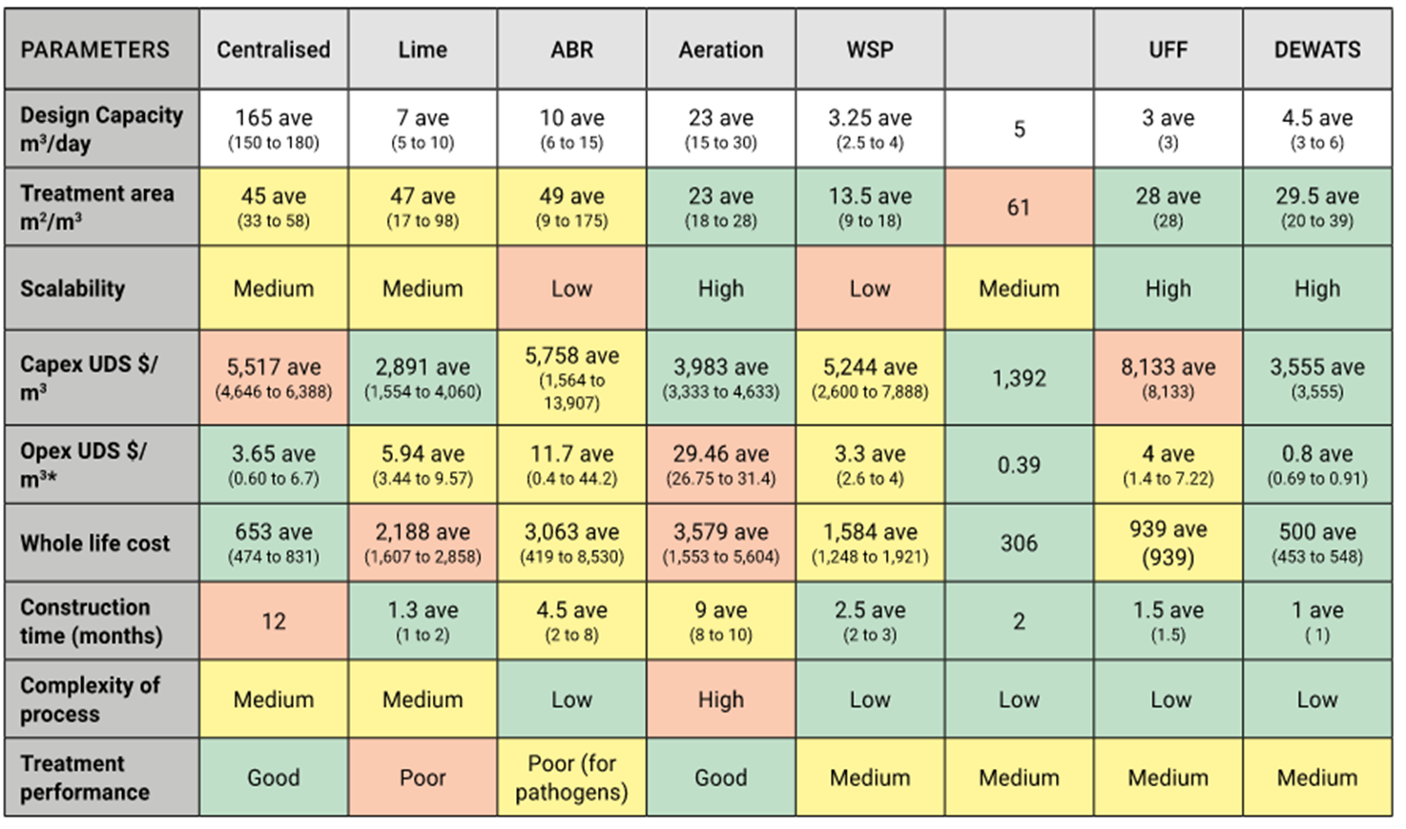
Treatment
Comparison of different systems
Source : FSM technical assessment report ,2022 - ARUP , OXFAM , WASH Sector

Slide 18
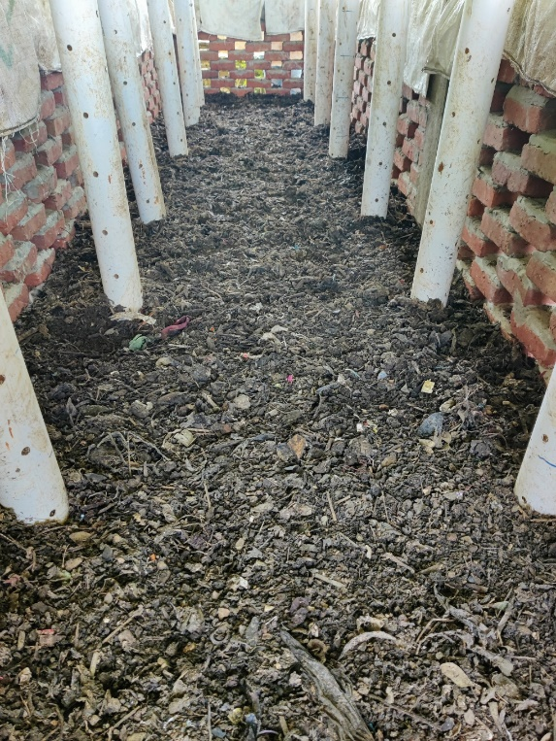
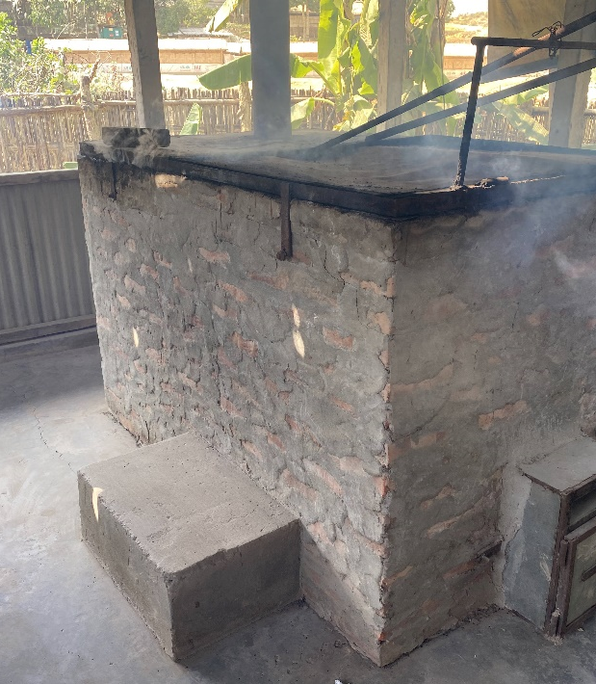
Reuse/Disposal
Less progress compared to other stages of value chain.
Current practice limited to landfilling, incineration & pilot scale co composting , biogas to electricity , cooking projects
Challenges -
Space limitation was noted as a constraint for safely disposed or reuse the final solids.
Need to understand market, country policies and acceptability for sludge products (compost, gas etc)
Co Composting
Incineration

Slide 19
Effluent Quality Monitoring
Jafar Ikbal
WASH Engineer
WASH Sector, Bangladesh
jafar.ikbal@brac.net

Slide 20
Effluent Monitoring
In 2019 Waste Water monitoring framework have developed to monitor the effluent quality
In 2022 a central fecal sludge lab (FS lab) have developed (under Department of Public Health Engineering, Cox’s Bazar, Bangladesh) to monitor the effluent quality.
Following parameter have been tested thrice in a year through FS lab
Parameter | Range
pH | 6 to 9
BOD (mg/L) | 30
COD (mg/L) | 125
Nitrate (mg/L) | 50
Phosphate (mg/L) | 15
Suspended Solid (mg/L) | 100
Temperature ( ̊C) | 30
Total Coliform (cfu/100 mL) | 1000

Slide 21
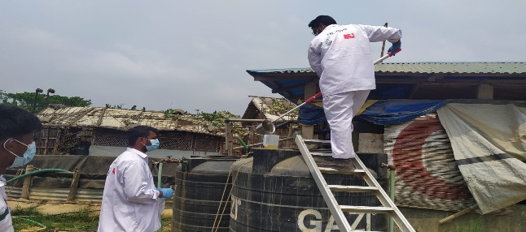
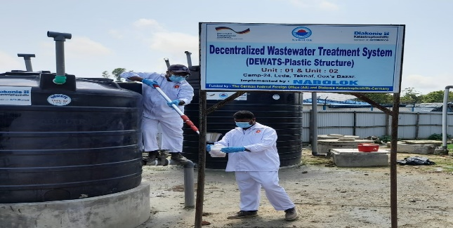
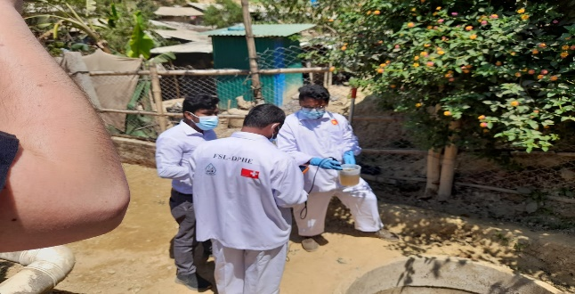
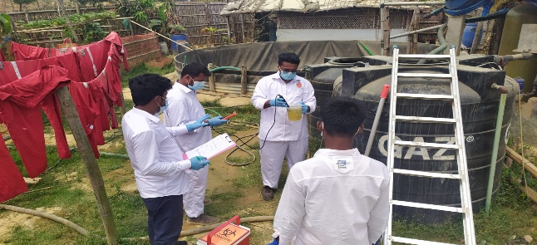
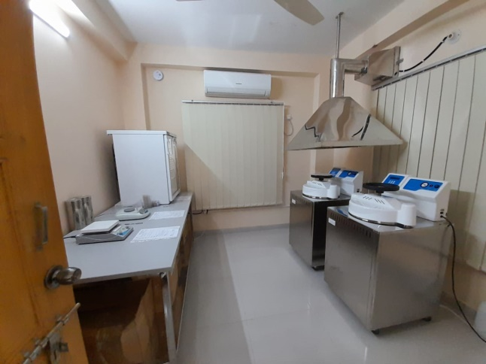
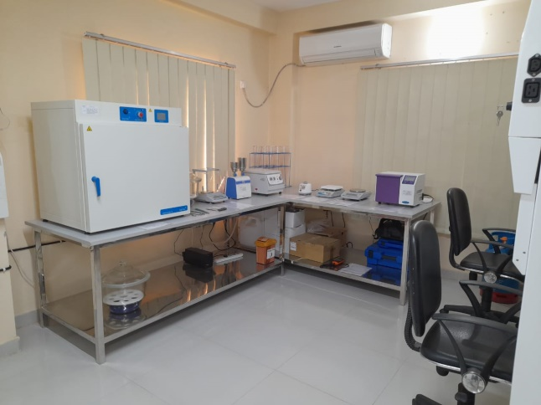
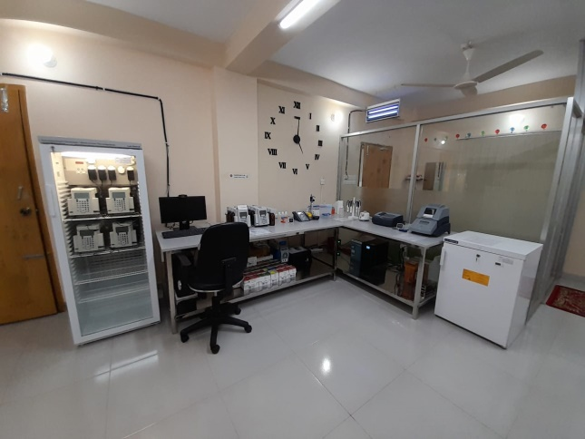
Effluent Monitoring
Mid of 2022 - Online FSTP Effluent Quality Monitoring Dashboard have developed
FSTP Effluent Sample Collection
Fecal Sludge Laboratory

Slide 22
Innovation and Learning
WASH Sector Resources Doc’s on FSM
Safwatul Haque Niloy
Sanitation Coordinator
OXFAM, Bangladesh
SNiloy@oxfam.org.uk

Slide 23
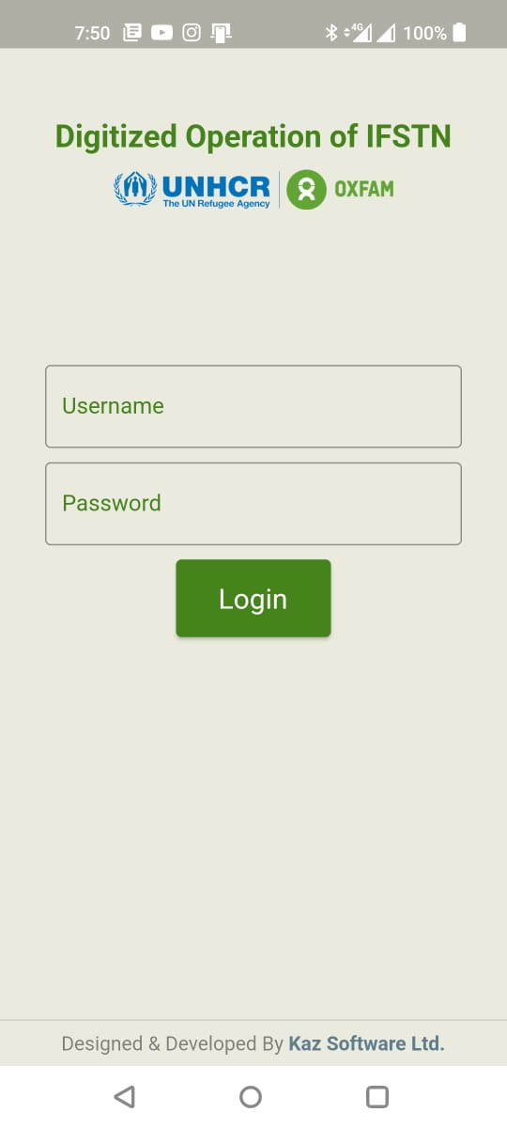
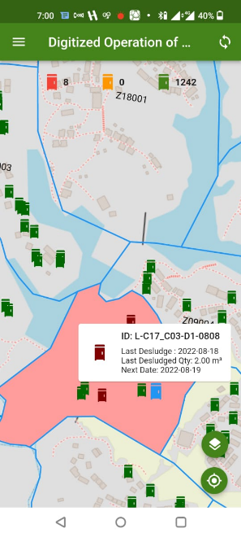
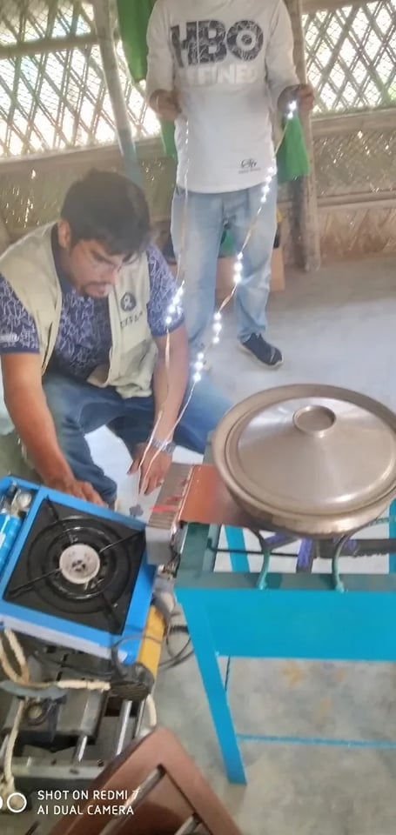
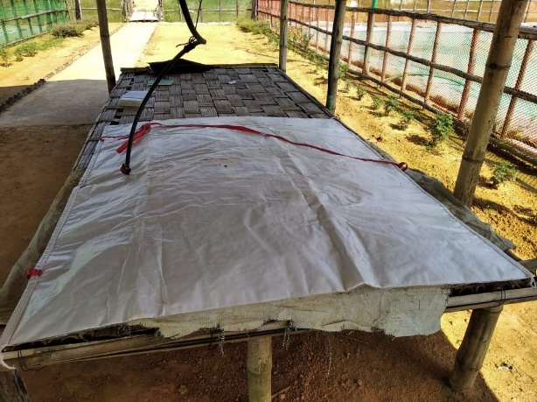
Innovation
PIT INTELLIGENT TRACKET ( PIT APP)

Slide 24
Learning
Copying FSTP design and BoQ from other context without analysis can significantly affect performance & eventually fail ( faecal sludge ≠ waste water , FS from urban context ≠ Emergency) )
Poor N and P removal of current FSTP’s , do they even designed to meet standards !
Future FS projection is important to design the capacity of treatment plant, factors- containment type, soil characteristics, user behavior , water usage etc.
Plan for solid storage , treatment and final disposal from FSTP .
Maintaining operational parameters . Example : Up flow velocity of an ABR
Capacity building trainings for FSTP operators

Slide 25
WASH Sector Resources Doc’s on FSM
WASH Sector Website – Link
Fecal Sludge Management (FSM) Strategy for Rohingya Response 2023 – Link
Phase 1 Technical Assessment of FSM in the Rohingya Response 2020 by ARUP – Link
Phase 2 Technical Assessment of FSM in the Rohingya Response 2022 by ARUP – Link
Approved Unified Latrine and Handwashing Stations Design 2023 – Link
Waste Water Monitoring Framework 2019 – Link
Mode of Operation of Fecal Sludge Laboratory Cox's Bazar 2023 – Link
FSTP Effluent Quality Monitoring Dashboard – Link
FSTP Location Map – Link
Latrine Location Map – Link

Slide 26
THANK YOU
Jafar Ikbal
WASH Engineer
WASH Sector, Bangladesh
jafar.ikbal@brac.net
Safwatul Haque Niloy
Sanitation Coordinator
OXFAM, Bangladesh
SNiloy@oxfam.org.uk
Mejbah Uddin Chowdhury
Manager, Water, Sanitation & Hygiene
IFRC, Bangladesh
Mejbah.CHOWDHURY@ifrc.org

