Slide 1
Exploring the Gender Dimension of Faecal Sludge Management (FSM)
Linking learnings from India to humanitarian FSM

Slide 2
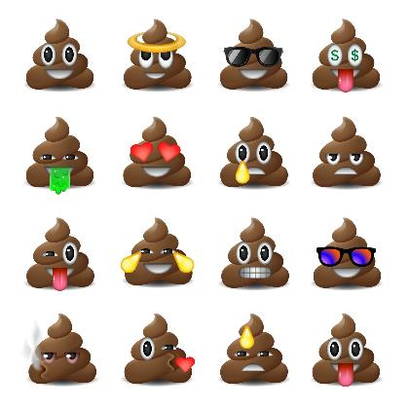
Exploring the Gender Dimension of FSM
Abhilaasha Nagarajan & Niladri Chakraborti –
Indian Institute for Human Settlements (IIHS)
Daphne Manolakos –
Sustainable Sanitation Alliance (SuSanA)
Maren Heuvels –
Sector Program Water Policy, GIZ

Slide 3
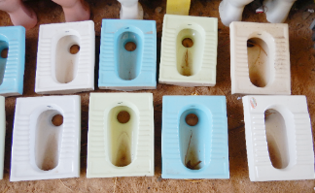
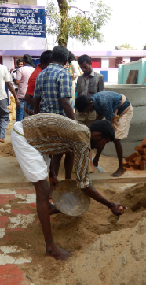
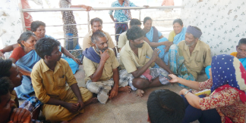
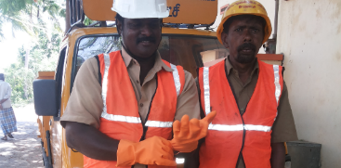
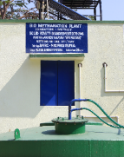
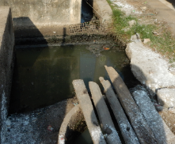
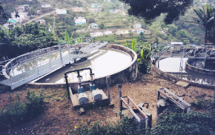
FSM & Gender
November 2023
Faecal Sludge Management – the Humanitarian Sanitation Hub

Slide 4
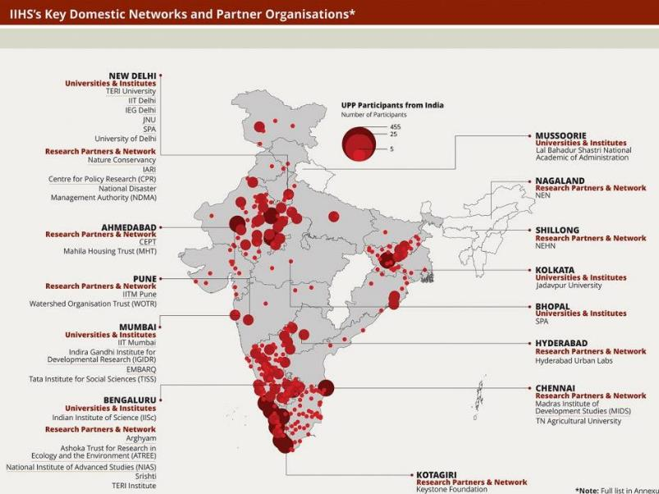
Indian Institute For Human Settlements (IIHS)
Established in 2008
A national education, practice and research institution
For equitable, sustainable and efficient transformation of Indian urban settlements
Practice-based, interdisciplinary, urban-focused prospective university
Extensive network of public, private and academic partners

Slide 5
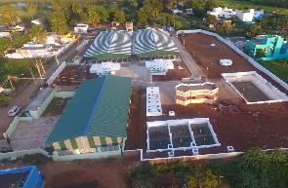
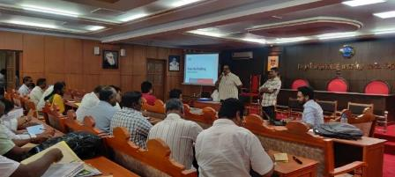
Tamil Nadu Urban Sanitation Support Programme (TNUSSP)
Supporting Tamil Nadu’s Total Sanitation Mission
Technical Support Unit (TSU) for the Government of Tamil Nadu - launched in 2015, instituted within Municipal Administration and Water Supply Department (MAWS)
Scaling FSM across 649 towns and cities covering a population of 30 million.
Engaging with Multiple Stakeholders: Govt, Civil Society, NGOs, CBOs, Private Sector
Multiple forms of intervention to address barriers and enable transformations
Focusing on Inclusive Sanitation
5

Slide 6
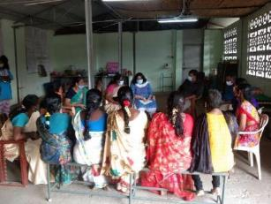
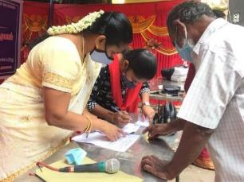
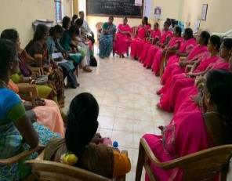
Inclusive Sanitation: Focus Areas
Inclusive Sanitation?
Everyone has access to safely managed sanitation along with equitable and sustainable services
Welfare and Well-being of Sanitation Workers
Improving Access and Services for Urban Poor
Integrating Gender in Sanitation

Slide 7
Integrating gender along the Full Cycle of Sanitation
Gender concerns along the Full cycle of Sanitation
B. Analytical Lens
EFFICIENCY
DO NO HARM
RIGHTS
Efficiency rationale does not challenge gender stereotypes but builds on them.
e.g.Targeting women as they are responsible for water and sanitation.
Not considering GSI in the Full Cycle of Sanitation will lead to harm inflicted on women and other excluded groups.
e.g. location of CTs should be increase vulnerability
Based on human rights principle.
Eg. Lack of women’s rights to water and sanitation is discrimination.
WELFARE
EMPOWERMENT
Positive health and well-being rationale
Eg. Access to disabled-friendly, child-friendly and elderly-friendly toilets can, in the long term, strengthen genito-urinary health of women,
Increasing the power of women and other marginalised groups, individually and collectively.
Eg. Marginalised women’s groups taking up contracts for toilet construction and maintenance.
Source: TNUSSP, 2019

Slide 8
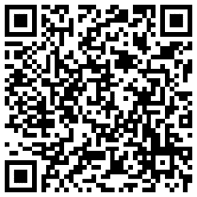
Gender and Social Inclusion Study
Scan to read
Access & containment
Design needs of elderly, disabled persons and children not fully addressed
Women and men in construction have unequal access to training (e.g.: masonry).
Women’s groups involved in operation/maintenance of community facilities
Emptying & transportation
Individual women/women’s groups rarely have the capital and capacities to buy a truck and desludging equipment, hire helpers and engage in desludging operations
Safety of desludging helpers inadequately considered
Treatment & Re-use
There are no examples of women engineers coming together to bid for contracts for constructing, maintaining and managing FSTP units
Overall findings:
Limited evidence across the full chain
Need to move from ‘Efficiency’ to ‘Rights & Empowerment’
Moving from ‘Women as users’ to ‘women as professionals’
Source: TNUSSP, 2019

Slide 9
Where are the women ?
Toilet cleaners, caretakers
Masons and construction workers
De-sludging operators, tank, sewer & drain cleaners
Workers at treatment facilities
Across the chain: City administrators, Engineers, Technical experts, Social workers/ mobilisers, Practitioners, Entrepreneurs, Researchers, NGOs, CBOs
Women play a significant role as professionals in the sanitation sector

Slide 10
Meet Parameshwari – desludging operator from Trichy

Slide 11
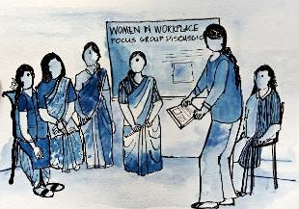
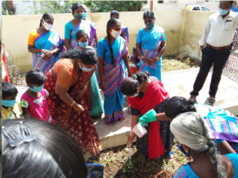
Initiatives For Women Professionals
Address Data Gaps
Improve access, MHM
Strengthen Governance
Focus: Women professionals
ACCESS and CONTAINMENT
EMPTYING and TRANSPORTATION
TREATMENT and REUSE
Public Toilet Caretakers
Masons and construction workers
De-sludging operators
Workers at treatment facilities
Strengthening women groups
Women Masons: Construction of a standard septic tank
First aid training
Business portfolio development
Provision of facilities: toilet, changing facilities at treatment plants
Alternative/ Supplementary Livelihoods for Sanitation Workers

Slide 12
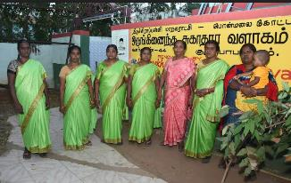
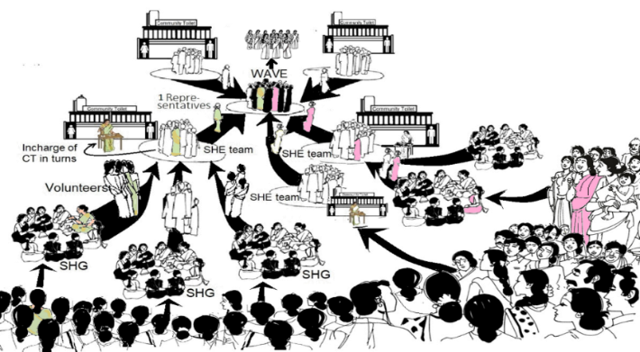
Empowerment
Women-led Self Help Groups for O&M of Community Toilets
Training: Institutional, fiscal and operational management of CT/PTs.
Infrastructure improvements: MHM facilities (manual incinerators, vending machines) and refurbishment (doors, taps, tiling etc)
Setting up quality assurance mechanism: Social audits, infrastructure and O&M periodic assessment, footfall monitoring
Improved services at ~200 CT/PTs.
Women groups from other cities visiting SHE teams to understand the model
Sanitation Hygiene Education (SHE) teams
Notes:
Local Self Help Groups (SHG) volunteers organised into ‘Sanitation Hygiene Education (SHE) teams’ for O&M of the community toilets.
SHE teams were federated at the city level. The federation handholds the SHE team in the effective maintenance of the community toilets.
This model has been functioning for more than two decades now.

Slide 13
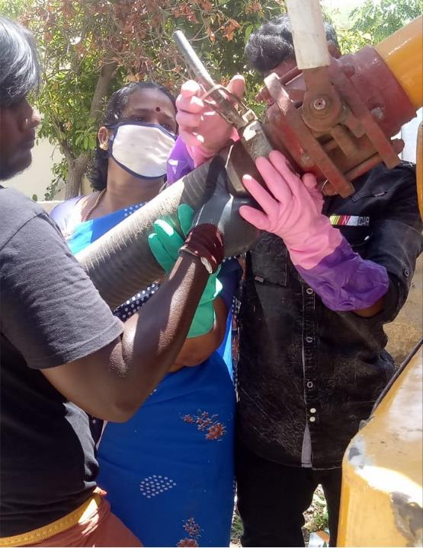
Empowerment:
Women De-sludging Operators
Business development:
Identifying women DSOs in Trichy
Documenting their work patterns, business models
Engaging resource persons to identify scope of improvement to business models in a participatory manner
Business portfolio development in progress
Financial linkage through relevant institutions
Valourising women DSOs through radio programs, campaigns, media coverage

Slide 14
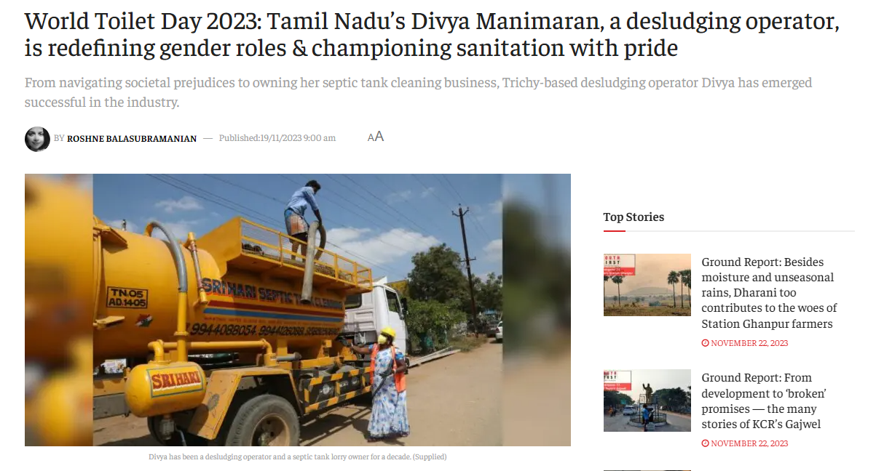
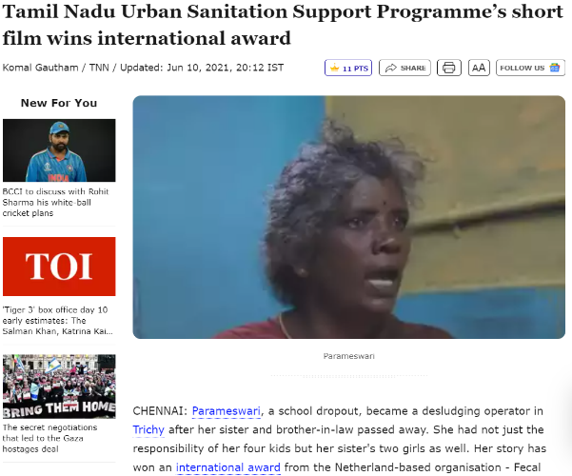

Slide 15
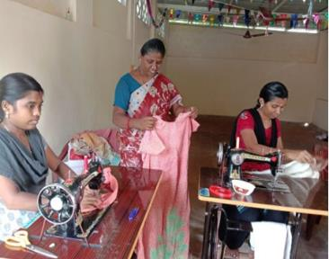
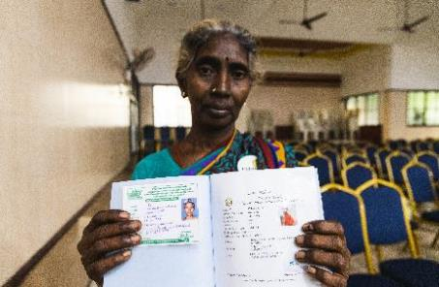
Entitlements
For Women Sanitation Workers
Federation and linkages to government programmes: ~ 683 informal workers (65 SHGs)
Supporting informal workers (including women and PwDs) to get occupational ID cards
Support for enterprise development :
Skill Training, Enterprise establishment and market linkage
Orientation on workplace safety and rights, entitlements, equal wages, legal protection and welfare schemes
Setting up and training of Prevention of Sexual Harassment (POSH) committee at Urban Local Bodies
Image source: TNUSSP

Slide 16
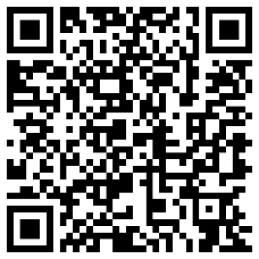
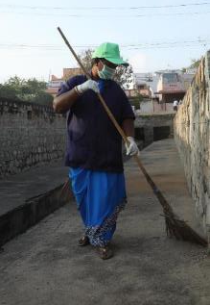
Advocacy: Women in Sanitation Campaign
Highlight women service providers and professionals
Recognise the wide range of work done by women in the sector:
- Public, private, informal
- Visible, invisible
- Paid, unpaid
Celebrate women professionals and their stories
Amplify voices across various themes collaboratively
Scan to watch
Notes:
The #womeninsanitation campaign revolves around the stories of women professionals in the sanitation sector. It is a space, platform…campaign to amplify their voices. To recognise and celebrate the value that women sanitation professionals bring to the sector. And in the process also generate much-needed conversations around the kind of challenges and biases women face, in general and more specifically in the sanitation sector

Slide 17
Reflections
Gender is a structural issue, limitations of a programmatic approach
Users – Professionals/other roles : Need to move towards empowerment, and transformative approaches
Professionals across the chain are not homogenous (public, private, informal/ Vary by social factors: gender, age, class, caste), face varying challenges, and nuanced approaches are required
Engage voices from the ground

Slide 18
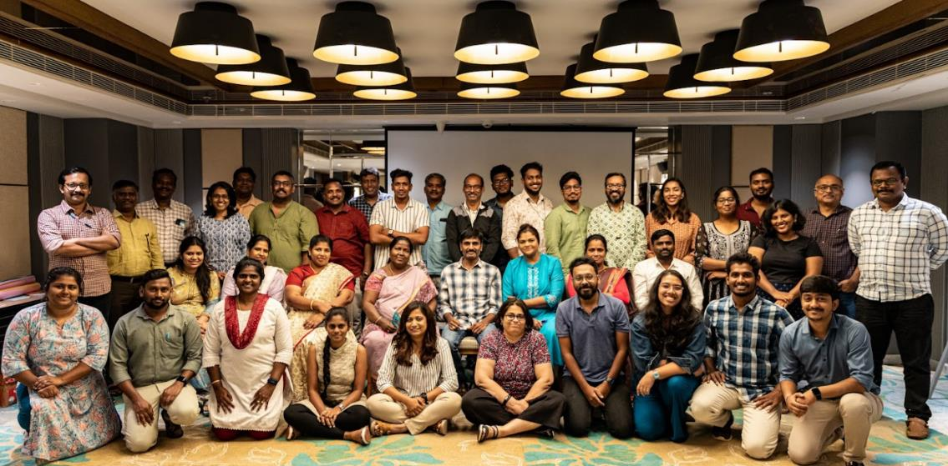
The Team
www.tnussp.co.in
To read our knowledge products:
www.tnussp.co.in/resources
@TNUSSP

Slide 19
Key Challenges for Women & Girls related to FSM in Emergencies – what do we know?
Environmental and Public Health risks
Exposure to contaminated water and unsafe sanitation practices
Increased vulnerability to waterborne diseases, especially for pregnant, nursing women & children
Rapid Population Growth and Density
Overcrowded living conditions and challenges in maintaining personal hygiene/ menstrual health and hygiene (e.g. disposal of menstrual products)
Limited access to safe and accessible sanitation facilities
Increased risk of open defecation and contamination
Greater vulnerability to Gender-Based Violence due to lack of safe and private facilities
Resource Constraints (incl. financial, human and technical resources)
Inadequate planning may increase challenges & hinder the implementation of effective FSM strategies
Continued health risks for women; lack of community engagement
Women are disproportionately underrepresented in organizations across the sector
Risk of inadequate sanitation services persisting in the post-emergency phase
The analysis shows that the link between FSM and gender in humanitarian situations/emergencies seems to be almost unexplored!

Slide 20
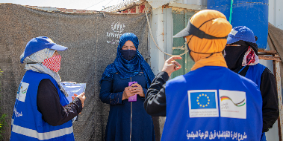
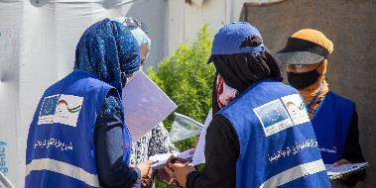
Learnings from Jordan
Assessing and prioritizing interventions based on identified risks and community needs
Community Engagement activities → Involving local communities, especially women and marginalized groups, in decision-making processes
Conduct Awareness Campaigns: Address questions related to cultural beliefs, especially regarding excreta disposal for women and children
Capacity Building: Provide plumbing training for males and females
©GIZ Jordan, Azraq refugee camp

Slide 21
FSM in Emergencies/Humanitarian Settings
Faecal sludge management (FSM) includes the storage, collection, transport, treatment and safe end use or disposal of fecal sludge. Faecal sludge is defined as the material that is collected in on-site sanitation technologies like pit latrines or septic tanks.
SDG 6’s targets address sanitation beyond access to toilets, to include safe management of excreta.
Past sanitation emergency responses focused on rapid on-site solutions, neglecting the entire sanitation service chain
Although information and guidance on FSM exists, measures are rarely applied in emergency settings
New challenges such as the Bangladesh (Cox’s Bazaar) context act as a catalyst for humanitarians to start considering FSM

Slide 22
Thank you!

