Slide 1
Lessons learned from Lebanon

Slide 2
Agenda
Notes:
Thanks a lot for joining – with the support of Water sector colleagues we will present lessons learnt from Lebanon around the sanitation conditions in the country, after 12 years in Syrian crisis and the deteriorating multilayered economic crisis affecting the country,

Slide 3
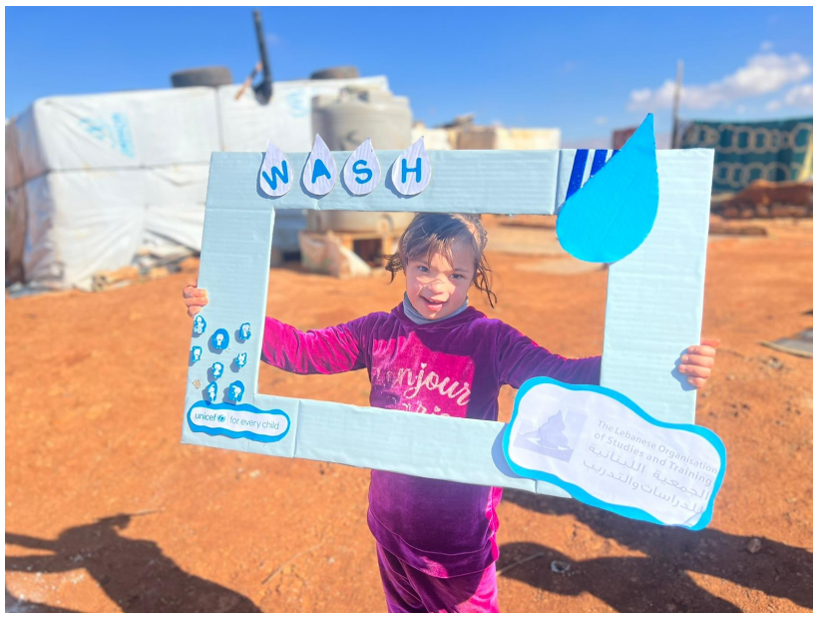
Introduction -
Sanitation context in Lebanon
4th of May 2023
Jakub Pająk
WaSH Sector coordinator

Slide 4
Lebanon remains the country hosting the largest number of refugees per capita and per square kilometre in the world.
Total population 5.6 M: 3.9 M Lebanese, 1.5 M displaced Syrians (incl. 300k+ in ITS), 210k Palestine refugees (incl. 30k PRS).
2.8 M WaSH PiN for 2023 (ERP and LCRP).
Multi-layered crises (2011-, 2019-), refugee, acute economic contraction, fuel and energy crisis… -> severely impacting both institutional capacities to supply services as well as HH purchasing power.
Cholera outbreak: in Syria Aug/Sep 2022, in Lebanon declared on 6 Oct 2022.
?
6129 Suspected
671 Confirmed
23 Death
0.37% CFR

Slide 5
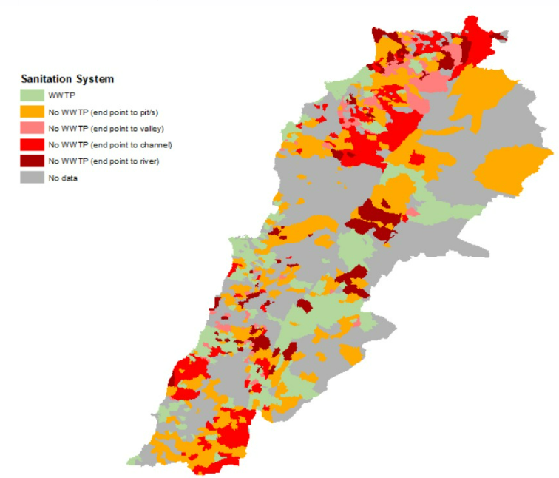
Wastewater treatment
There are around 75 existing WWTPs within the country.
Operated by different stakeholders, not only WEs & CDR
(municipalities, UNDP, USAID…).
The majority of WWTPs are no longer functioning as per their original design due to:
electricity cuts,
the unaffordability of fuel to run the backup power generators
understaffing.
More than 1.5 million people is discharging wastewater without any treatment, 700,000 of which are directly discharging in a valley or a river.

Slide 6
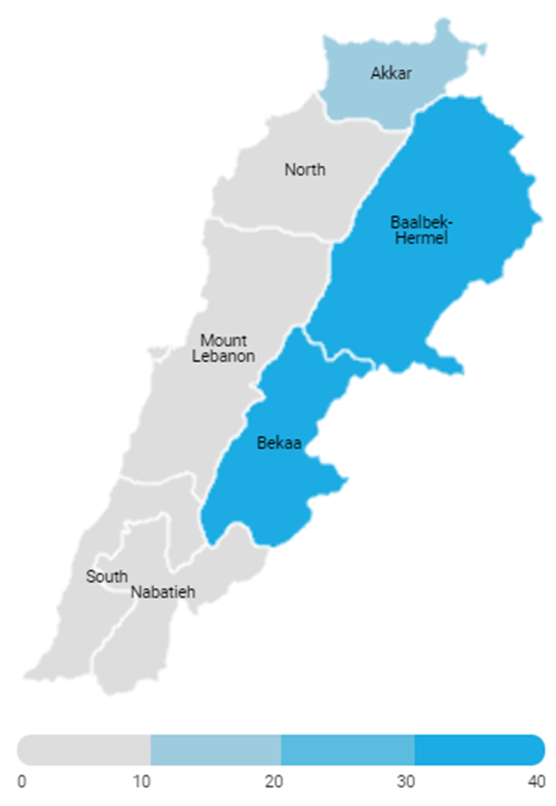
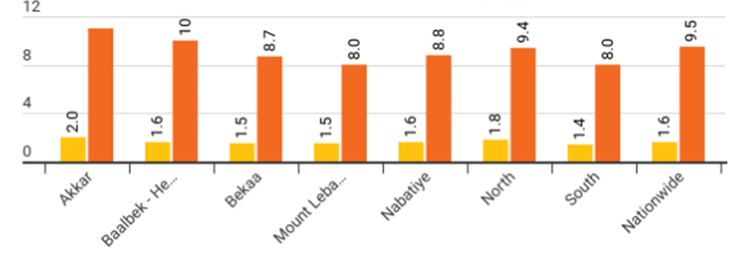
Sanitation in Informal Settlements
Avg. number of households and individuals sharing 1 latrine.

Slide 7
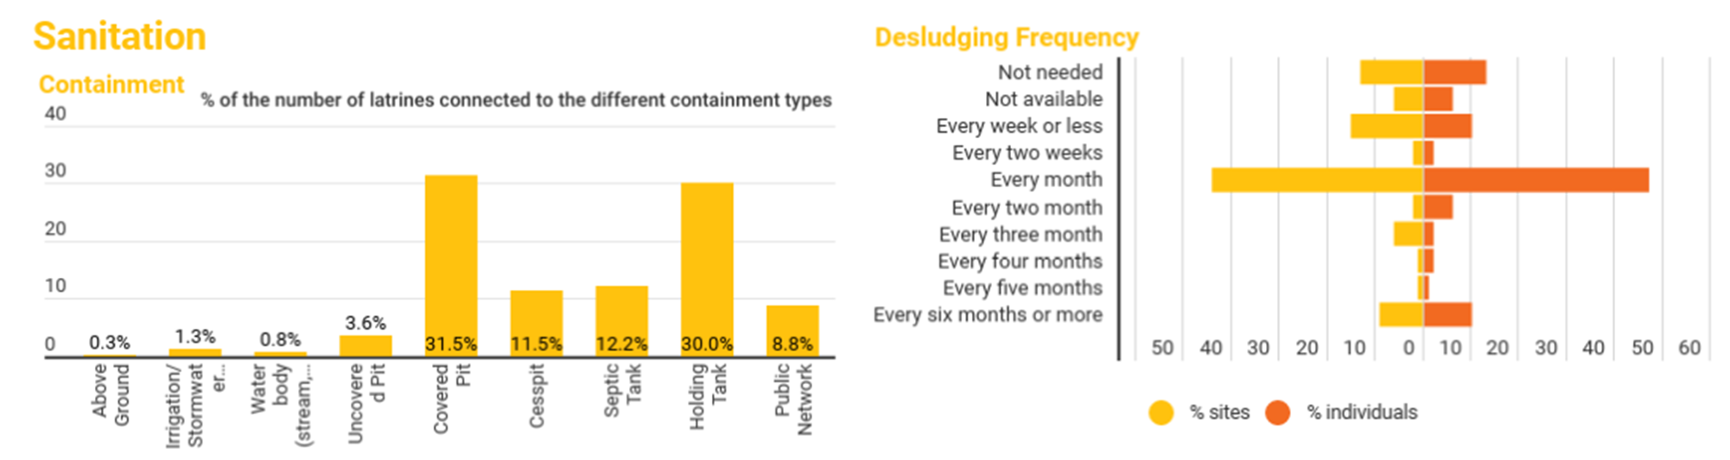
Sanitation in Informal Settlements
Political ban on the sites’ connection to public infrastructure -> costly and unsustainable desludging from Informal Settlements since 2011 (~US$6 M in 2022).
In 2022 the reported desludging activities targeted 3,636 Informal settlements (65% sites) hosting 252,741 individuals (81% ind.).

Slide 8
Sanitation Technology Demonstration in Emergency Settings in Lebanon Programme Bill & Melinda Gates Foundation
Kevin Bonel - WaSH in Emergency Consultant - UNICEF Hussam Hawa - CEO - Difaf

Slide 9
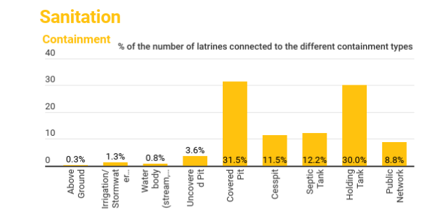
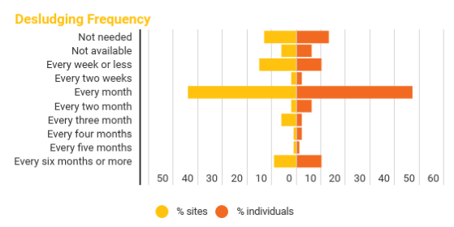
Context and Problem statement of the Wastewater in ISs
UNICEF partners reported desludging activities targeted ~3000 Informal settlements hosting 200,000 individuals
UNICEF spent m$4.9 in 2022 (m$5.9 in 2020)
Objective: Identify and put at scale an innovative treatment systems enabling reduction of the desludging frequency and the improvement of the environmental conditions in ISs and Surrounding host community.
Notes:
Graphics from WAP 2022 (K. Bonel, M. Wehbi, 2022, "WaSH Assessment Platform Report", UNICEF, Lebanon.)

Slide 10
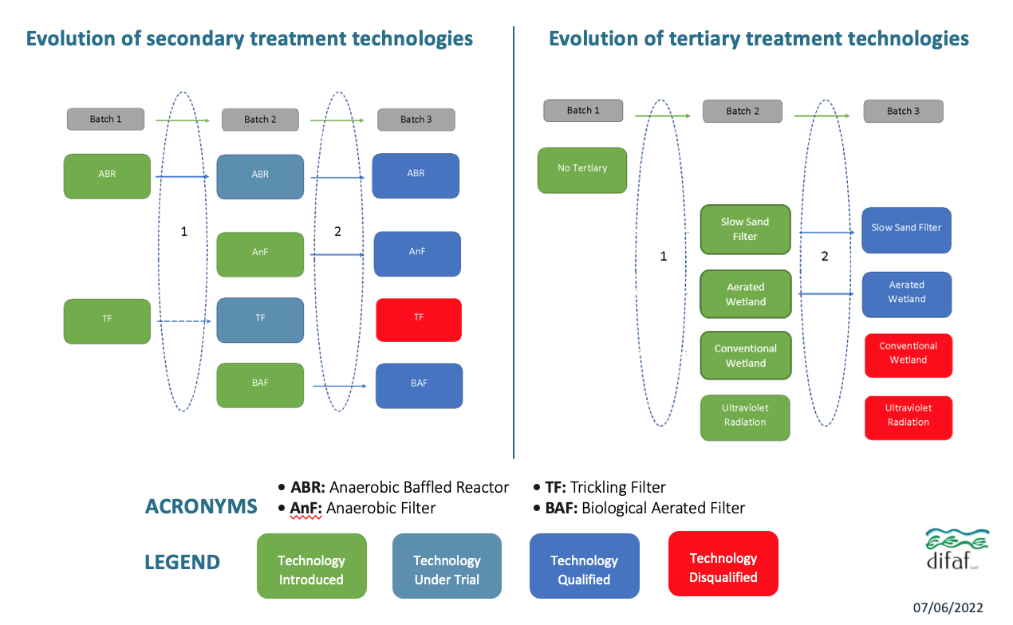
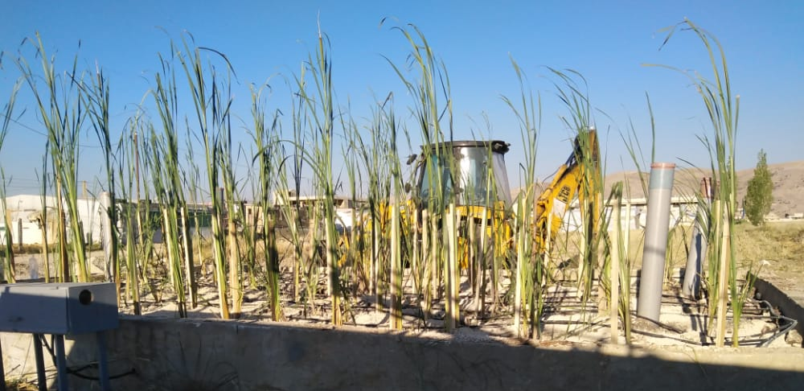
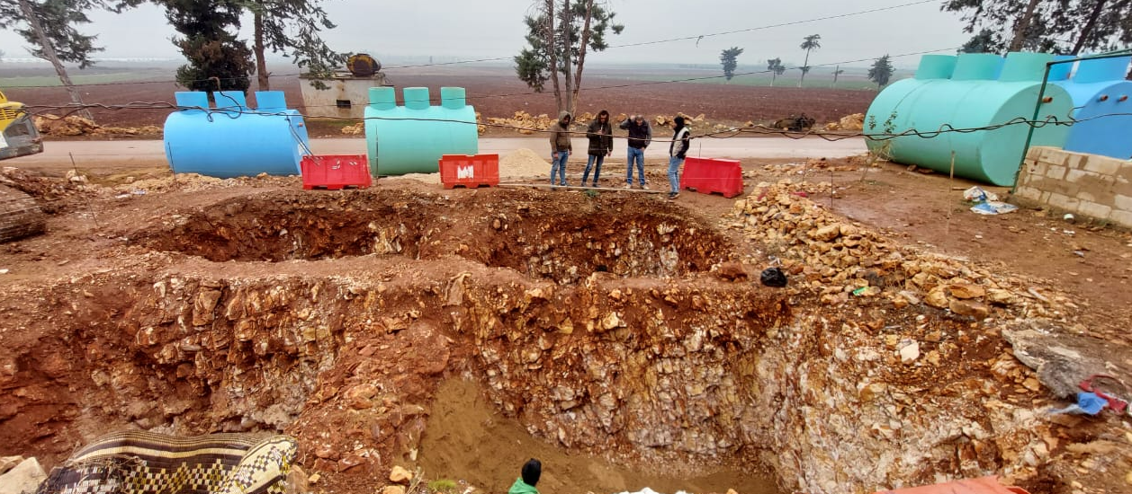
Assessment / Development & key components of technical solution
Iterative approach per batch to test and validate technologies.
Notes:
Graphics from Evaluation of the Sanitation Technology Demonstration in Emergency Settings in Lebanon Programme (STDP) Final Report DIFAF December 2022

Slide 11
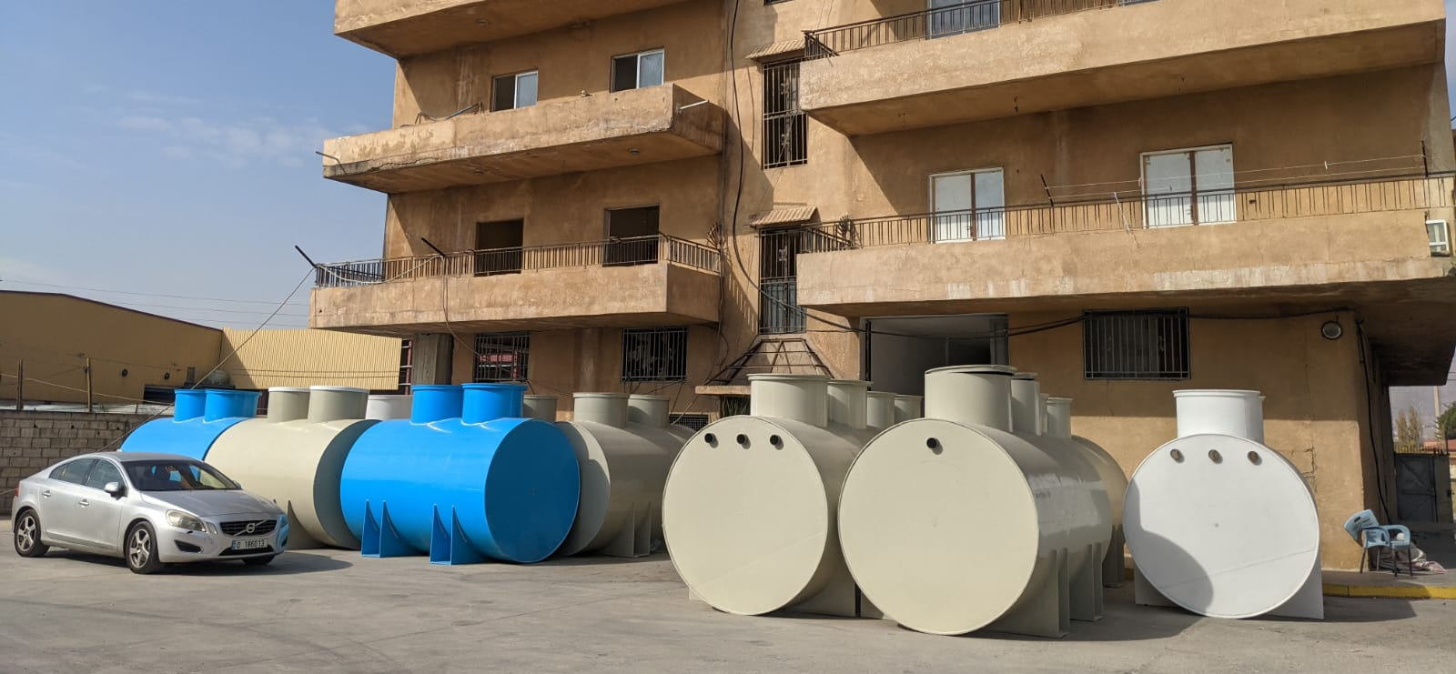
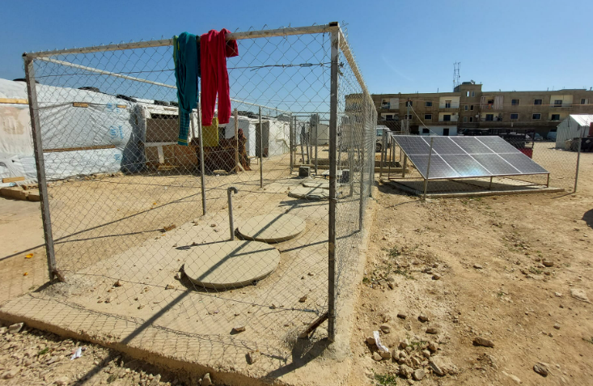
Sanitation Chain
San
Development of 1 system treating 2.5m3/d (50 ISs residents or 25 Lebanese citizens)
Primary/Secondary: Anaerobic Baffled Reactor (ABR)
Secondary: Anaerobic Filter (AnF) and Biological Aerated Filter (BAF)
Tertiary: Slow Sand Filter (SSF) and Aerated Constructed Wetland (ACW)
Three treatment chains developed:
ABR + AnF + BAF + ACW (energy required)
ABR + AnF + BAF + SSF (moderate energy required)
ABR + AnF + SSF (low to no energy required)
Secondary treatment enables 83-94% removal of COD| 82-92% removal of BOD5 | 70-87% removal of TN, but 3ry treatment needs improvement to comply with the ELV (decision 8/1 MoE)

Slide 12
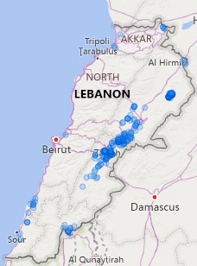
Sanitation Chain
San
System cost-effective in 240 ISs (+42,000 ind.) return on Investment in less than five years compared to desludging cost.
System could be installed 305 sites (+24,000 ind.) to reduce the environmental degradation

Slide 13
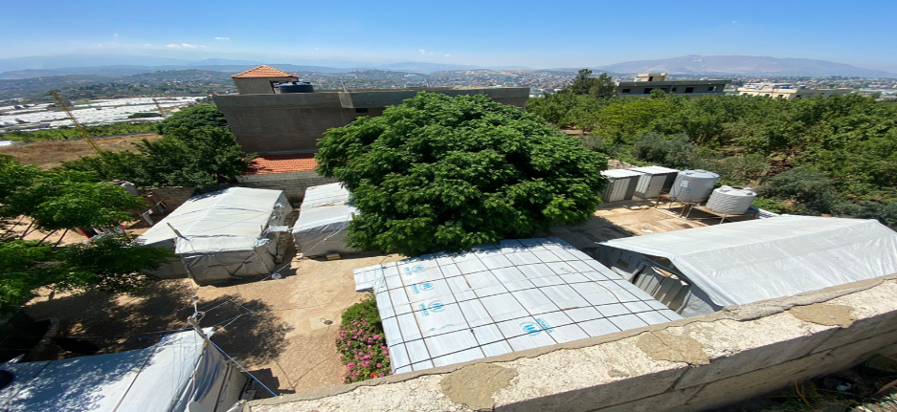
End of Project Evaluation
Sanitation Technology Demonstration
in Emergency Settings Program (STDP)
GWC FSM TWIG Presentation
Eng. Hussam Hawwa – Lead Evaluator
CEO Difaf SAL

Slide 14
Objective
To provide lessons about the challenges and success factors of implementing innovative WASH solutions in humanitarian & host community contexts through:
an independent assessment of the STDP design, implementation, and performance by
identifying success/failure factors, critical barriers and enablers to adapting,
testing and mainstreaming requirements.
The evaluation took place between April & December 2022 at the final stage of the SDTP.

Slide 15
Evaluation Criteria & Lenses
Relevance
Does it meet needs?
Efficiency
Cost effectiveness and partnerships
Effectiveness Innovative? Was knowledge built? Unintended consequences?
Sustainability & Barrier to Scale What will remain operational?
Obstacles?
Gender & Inclusion
Was it considered?
Project Level Lens: conceptual value, implementation success, coordination, troubleshooting, diffusion
Technical Lens: functionality of system components, treatment efficiency, successful batch models
Innovation Lens: Iteration process: batch model combinations, success of innovative ideas, & maturation (- market analysis - discontinued )

Slide 16
Methodology
Secondary Sources
Qualitative Methods: KIIs and FGDs with implementers & beneficiaries, case studies
Quantitative Methods: Technical assessment & Sampling:
16 systems at 13 sites
Site / Systems Selection
Scientific method
Focus on Batch 3 models
Assumptions
Case studies
Technical Quant (Field And Lab Results)
)
Qual
(Kiis, Fgd)
Secondary Sources (Reports, Monitoring Data)
Case Studies Bekaa 🡪 ITS Akkar🡪 Host

Slide 17
Relevance
DEWATS technologies based on established references (e.g., BORDA) & customized & streamlined through extensive trials of various combinations meeting critical needs of refugees and host communities in Lebanon,
Highly relevant for:
Environmental needs: potential for large pollution reduction + associated env & health costs
diversity of Lebanese contexts & variability (climatic, geographic, environ, economic, etc.)
for WASH intern’l / nat’l community 🡪 reports on desludging services & costs can potentially be reduced (roi to yet be determined - market impasse) + timely in terms of knowledge / sector growth
national policies: mobility / performance= temporary context, policy alignment, for host communities,
Local market (available material)
Nevertheless, challenges faced when rolled out due to emerging issues & conflicting interests (landlord, MDC, refugee engagement)

Slide 18
Efficiency
Investments justified on technical & projected scale-up / ROI potential; still iterations followed high emphasis on cost-effectiveness
increasingly present challenges due to deteriorating economic crisis situation, low engagement of communities/beneficiaries as well as the large number of IPs (turnovers) led to some setbacks e.g. landlords, eviction rates from ITSs, vandalism, theft, disruptions in workflow / reporting channels, consumables for lab tests, etc.
PMU / IPs dedication, relative flexibility, engagement, system robustness, led to continued efficiency and resiliency throughout the unfolding multi-dimensional crisis.

Slide 19
Effectiveness
DEWATS demonstrate good performance (as per international standards and guidelines), exceptional in terms of removal of organic pollutants. Reaching 85% to 95% reduction in BOD5 and COD. Considered robust with 79% of the systems actively treating wastewater (of various loads, climates, handling).
Approach through iterative batch process (selection, design and contextualization, redesign) was instrumental 🡪 experimenting with different types of materials e.g. fixed-bed filter media, power / space requirements, variable effluent loads,..
Technical innovation in having several options, incl. mini aerated wetlands and biological aerated filters to the context of DEWATS, tipping bucket + Modular designs that allow for swift motility, business dev, upscaling
UNICEF’s skill at managing partnerships led to emergent positive outcomes e.g., setting the foundation for culture of DEWATS, through continuous engagement, knowledge build-up, SMEs to take on services or manufacturing, encouraged by the launch of the open-source designs.
Tertiary treatment units to be improved, community engagement, by-product end-use, cost-recovery, market & economic validation. Decision support mechanism lacking

Slide 20
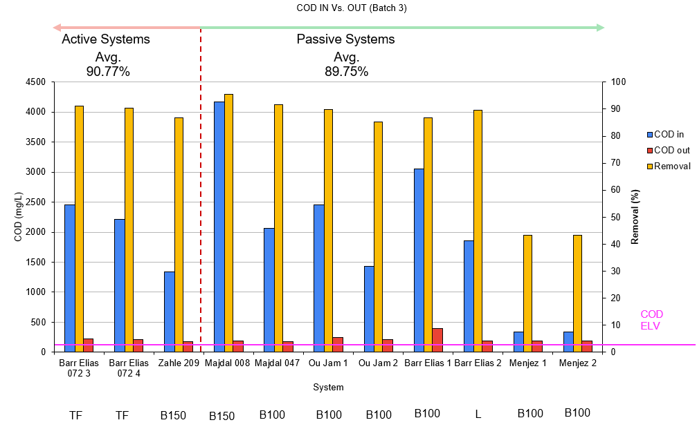
COD Removal Efficiencies in Batch 3
Notes:
The low efficiency in Menjez is not an issue as long as effluent COD is consistent with other systems
The system for Menjez used double the number of modules for a similar PE to adapt the system’s HRT to the different wastewater

Slide 21
Sustainability vs. Barriers
Given the worsening MDC, sustainability was subject to factors outside the scope of the STDP 🡪 amplifying an already complex reality & challenges
Modularization also presents an innovation in sustainability-oriented planning; systems can be moved from ITSs to other active ITSs or to Lebanese communities
Systematic communications & partnerships have led to improved institutional knowledge, which will extend beyond project (partnerships, SMEs, now operate beyond UNICEF’s involvement),
However, deeper participatory approach could have presented unforeseen solutions
Policy changes (DEWATS) in national strategies & standards, market stability, current landlord vs refugee set-up, cost recovery mechanisms, post-development phases was only partially addressed: partially because an O&M planning, SOPs & implementation frameworks cannot be not fully realized.
may eventually fall into perpetual “piloting” mode instead of upscaling 🡪 donor funds will likely be needed, eventual resistance of MoE / MoEW

Slide 22
Gender & Inclusion
The project design made no clear reference to gender considerations so lacked gender related indicators, although some women’s participation in the programme was noted. This can partly be explained by the low interactive element of DEWATS and indirect benefits that need to be surfaced, and gender mainstreaming not attempted.
However, indirect benefits to women and children resulting from the programme were noted.

Slide 23
Conclusions
The 3 batch approach led to a notable success, an iterative approach was a crucial step in innovation design 🡪 developed a DEWATS option that is appropriate for the complex emergency and in establishing proof of concept even for host
Cost recovery is extremely challenging in complex, protracted emergencies. An enabling environment is needed to maintain and build on successes, benefits, beyond direct system operations.
The STDP spear-headed a DEWATS learning culture (sharing success /failures) and stakeholder participation, albeit missing at ground level 🡪 WASH market activated 🡪 open-source designs instrumental in igniting SMEs interest & BD 🡪 Local manufacturing and local capacities enabler for production and scale up.
Social, economic and physical conditions must be analyzed in depth for DEWATS in protracted emergencies – even a priori and continuously esp if emergent issues – with project strategy re-adaptations
Forming partnerships with local key players, leaders (including municipalities) is instrumental in dealing with unforeseen problems 🡪 Participatory approach is key even before roll out, and key for sustainability after..

Slide 24
Recommendations
Enabling Environment
Humanitarian – Development Nexus 🡪 Parallelism with host community trials key PMU to engage institutional partners
Attempt to cont develop sector policy frameworks
Map out potential relocation / repurposing options
DEWATS
Tertiary system improvements
Explore all possible economic benefits & cost-recovery mechanisms, including irrigation on-site, energy, sludge re-use
Effluent sink: re-use / disposal standards, environmental costs save
Secondary level treatment can be enough?
Future Strategies
Avoid Complex Operating set-ups = few operating partners , focus more on local
More Socio-political, SH analyses & Participatory approach, gender, landowners, refugees, muni e.g. Ownership & OM, PDM
Iron out all possible agreements / benefits / capitalizations legal , government backing
🡪 prioritize strategic options esp with regard to sustainability
PDM & Lessons Learnt
Establish 2 separate bundles –
performance monitoring and routine monitoring programmes
Use to develop decision support matrix for future endeavours 🡪 Prioritize lowest opex / lowest complex vs liability

Slide 25
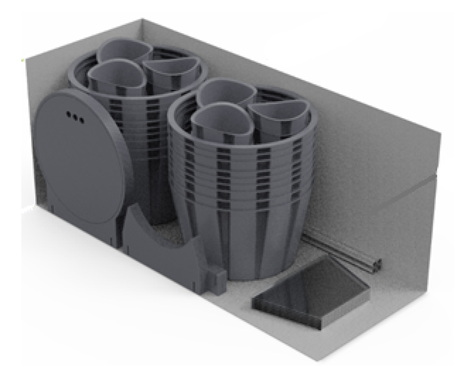
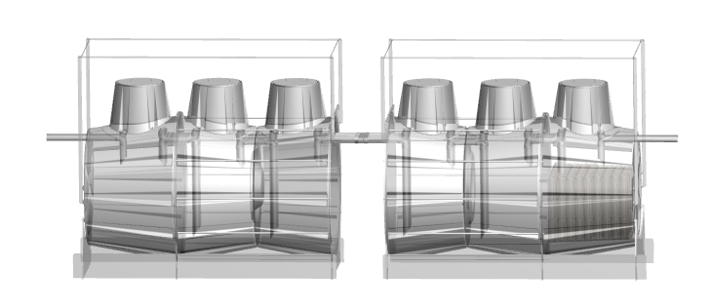
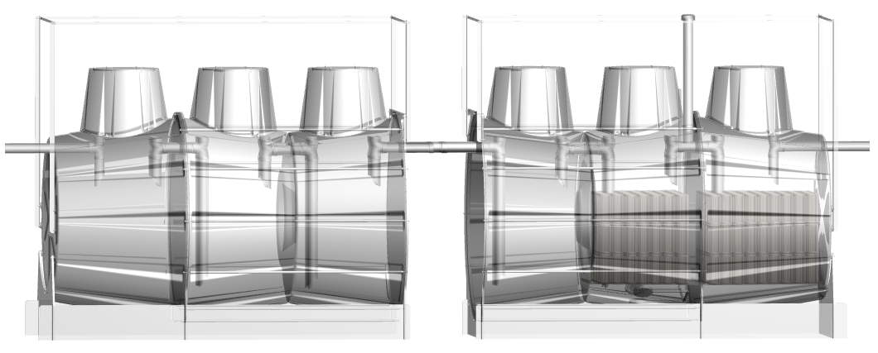
Way forwards
Systems are replicated beyond UNICEF’s involvement (NGO partners | SMEs)
Concept design achieved for stackable systems, easing transportation and further replication in any on-set emergencies.
Notes:
Introduction of technologies in country reused by partners under funds than BMGF – UNCIEF + Open source designed installed in UAE by one of the Lebanese manufacturer
Technical solution that cost effective in 240 ISs over 5 years of Desludging
Solution that could be installed in sites with environmental risk
Concept design for stackable solutions to ease transportation and further

Slide 26
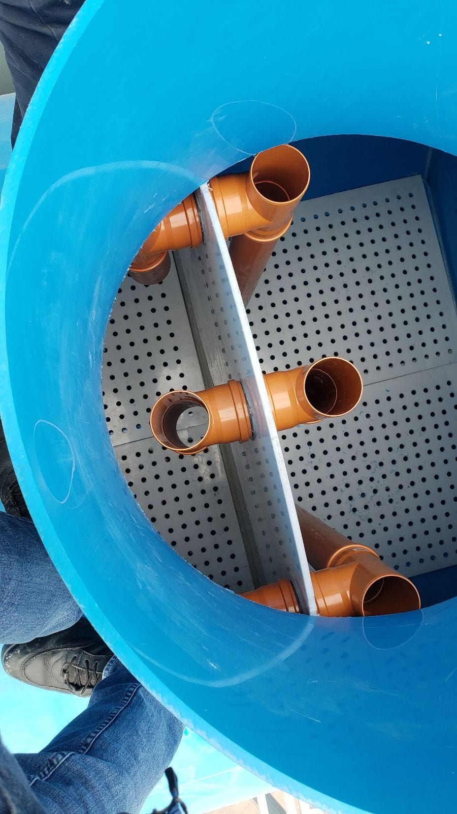
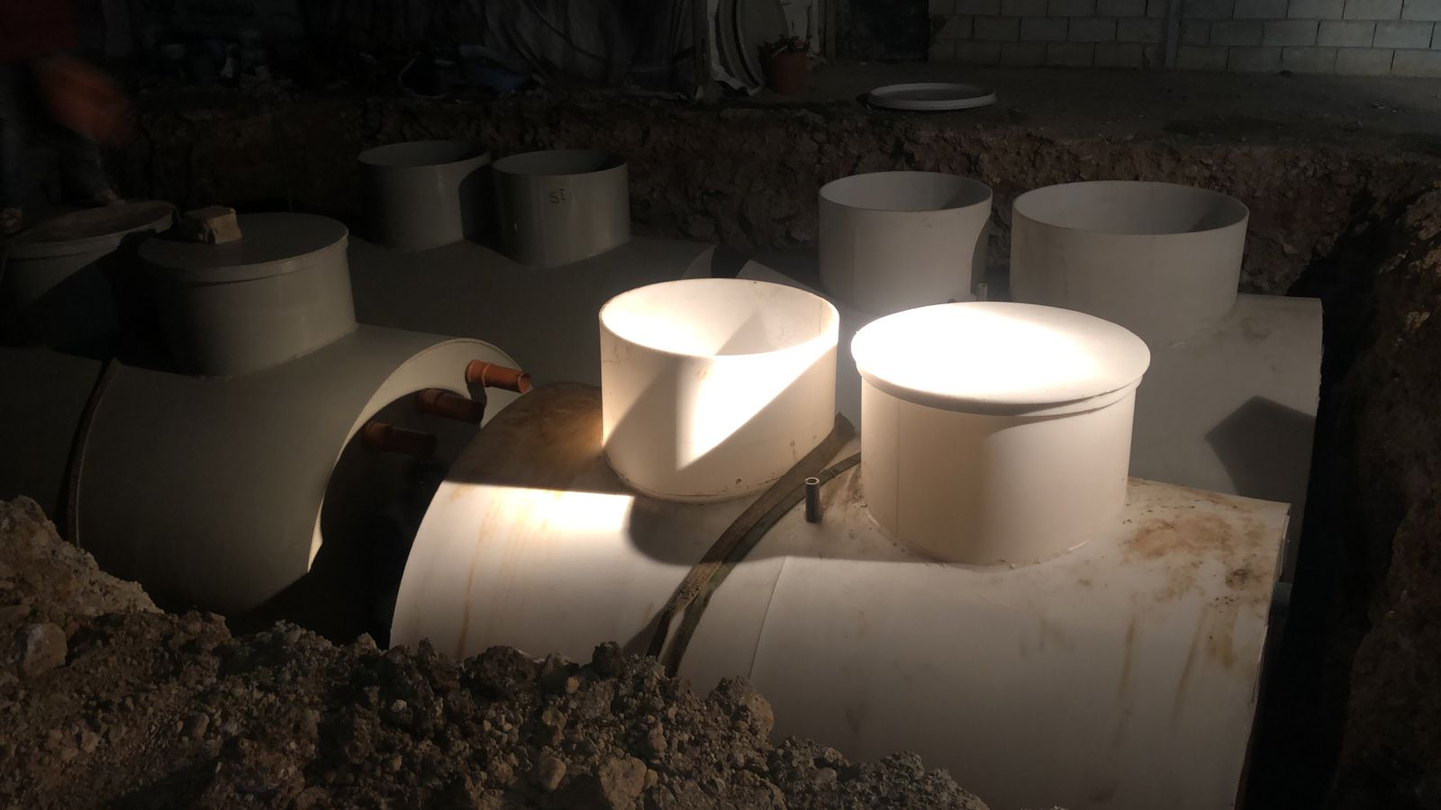
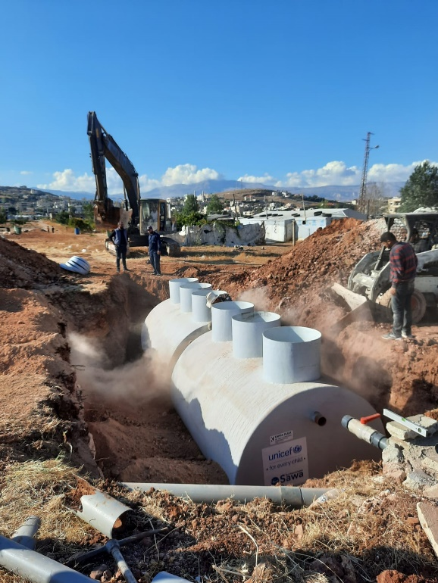
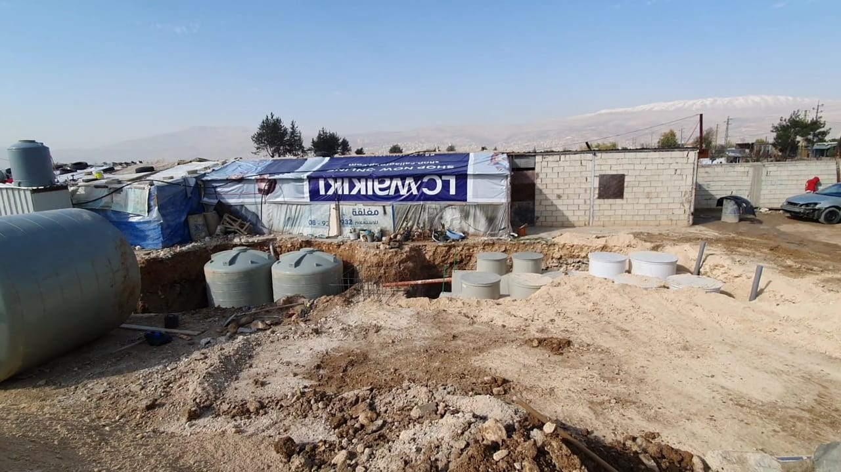
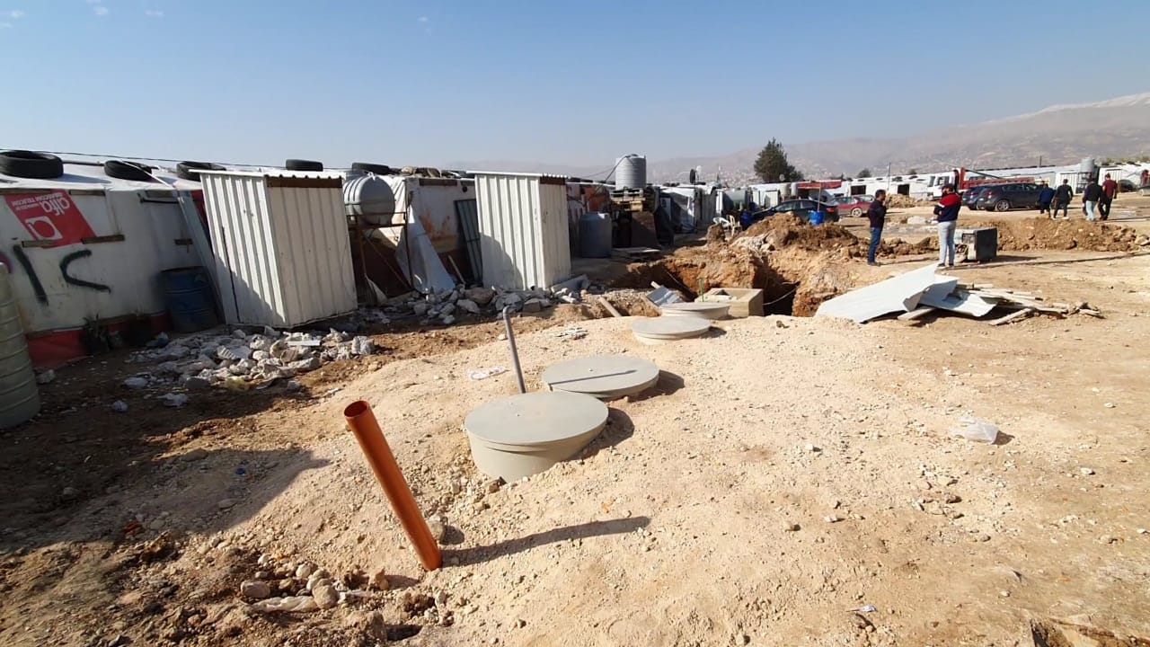
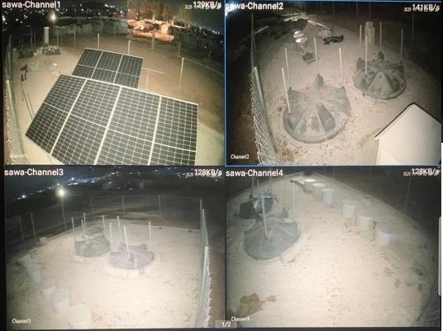
Thank you for your attention
Do you have any questions?

Slide 27
Piloting low-tech Omni-processor
Kevin Bonel - WaSH in Emergency Consultant - UNICEF

Slide 28
Support to the WWTP- receiving sludge
Large volume of anoxic/anaerobic wastewater removed from sites every year (+450,000m3/year) and disposed of in overstretched WWTP :
Conventional treatment (aerobic | activated sludge)
Non or partially operational
Operation status has deteriorated with the current Energy crisis
Even if Innovative DEWATS is at scale in the country, sludge will still need to be removed and safely managed

Slide 29
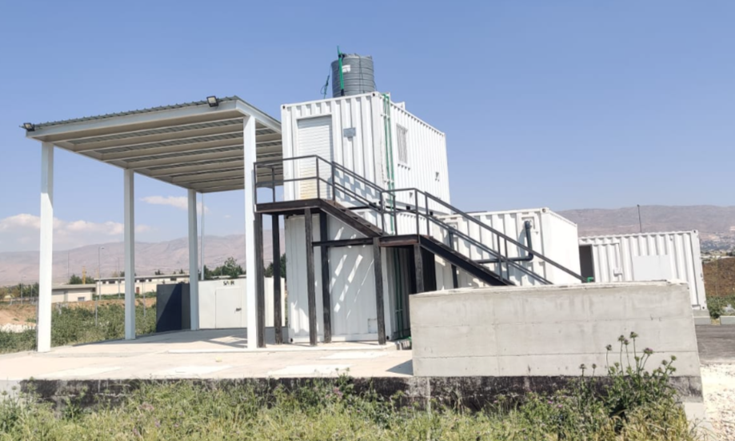
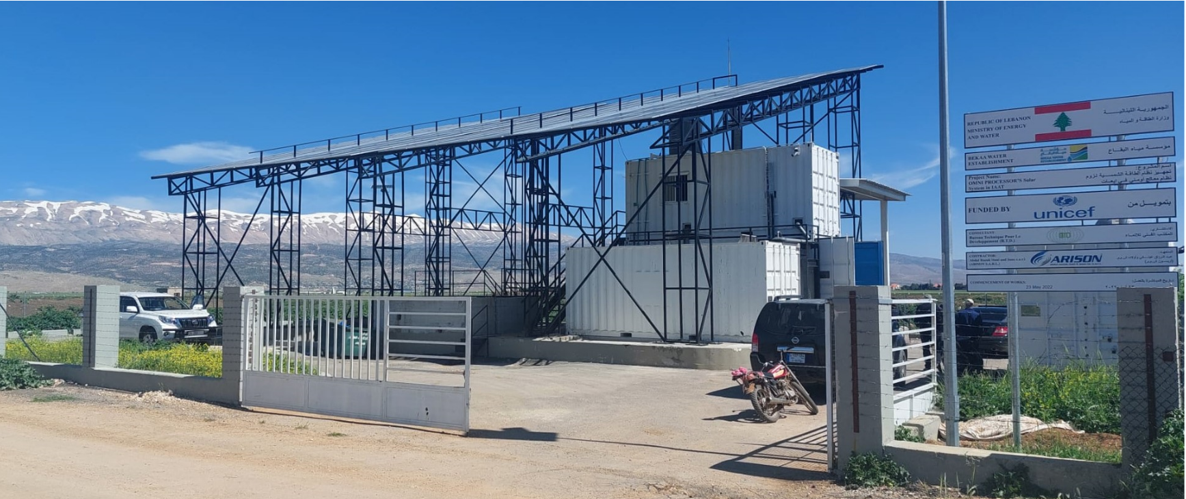
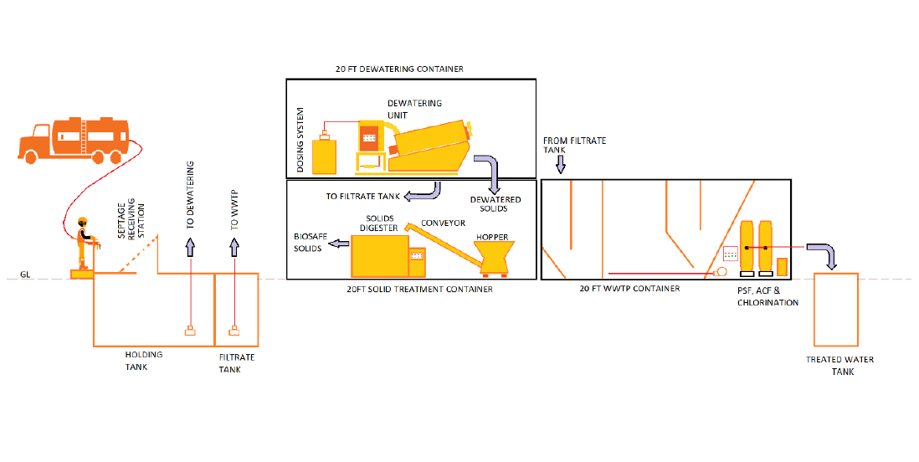
UNICEF LCO is piloting the treatment performance of a LowTech Omniprocessor enabling receiving and treating the Wastewater and sludge from ISs desludging.

Slide 30
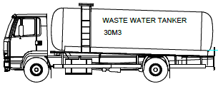
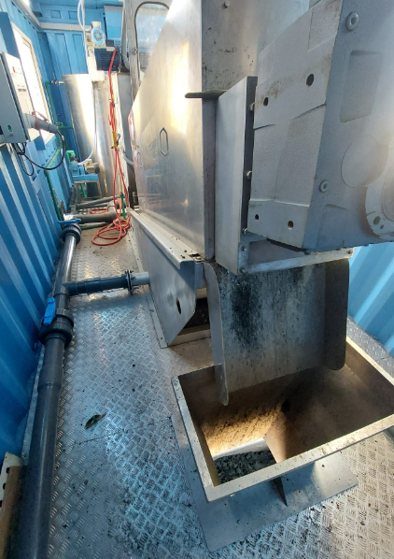
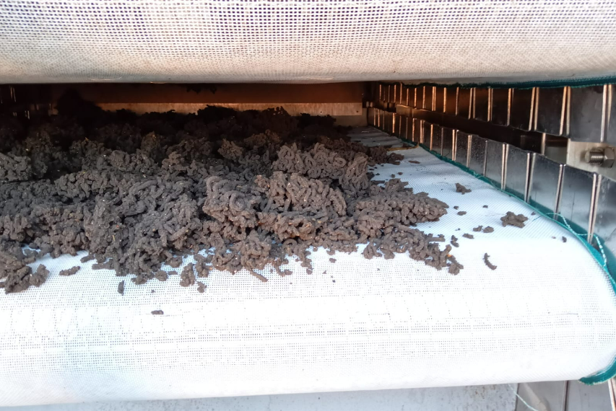
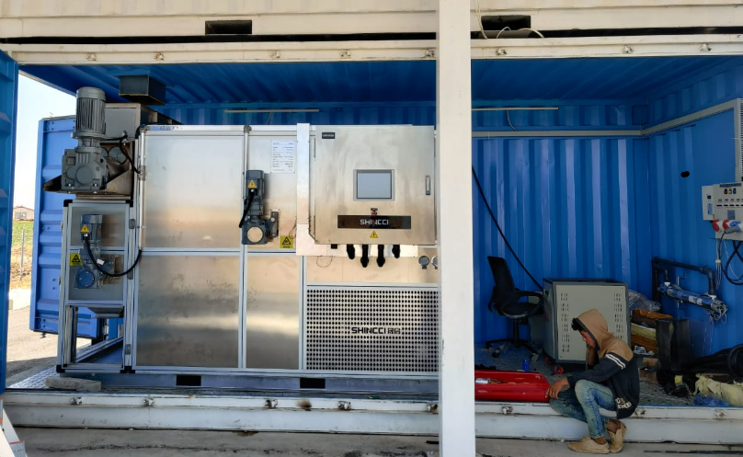
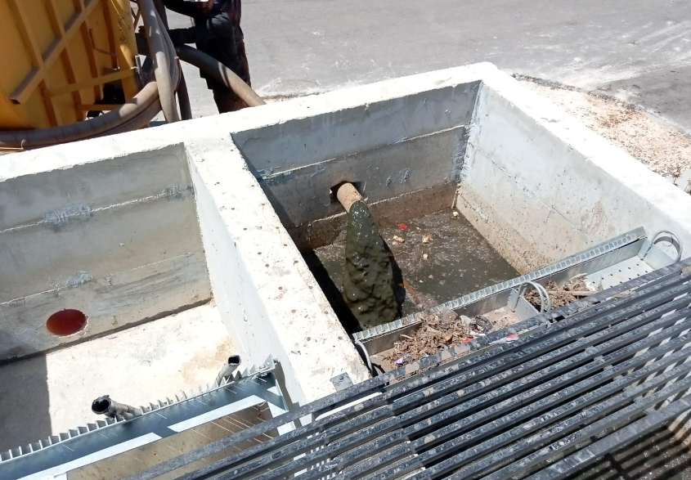
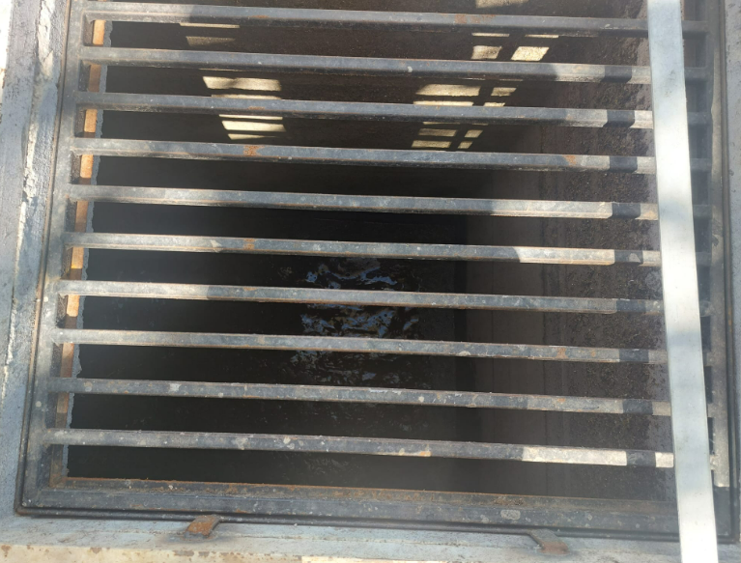
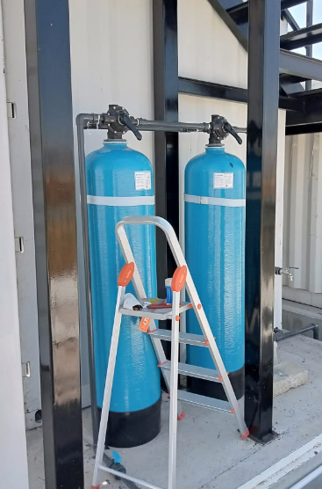
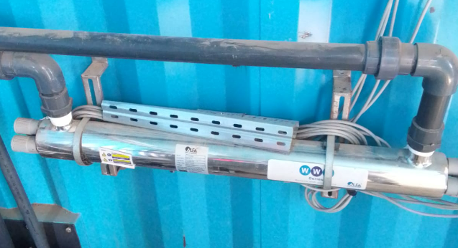
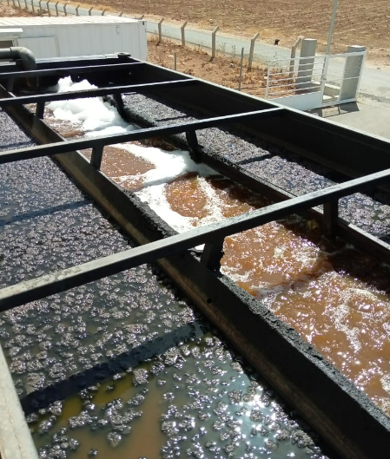
OMNIPROCESSOR ACTUAL BLOC FLOW DIAGRAM
Mass balance
BOD 500 mg/l
COD 980 mg/l
FOG 25,000 mg/l
TSS 2,400 mg/l
Mass balance
BOD 1320 mg/l
COD 2400 mg/l
FOG 51000 mg/l
TSS 16,000 mg/l
Flocculent
Dried sludge
Reception Area
Raw sewage tank
Screw Press
Sludge dryer
Solid waste manually removed / Manual bar screen
Mass balance
BOD 225 mg/l
COD 460 mg/l
FOG 13,500 mg/l
TSS 1,300 mg/l
Mass balance
BOD 200 mg/l
COD 470 mg/l
FOG 9700 mg/l
TSS 900 mg/l
Filtrate
Disinfection
Polishing filters
Holding tank
MBBR
Discharge
Mass balance
BOD 50 mg/l
COD 280 mg/l
FOG 1,300 mg/l
TSS 350 mg/l
Mass balance
BOD 60 mg/l
COD 290 mg/l
FOG 1350 mg/l
TSS 600 mg/l
Mass balance
BOD 170 mg/l
COD 400 mg/l
FOG 2,500 mg/l
TSS 350 mg/l
Mass balance
BOD 180 mg/l
COD 400 mg/l
FOG 3400 mg/l
TSS 600 mg/l
Backwash
Irrigation Channel

Slide 31
Stakeholders
Challenges
Energy Crisis leading to solarize the system
Current treatment of the MBBR is affected by the low level of solid capture by the Flocculation and too high level of Fat Oil and grease
Upgrade of the system, adding a Coagulation stage and DAF system

Slide 32
OMNIPROCESSOR ACTUAL BLOC FLOW DIAGRAM
Coagulant
Flocculent
Dried sludge
Reception Area
Raw sewage tank
Screw Press
Sludge dryer
Solid waste manually removed / Manual bar screen
Filtrate
DAF
DAF Scum tank
Scum
Excess floating sludge
Disinfection
Polishing filters
Holding tank
MBBR
Discharge
Backwash
Irrigation Channel

Slide 33
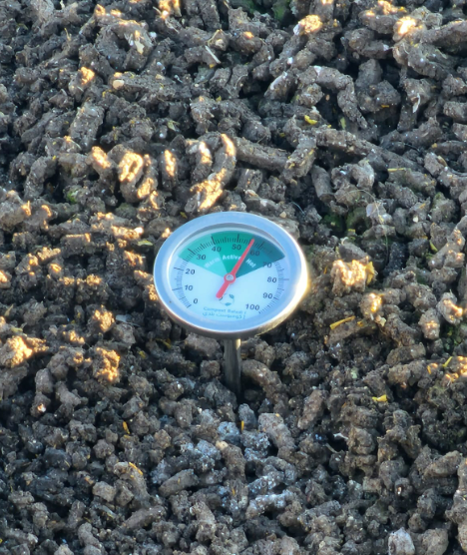
Stakeholders
Challenges & Opportunities
Energy Crisis leading to solarize the system
Current treatment of the MBBR is affected by the low level of solid capture by the Flocculation and too high level of Fat Oil and grease
Upgrade of the system, adding a Coagulation stage and DAF system
Sustain the Operation and maintenance of the system with BWE having already stretch financial and human resources
Develop a circular economy market to generate revenue from the biosolids produced.

Slide 34
Thank you for your attention,
do you have any questions?

Slide 35
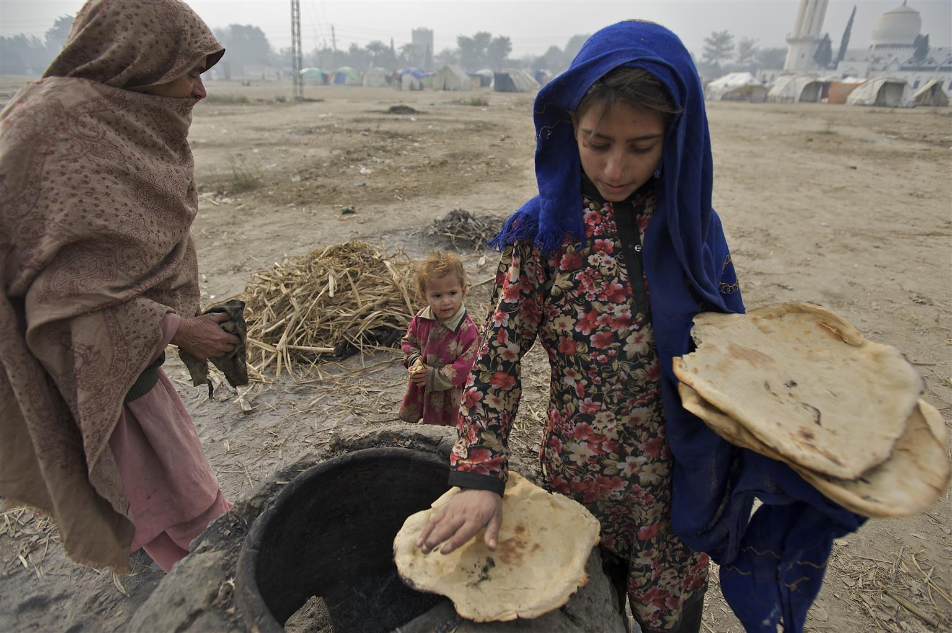
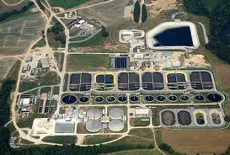
Sustaining Continuity of Wastewater Treatment Services within a Multiple Crisis context
Prepared by: Salam Eid
Wash Officer (Stabilization Wastewater)

Slide 36
OVERVIEW
There are around 75 existing WWTPs within the country.
Some of them are Wetlands operated by the municipalities,
Some cannot be in operation awaiting the corresponding network,
Some are still under construction/awaiting commissioning,
Some are operated by other stakeholders such as UNDP for Zahle and USAID for Safa, Barouk and Sahgbine.
Our assessment has been focused on all the WWTPs currently under the Water Establishments and CDR management which are in Total 28 WWTPs and their relevant 42 Pumping/Lifting stations.

Slide 37
OVERVIEW of 28 assessed WWTPs in Lebanon
Designed/Theoretical Level of treatment
2 WWTPs Preliminary Level
3 WWTPs Tertiary Level
23 WWTPs Secondary Level
Almost All 28 WWTPs are NOT Operational
Current Level of Treatment
Minimum required Level of Treatment
7 Coastal WWTPs Preliminary Level
21 Inland WWTPs Secondary Level
Current O&M Management Entity
16 WE
12 CDR

Slide 38
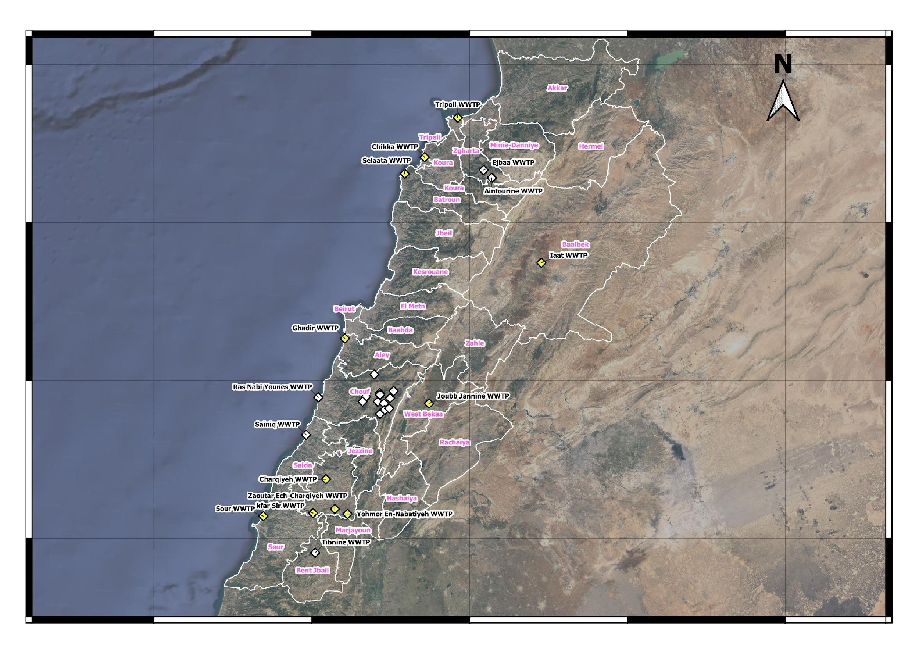
OVERVIEW of 28 assessed WWTPs in Lebanon

Slide 39
Project Objective/Results
Overall Objective:
By the end of the project, Children within the target area have access to Improved Environment
Specific Objective:
Improve the provision of the essential public wastewater services.
Results
Water Establishments ensure continuity of wastewater services under their management.
Sustainable reforms for the sector are in place, including promotion of treated wastewater reuse.
Public Awareness about wastewater's impact on the environment is raised to promote a culture of payment for wastewater and water services

Slide 40
Key Principles and Considerations
Legal issues - Legal ownership, responsibility, accountability remain with the Water Establishment
Handover of WWTPs from CDR to WE – this is a precondition for UNICEF support
Role of UNICEF - UNICEF supports the WE in carrying out its duties. UNICEF does not take on any legal obligations
Limited budget availability - WWTPs have been prioritized, 11 WWTPs along with the associated 25 PS are selected, and level of service is limited
Flexibility – Further developments (e.g. EIB funding, improved power situation) may result in changes in number and way in which WWTPs are supported
Inclusion of power support – without power WWTPs cannot operate, so provision is made for diesel for generators
Promotion of public awareness on wastewater situation – the project will support MoE and facilitating NGO to monitor WWTP performance and make data publicly available

Slide 41
Main Activities
Support operation of wastewater treatment plants
Facilitate handover-ability assessment from CDR to WE
Rehabilitation of WWTPs as per assessment
Ongoing repair and maintenance, operational supplies including fuel
WE staffing support – secondment of experts, allowances to WE staff
Support sector reforms related to wastewater
Engagement with sector stakeholders, including EU-AFD TA, on reforms related to wastewater, including tariff
Promote reuse of treated wastewater and sludge, including through finalization and adoption of national guidelines – link to UN Habitat and BMGF projects
Raise public awareness on wastewater and its impact on the environment
Support WQ testing and publication of data
Awareness campaign with MoE, MoEW and other stakeholders

Slide 42
Roles and Responsibilities
Water Establishments
Take full responsibility for the performance of the WWTPs under their management
WEs Contractors
Contracted by WEs/On demand contract basis to carry out operation, maintenance and security tasks.
Consultancy Firms
Contracted by UNICEF to oversee rehabilitation, repair and maintenance of the WWTPs
UNICEF
Funding for and organization of rehabilitation, repair, maintenance materials, equipment etc.
Secondment of staff to WEs (electromechanical engineers) and payment of WE staff allowances
Coordination with key stakeholders at national level
EU
Funding to UNICEF, support, guidance and advocacy engagement

Slide 43
Technical Assessment of 28 WWTPs
Rehabilitation
Process: Electromechanical, Control, Static equipment and Laboratory equipment assessed for maintenance, reparation or replacement.
Security and safety: Fire extinguisher, Internal and external lighting and Personal protective equipment (PPE)
Civil: Protection of metallic works, Fence and entrance gates and Paint when needed
Operation and Maintenance (O&M)
Process Calculation : Tank Volumes , Air capacity , Sludge quantity ,
Wastewater incoming Flow: Design Flow versus the Current Flow
Manpower: Required Personnel for O&M including engineers, workers, operators, security guards, etc.
Chemicals: Quantities required for the O&M of the WWTP
Energy/Power Consumption: Based on current flow received and current level of treatment.
Sludge Handling: For secondary level of treatment (inland)
Periodic Maintenance: According to the norms and standards.
Insurance, Training of WE Staffs

Slide 44
Result of Technical Assessment
Bill Of Quantities (BOQs) for Rehabilitation
28 WWTPs & 42 PS
Bill of Quantities (BOQs) for O&M
28 WWTPs & 42 PS
Detailed Rehabilitation reports
Detailed O&M reports

Slide 45
Estimated budget based on technical assessment
Estimated Budget for the 28 assessed WWTPs and PS
Total Rehabilitation
9,200,000 USD
Total O&M For 2 Years
46,800,000 USD
TOTAL
56,000,000 USD
Project Budget
25,000,000 USD
Budget GAP
31,000,000 USD

Slide 46
Scenarios to cope with budget constraint
Given the Budget constraint, several Scenarios have been initiated in order to support the maximum number of WWTPs
Inland WWTPs Only
Coastal WWTPs Only
All the 28 WWTPs at 8 Hours of operation
All 28 WWTPs Seasonal
Tripoli + Sour + Inland WWTPs
WWTPs Inland 24 Hours / WWTPs Coastal 24 Hours (Seasonal)
Tripoli + Sour WWTPs Especially with the potential of EIB support

Slide 47
Prioritization of 11 WWTPs
Final agreed scenario, 11 WWTPs and their relevant 25 PS have been prioritized, according to the following criteria:
Inland plants – secondary treatment
Coastal plants – preliminary treatment only
Summer operation only for coastal
EU funded projects (Tripoli, Sour, Yehmour, Zawtar, Kfarsir)
WWTPs and related pumping/lift stations
South Region: 5 WWTPs
Sour (coastal)
Nabatiyeh (inland)
Yehmor (inland)
Zawtar (inland)
Kfarsir (inland)
North Region: 3 WWTPs
Tripoli (coastal)
Batroun (coastal)
Checca (coastal)
BML Region: 1 WWTP
Ghadir (coastal)
Beqaa Region: 2 WWTPs
Joub Jannine (inland)
Iaat (inland)

Slide 48
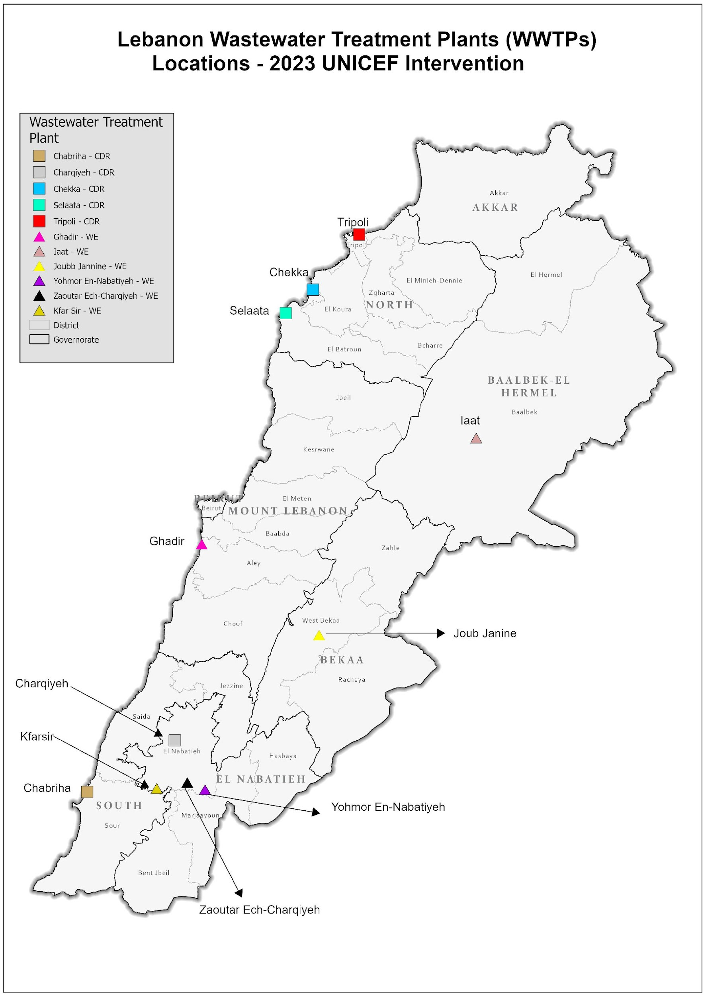
Prioritization of 11 WWTPs

Slide 49
Estimated budget
Total Rehabilitation
6,370,415 USD
Total O&M For 2 Years
17,542,286 USD
TOTAL
23,912,701 USD
Project Budget
25,000,000 USD
The Balance budget will be flexible to provide Minimal Support to the WEs in terms of Essential Repair and Maintenance for the critical WWTPs under their management and outside the prioritized list.

Slide 50
SUMMARY
 | No. of WWTPs | No. of PS | No. of Beneficiaries | No. of WWTPs potential Solarization | O&M + Rehab Estimated Cost | Solarization Estimated Cost *
Total WWTPs assessed | 28 | 42 | More Than 1.5 Million | 8 | USD 56 Million | 5,755,000 USD
Selected/prioritized WWTPs | 11 | 25 | Exceed 700,000 | 3 | USD 25 Million | 2,585,000 USD
* Subject to cost analysis versus the Diesel power supply and the Land legal aspect.

Slide 51
THANK YOU

Slide 52
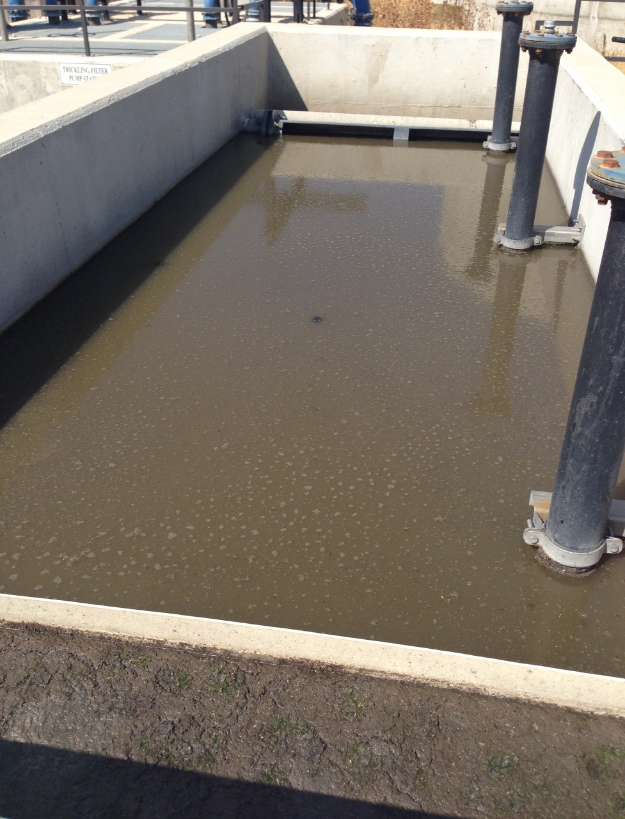
Reuse of treated water and sludge in Lebanon
Marie Therese Abi Saab
mtabisaab@lari.gov.lb
Lebanese Agricultural Research Institute (LARI)
May 2023

Slide 53
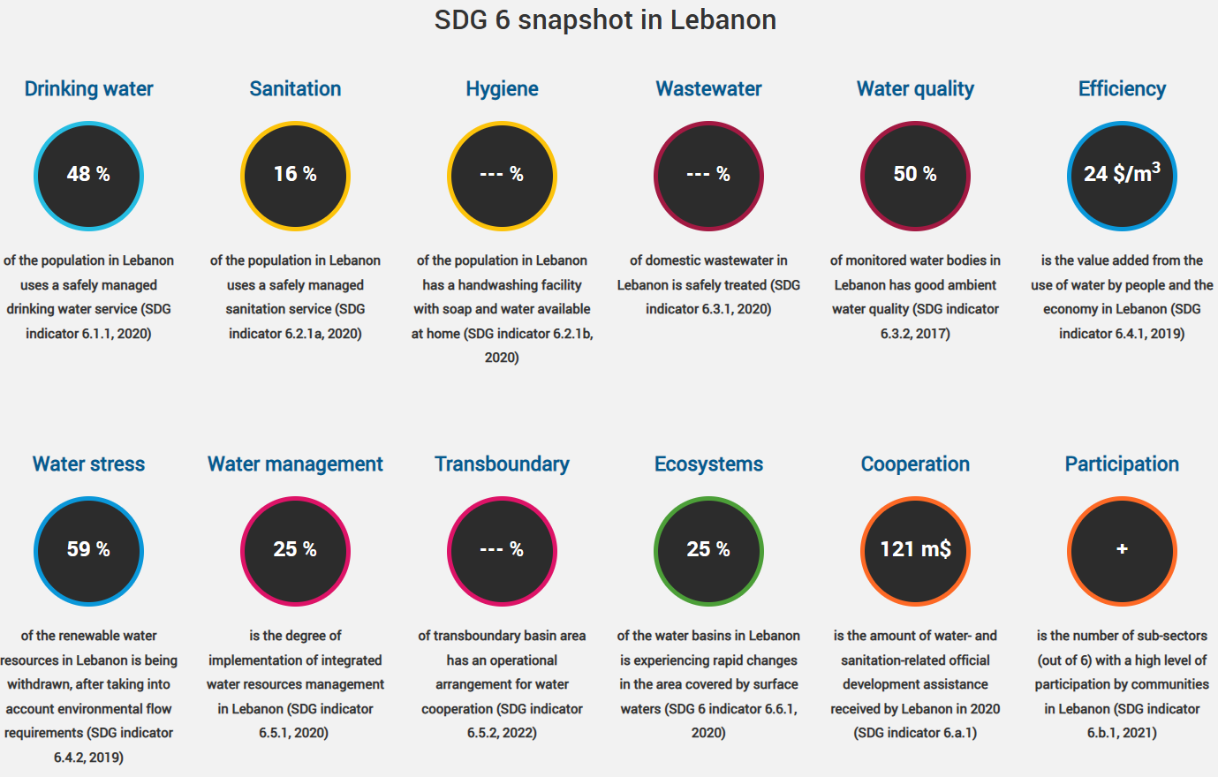
No data for Lebanon on the progress over time of indicator 6.3.1 Proportion of wastewater flow (safely) treated
Water treatment and reuse in Lebanon?
SDG target 6.3 is: ‘By 2030, improve water quality by reducing pollution, eliminating dumping and minimizing release of hazardous chemicals and materials, halving the proportion of untreated wastewater and substantially increasing recycling and safe reuse globally’.
In 2023, still there is no official standards for water and sludge reuse in agriculture
Source: https://www.sdg6data.org/en/indicator/6.3.1

Slide 54
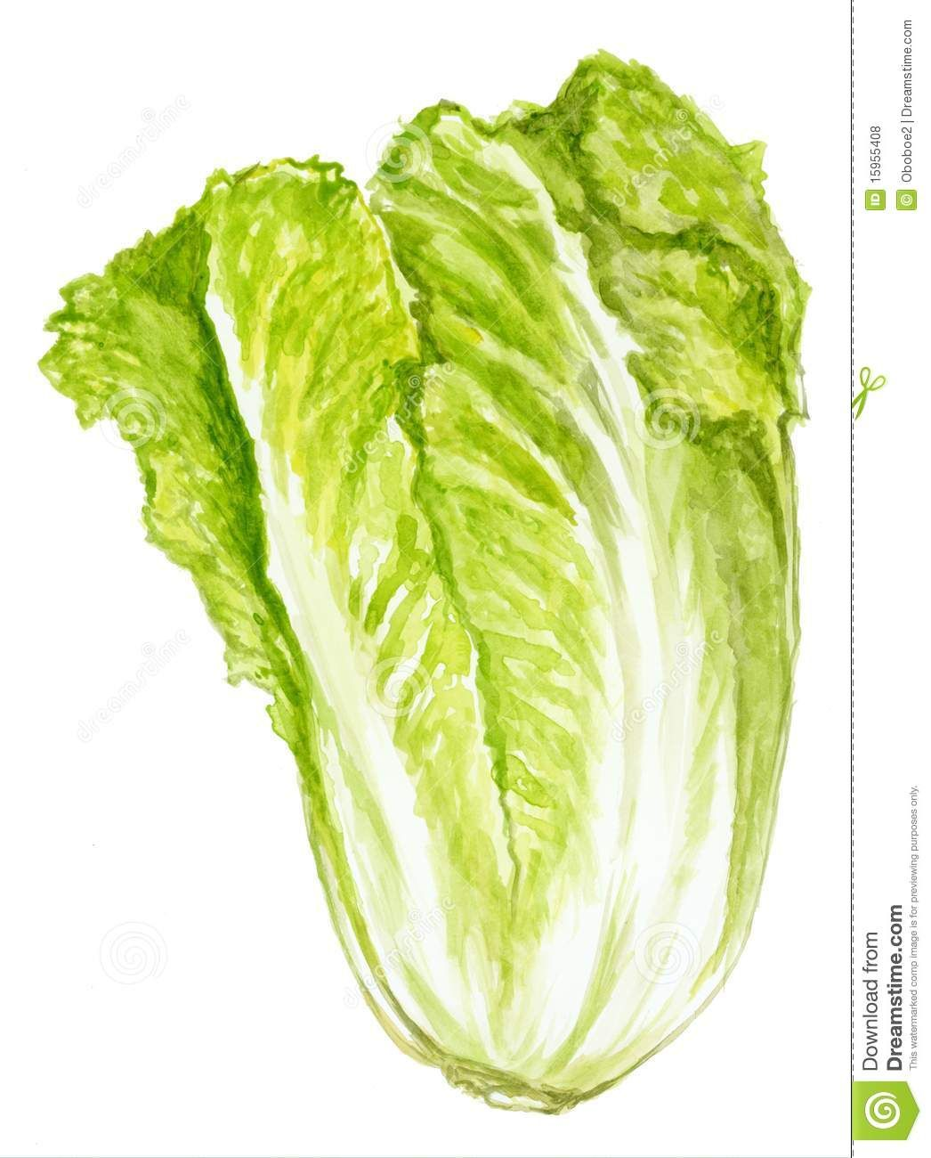
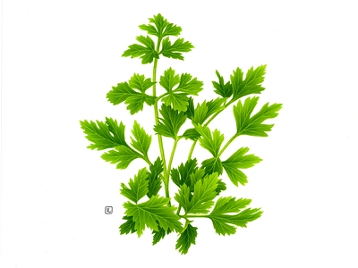
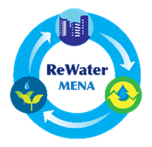
Water treatment and reuse in Lebanon?
Vegetables eaten raw cannot be grown
2019
Lebanese Standards Institution (LIBNOR) to issue national standards on wastewater reuse in agriculture
2017
Limited studies in Lebanon on the agricultural use of treated water
Parameter | Category
 | I | II | III
BOD₅ (mg/l) | 25 | 100 | 100
COD (mg/l) | 125 | 250 | 250
TSS (mg/l) | 60 | 200 | 200
pH | 6 – 9 | 6 – 9 | 6 – 9
Cl₂ residual (mg/l) | 0.5 -2 | 0.5 -2 | 0.5 -2
F. Coliforms (in 100ml) | <200 | <1000 | None required
Helminth ova (in 1 lit) | <1 | <1 | <1
Vegetables eaten fresh: parsley, lettuce, radishes, onion (Abi Saab et al., 2022; Abi Saab et al., 2023)
Table grapes (Abi Saab et al., 2020; Mcheik et al., 2017)
Eggplant (Abi Saab et al., 2021)
Spinach (Mcheik et al., 2018)
2011
Proposition for wastewater reuse guidelines in Lebanon (FAO, 2011)

Slide 55
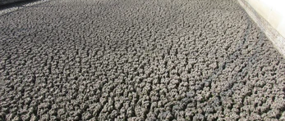
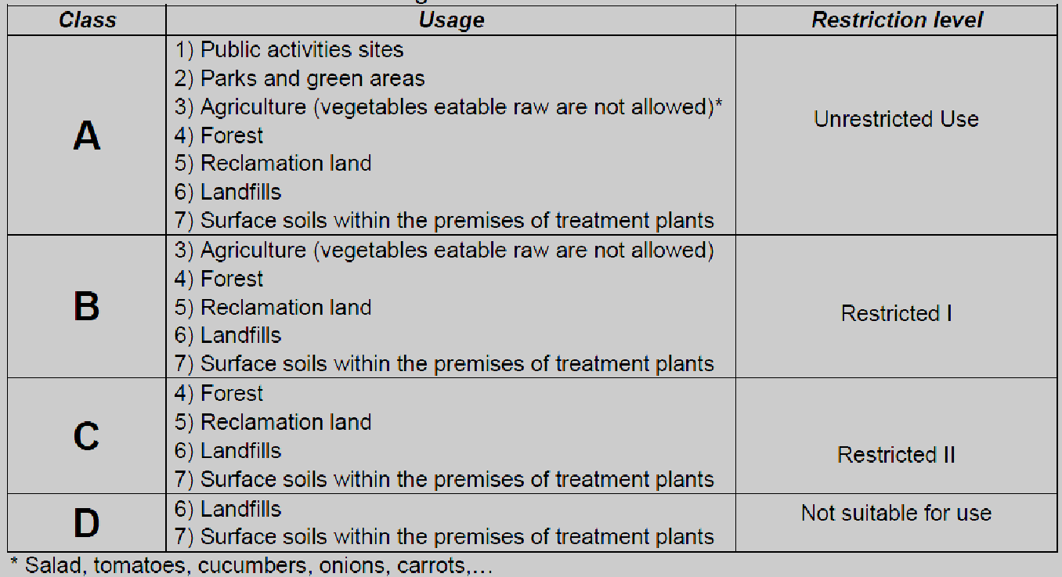
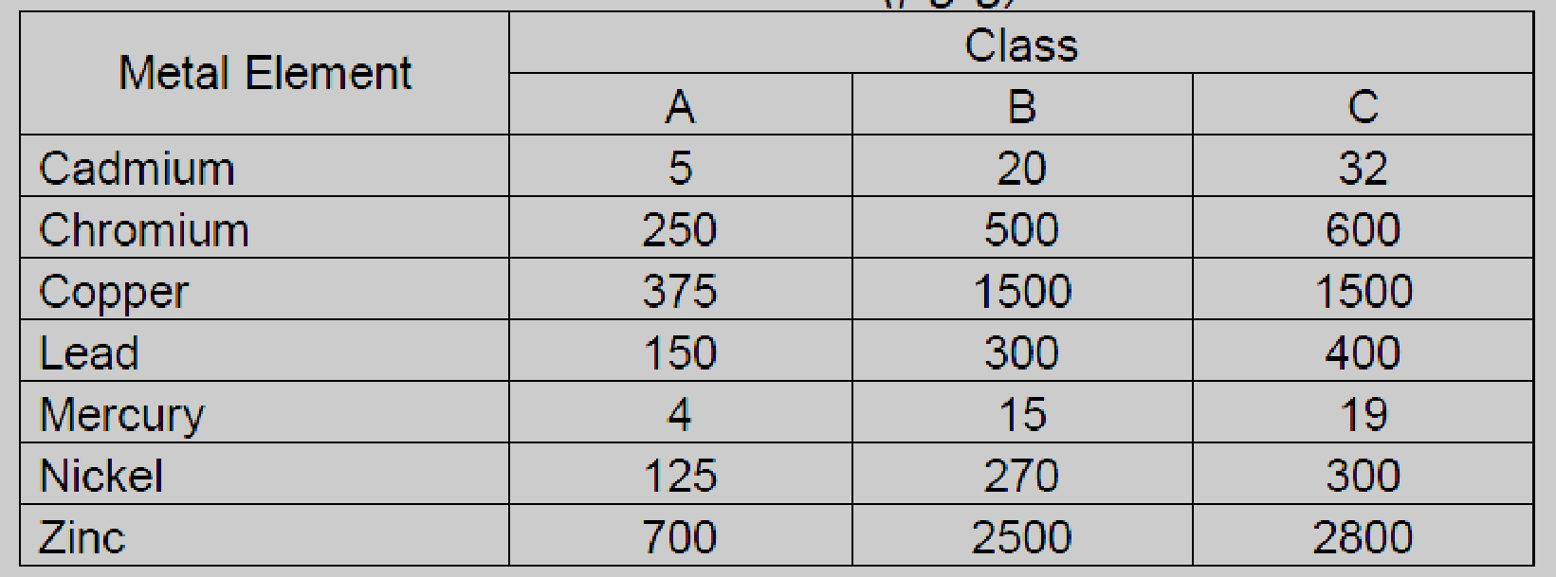
Water treatment and reuse in Lebanon?
Guidelines for sludge use in agriculture (FAO, 2011)
Sludge use on the basis of its class
Sludge classes on the basis of the sludge content of heavy metal concentration (μg/g)
Faecal coliform <1,000 MPN per g ds (ds = dry solids)
Salmonella <3 MPN per 4 g ds
Ascaris ova concentration < 1 viable egg per 5 g of dry solid

Slide 56
Water treatment and reuse in Lebanon?
Opportunities?
Risks
Managing risks
Trials to generate local evidence
if unproductive wastewater is managed efficiently
>25% increase agriculture water
> 20% reduction of groundwater abstractions
Policy interventions and infrastructure development tailored for reuse is vital.
Objective: To Maximize the protection of human health and the beneficial use of human waste
Source: Naga Manohar Velpuri, Javier Mateo-Sagasta, Mohamed O.M. Orabi, Spatially Explicit Wastewater Generation and Tracking (SEWAGE-TRACK) in the Middle East and North Africa region, Science of The Total Environment, Volume 875, 2023, 162421, ISSN 0048-9697, https://doi.org/10.1016/j.scitotenv.2023.162421.
Notes:
SEWAGE-TRACK: Spatially Explicit Wastewater Generation and Tracking model

Slide 57
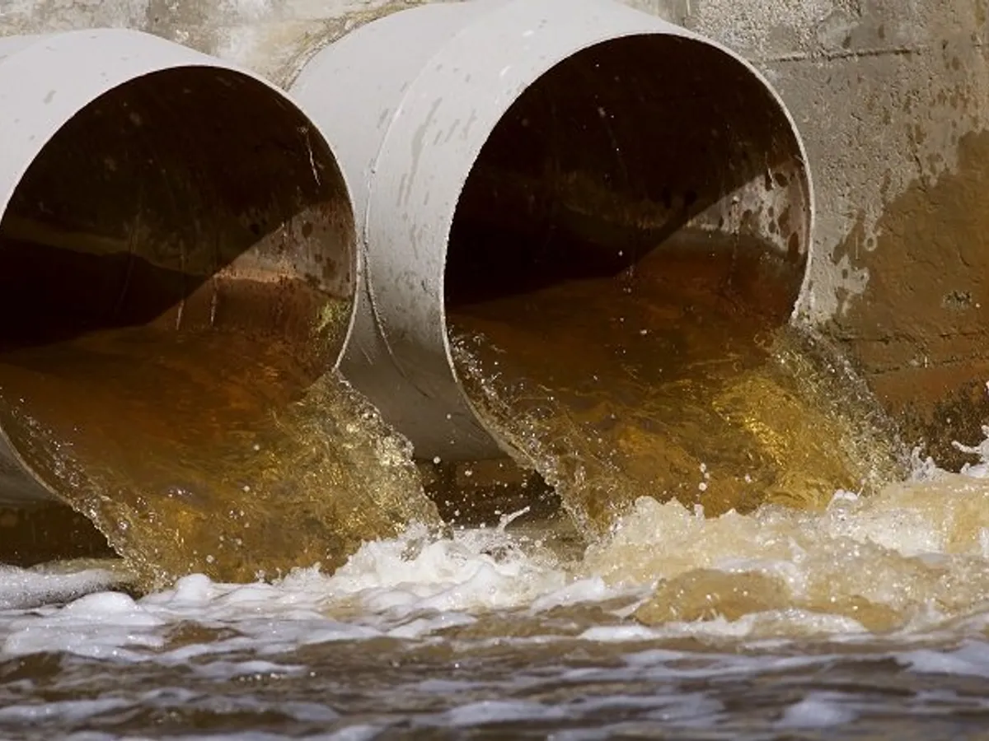
Risks
Hazards in wastewater
Can harm
Environment
Crops
Human health (consumers, farmers and close communities)
Pathogens
Chemicals

Slide 58
Risk management
OPTION 1: Eliminate hazards from water
One barrier: Water Reclamation
Common in high income countries
Strict water quality standards for reuse
Advanced Wastewater Treatment
Not applicable for Lebanon
Irrigation water quality thresholds
Food safety thresholds
OPTION 2: Lower the hazards
(2006 WHO Guidelines)
Multiple barrier: Risk management along the sanitation-food chain
Wastewater treatment operators
Agriculture
Urban planning
Food safety
INSTITUTIONS INVOLVED IN ENSURING SAFETY

Slide 59
On-farm options/barriers
Crop restriction
Irrigation method
On-farm water filtration
Irrigation strategy
Other practices…
Other practices…
Vegetables eaten raw
Drip
Three tank system
Blending TW with freshwater
Use of plastic mulch
Use of plastic mulch
Grown underground
Grown aboveground
TW
Vegetables eaten cooked
FW
Sprinkler
Simple sedimentation
Fruit trees and vines
Cessation of irrigation few days before harvest
Cereals and industrial crops
Alternating irrigation between TW and freshwater
……………………
Surface
Simple filtration
Pathogen reduction (log units)
Pathogen reduction (log units)
0.5 to 2
6 to 7
1 to 4
0.5 to 3
0.5 to 2
6 to 7

Slide 60
Trials on reused water in Lebanon – Tested barriers
Reference |  | Wastewater treatment |  | Tested on-farm option/barriers
Project | Published Paper | Treatment plant | Treatment level | Crop | Irrigation method | On-farm water filtration | Irrigation strategy | Other practices
FAO/GCP/INT/124/ITA | Abi Saab et al., 2021 | Iaat/Bekaa valley | Secondary/activated sludge process+chlorination | Vegetables eaten cooked/Eggplant | Drip | Media filter |  | Plastic mulch
 | Abi Saab et al., 2020 | Ablah/Bekaa valley | Secondary/Trickling filter process+chlorination | Vines/Table grapes | Drip |  | Irrigating all the time with TW
 |  |  |  |  |  |  | Alternating irrigation between FW and TW
IWMI/RewaterMENA | Abi Saab et al., 2022 |  |  | Parsley | Drip
 |  |  |  | Radishes | Sprinkler
 |  |  |  | Spring onion | Surface
 |  |  |  | Lettuce
 | Abi Saab et al., 2023 (to be published soon) |  |  | Lettuce | Surface |  |  | Withholding irrigation for 1, 2, 4 or 6 days before harvest

Slide 61
Trials on reused water in Lebanon – Results highlights
Pathogen content in treated effluent | Restriction on crops | Restriction on irrigation methods
< 2 log E. coli CFU/100 mL | All crops including vegetables eaten raw can be grown | All irrigation methods are allowed (Drip safer than other method?)
2 to 3 log E. coli CFU/100 mL: | Underground vegetables eaten raw are not allowed
 | Aboveground vegetables eaten raw allowed | Only drip system is allowed. Other irrigation methods could lead to crop contamination with parasites (ex. Ascaris)
3 to 6 log E. coli CFU/100 mL: | All vegetables eaten raw are not allowed | Only drip system is allowed
Treated wastewater had no adverse effect on vegetable quality.
Crop yield increased by 14 to 24%
Table grapes: Total soluble sugars, total titratable acidity and sweetness ranged respectively between 18.43-20.13, 0.69-0.81% and 21.52-29.19 and were within the desirable levels for table grapes harvest
Lettuce: Irrigation can be withheld for 2 to 4 days before harvesting with little loss of yield
Dripper sensitivity to clogging: discharge reduction rate Rd = 6.75%

Slide 62
Trials on sludge reuse in Lebanon

Slide 63
Key conclusions
Less stringent standards proposed for Lebanon but more realistic especially for farmers, investors and the whole water sector.
All vegetables eaten raw allowed under drip irrigation
Vegetables eaten raw allowed under drip irrigation except those grown underground
Vegetables eaten raw are not allowed
Zero risk does not exist. Risk reduction is necessary (WHO multibarrier approach) where wastes receive no or inadequate treatment. This is relevant to Lebanon.
Strict standards borrowed from other countries are to be avoided. (CWANA project/IWMI).
Low-cost risk reduction on-farm practices are needed.
Conducting more trials on water reuse is needed in order to generate local evidence on the health and environmental risks.
Parameter | Category
 | I | II | III
BOD₅ (mg/l) | 25 | 100 | 100
COD (mg/l) | 125 | 250 | 250
TSS (mg/l) | 60 | 200 | 200
pH | 6 – 9 | 6 – 9 | 6 – 9
Cl₂ residual (mg/l) | 0.5 -2 | 0.5 -2 | 0.5 -2
F. Coliforms (in 100ml) | <200 | <1000 | None required
Helminth ova (in 1 lit) | <1 | <1 | <1

Slide 64
Reference works done by LARI and published in international journals
Abi Saab, M.T.; Jomaa, I.; El Hage, R.; Skaf, S.; Fahed, S.; Rizk, Z.; Massaad, R.; Romanos, D.; Khairallah,Y.; Azzi, V.; et al. Are Fresh Water and Reclaimed Water Safe for Vegetable Irrigation? Empirical Evidence from Lebanon. Water 2022, 14, 1437. https://doi.org/10.3390/w14091437.
Marie Therese Abi Saab, Claude Daou, Isam Bashour, Antoun Maacaron, Salim Fahed, Dany Romanos, Yara Khairallah, Nada Lebbous, Celine Hajjar, Roula Abi Saad, Caroline Ojeil, Mohamed Houssemeddine Sellami, Salim Roukoz, Maher Salman (2021). Treated municipal wastewater reuse for eggplant irrigation. Australian Journal of Crop Science AJCS 15 (08):1095-1101. doi: 10.21475/ajcs.21.15.08. p2711.
Marie Therese Abi Saab, Hassane Makhlouf, Joanna Zaghrini, Salim Fahed, Dany Romanos, Yara Khairallah, Celine Hajjar, Roula Abi Saad, Mohamed Houssemeddine Sellami, Mladen Todorovic, 2020. Table grapes irrigation with treated municipal wastewater in a Mediterranean environment. Water and Environment 35 (Issue 2), 617-627. https://doi.org/10.1111/wej.12656.
Marie-Hélène Nassif, Mohamed Tawfik and Marie Therese Abi Saab, 2022. Water quality standards and regulations for agricultural water reuse in MENA: From international guidelines to country practices. Book Chapter In: Mateo-Sagasta, J.; Al-Hamdi, M.; AbuZeid, K. (Eds.). 2022. Water reuse in the Middle East and North Africa: a sourcebook. Colombo, Sri Lanka: International Water Management Institute (IWMI). 292p. doi: https://doi.org/10.5337/2022.225.
Romanos D., Nemer N., Khayrallah Y., Abi Saab M., 2021. Application of sewage sludge for cereal production in a Mediterranean environment (Lebanon). International Journal of Recycling of Organic Waste in Agriculture. DOI: 10.30486/IJROWA.2021.1903739.1098.
Romanos, D., Nemer, N., Khairalah, Y., Abi Saab, M., 2019. Assessing the quality of sewage sludge as an agricultural soil amendment in Mediterranean habitats. International Journal of Recycling of Organic Waste in Agriculture https://doi.org/10.1007/s40093-019-00310-x.
Marie Therese Abi Saab, Doha Jammoul, Hassane Makhlouf, Salim Fahed, Nada Lebbous, Celine Hajjar, Roula Abi Saad, Mohamed Younes, Mohamad Hajj, Mladen Todorovic, 2018. Assessing the performance of constructed wetland for water quality management of a Southern Mediterranean river. Water and Environment Journal, 508-518. Print ISSN 1747-6585.

Slide 65
Treated Wastewater Reuse in Lebanon: Where are the opportunities?
Dr. Marie-Helene Nassif (independent researcher)
Based on the work of IWMI-ReWater MENA project in Lebanon

Slide 66
Topics of focus
Five documents
Policy and planning
Analysis of Water Reuse Potential in Irrigation in Lebanon
LARI scientific field experiments
Outputs
Regulation on quality standards
Contribution to Standard Development with LIBNOR
Feasibility studies and governance plans
2 Studies on Zahleh and Ablah WWTPs
Detailed Technical Design and Feasibility Studies
Summary Report on Ablah
Summary Report on Zahleh

Slide 67
Context
Heterogeneity of water sources (surface, grounwater)
Water shortages/over allocation in most basins
100,000 Ha of agricultural lands
Heterogeneity of Agro-climatic areas and cropping pattern
Around 106 WWTPs (data needs consolidation)
Governance of the wastewater sector centered on the Ministry of Energy and Water; CDR; and Regional Water Establishments supposed to operate water, wastewater and irrigation infrastructure and recover their cost from users
Meanwhile irrigation is mostly community-based, and sanitation distributed between State/municipalities and increasingly new actors

Slide 68
Analysis for Water Reuse Potential at National level
Part I: technical, GIS analysis
Mapping and characterization of all WWTPs
(capacity, level of treatment, status of operation, governance, reuse practices)
Mapping of surrounding agricultural areas (crop pattern and water use).
Part II : Institutional and Policy analysis
Institutional and political economy analysis of the wastewater sector
(review of policies, administrative framework, financial capacities and interviews)
8 case studies on specific WWTPs (interviews with irrigators, local committees)
Reuse Potential for each WWTP
(Irrigated Area; Score based on level of treatment, irrigation infrastructure)
What are the obstacles in terms of planning, implementation, operation and regulation of WWTPs and Reuse systems?

Slide 69
Useful maps for planning

Slide 70
WWTPs vs/ existing irrigation systems

Slide 71
WWTPs vs/ cropping pattern

Slide 72
Governance
CDR (developer) | 17 | 16%
RWEs (operators) | 17 | 16%
Municipalities | 72 | 68%
Total | 106 | 100%
60% not operational; 40% operational (Pre-crisis and weak sustainability)
 | Not or partially operational | Operational
CDR (developer) | 65% | 35%
RWEs (operators) | 18% | 82%
Municipalities | 68% | 32%
80% of operational WWTPS < 2000 m3/day
Variations between RWEs; municipalities

Slide 73
Main results
Need for reuse but opportunities are restricted by the low level of treatment; governance of the wastewater sector
Planning inconsistent with managerial and financial capacities
Waster and wastewater sector very fragmented, which affects planning and implementation of reuse projects
Capacity for water quality monitoring is low at the level of all managing entities
No standards and governance framework for reuse
Governance differentiation: specific municipalities and BMLWE
Geographic differentiation: Inland and the Bekaa
Possibility of reuse by gravity in existing networks but Issue on ‘rights to use TWW’ contradicts economic feasibility
Heterogeneity of cropping pattern complicate the regulation of water quality

Slide 74
Local studies on two WWTPs in Bekaa
Zahleh WWTP (20, 000 m3/day; activated sludge + UV)
State-built (CDR); external loan; operated by SUEZ
Supposed to be operated by a regional State authority (Bekaa Water Establishment)
Water shortage in summer / Crops such as potato, grapevines, vegetables
irrigation systems supplied by different water sources and managed by irrigation committees/ water markets between farmers around wells
Baalbeq
Riaq
Monts Anti-Liban
Zahle
Terbol
Chtaura
Anjar
Route de Damas
Barr Elias
Litani
Joub Jenine
Ablah (2,000 m3/day; Trickling Filter +Chlorination)
Built by USAID/grant
Managed by the municipality
Only organized reuse system - EU project in 2015 (20 ha)
Built in a region main irrigated by groundwater and planted by grapevines
Reuse system operated for 2 years at the expense of the municipality but stopped due to a complaint by a resident impacted by the reservoir
Monts Liban
Canal 900
Limites du bassin
Karaoun

Slide 75
Main results
Zahleh
500 ha of potentially irrigated land in an area of water shortage and high pumping costs
Cost: 3.3 M USD
Found economically feasible ; concept to allocate water between two existing systems (upstream/downstream)
BUT
Cost due per farmer higher than existing costs
Conflicts on water allocation between upstream and downstream communities
Institutional arrangement between BWE and irrigators while the former did not implement its mandate in this area
Sustainability of operation of Zahleh WWTP not guaranteed
Ablah
Possibility of extension up to 20 ha based on existing infrastructure
Investment: 500,000 USD
Economically feasible
BUT
Cost due per farmer higher than existing costs
Transition from individual pumping to collective
Monitoring capacity is weak
Sustainability of operation not guaranteed

Slide 76
Main conclusions
National level
- Wastewater Sector struggling especially after the crisis, very few operational WWTPs
- Managing administrations (RWEs) and Municipalities struggle to finance the operation of WWTPs and guarantee effluents of safe quality
- No official reuse standards; delay of LIBNOR initiative because of the crisis
- RWEs not ready to support/manage irrigation, comprehend or establish institutional arrangements with irrigators
Local level
Need for reuse but planning is complex: many different and sometimes over lapping irrigation systems i.e. possibility of water allocation and heterogeneity of individual costs
Two experiences showed that cost-recovery by users is not feasible (pumping); other financing mechanisms should be considered
Sometimes users would have to transition from individual irrigation (wells) to collective system; new institutional arrangements need to be developed; and arrangements between them and operators

Slide 77
Where are the opportunities ?
Very limited opportunities to establish organized direct reuse in the current state of affairs ;
Focus should be put on finding solutions for sustainable wastewater treatment first : why does the current framework not work??
New infrastructure building /reuse systems are extremely unlikely to be operated in a sustainable way
In the context of generally low organizational and financial capacity, the focus should be put on low-cost solutions making informal reuse safer (WHO 2006); such as multi-barrier approach, use of filters, cleaning, awareness, etc.
The focus should be put on improving institutional capacity, develop knowledge around irrigation at the level of RWEs and create links with farmers and municipalities
Research should focus on investigating the diversity of irrigation arrangements /costs and proposing realistic cost-recovery mechanisms and institutional arrangements adapted to the complexity of contexts
Reuse standards are needed, and we recommend making them less stringent than those proposed in 2010 (FAO)
Most importantly the administrative capacity to implement standards needs to be strengthened
Let’s Treat Reuse Wisely!

Slide 78
For further information
Mariehelene.nassif @gmail.com
IWMI CWANA
m.zubi@cgiar.org

Slide 79
Enhancing Water Resource Management (WAMA) Output 1
Pilot of an Energy-Efficient Sludge Management System

Slide 80
Output 1 Pilot of an Energy-Efficient Sludge Management System
Module (Project) Objective:
Conditions have been created for improving the legal, financial, institutional, and organizational framework for wastewater management
Output 1:
An energy-efficient sewage sludge management system has been piloted by a selected WE at a wastewater treatment plant
Key envisioned activities:
Planning and construction of a sludge management system (Ongoing)
Providing technical and process advice to MoEW on improving inter-ministerial coordination standards and guidelines for sewage sludge management and re-usage

Slide 81
Pilot of an Energy-Efficient Sludge Management System
Context:
Framework:
Ministry of Agriculture 2012 decision prohibits import of sludge regardless of treatment
Lebanon adopted ISO 2020 as-is, with the only modification being upholding the local source limitation
No complete licenses/permits have been issued yet to allow commercial sludge reuse
Actors:
Private entrepreneurs such as CubeX (composting) and C Green (algae)
Non-profit and public users such as WWTP operators (Ablah) and reserves (Chouf)
International organizations piloting/demonstrating sludge treatment to reduce burden of refugee (UNICEF) and host (DAI) wastewater management and promote nexus

Slide 82
Pilot of an Energy-Efficient Sludge Management System
Opportunity:
Sludge is currently dumped (or landfilled) at high transportation and environmental cost
At best, sludge dewatering/drying is used to reduce the load, but no effective treatment
Sludge has potential in energy recovery, soil enhancement, and land reclamation
Feasibility:
Lebanon imports large quantities of fertilizer/compost for agriculture, generates more than enough sludge to cover the needs (quantitatively)
Crossboundary (USAID) has made a strong case for commercial sludge reuse
Safe reuse needs to be demonstrated empirically to unblock licensing/permitting

Slide 83
Pilot of an Energy-Efficient Sludge Management System
Selected site (Tebnine WWTP)
Tebnine Wastewater Treatment Plant is located in Bint Jbeil Caza/District, Nabatiyeh Governorate (South)
Tebnine WWTP is designed for secondary treatment of up to 3,500 m³ of wastewater per day, with space/plans for extension to to ~4,800 m³/d
Current Flows (influent) entering the only operating line (one out of two lines in total) range from 840 to 1,182 m³/d
Quantity of Sludge during normal operation is 70 Tons/Month; Quality is (seemingly) quite promising; Dewatering unit is available

Slide 84
Pilot of an Energy-Efficient Sludge Management System
Tebnine Wastewater Treatment Plant

Slide 85
Pilot of an Energy-Efficient Sludge Management System
Sludge extracted

Slide 86
Pilot of an Energy-Efficient Sludge Management System
Next Steps
Feasibility study to determine suitable sludge treatment solution, synergies, costs
Deliberation with the South Lebanon Water Establishment (SLWE) and relevant ministries on the preliminary/conceptual design and reuse pilot/scenarios
Solicitation of approvals, detailed design of the solution, construction of the treatment unit, commissioning, handover, etc.
Set up of treatment monitoring and reuse testing protocols/processes with a university, research institute, or (preferably) public institution
[Optional] Commission national study on sludge composition, hazards, potential

Slide 87
Pilot of an Energy-Efficient Sludge Management System
ECAM (Energy Performance and Carbon Emissions Assessment and Monitoring) is a tool to calculate direct and indirect GHG emissions from water supply and wastewater treatment processes
Will be used to calculate baseline and endline GHG emissions especially from Sludge Management

