Slide 1
Sustainable Sanitation for long term responses with reducing budgets
Faecal Sludge Management (FSM)
Technical Working Group (TWiG)
Date: 10.10.2023

Slide 2
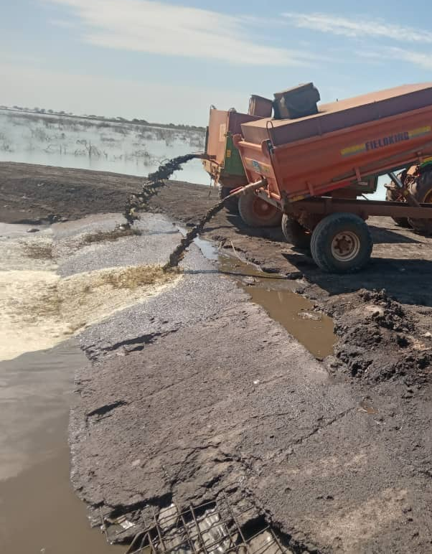
To openly discuss the impact of reduced funds on humanitarian sanitation, and on how the sector should deal with reducing funds, while long-term needs continue to increase.
Session Objective
Host
Marij Zwart, Netherlands Red Cross
Pic credit: Pride Kafwembe, IOM South Sudan

Slide 3
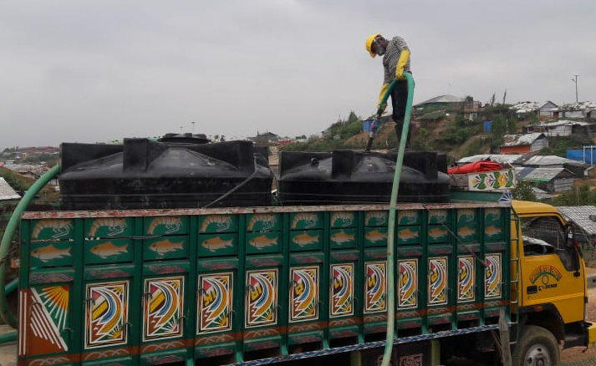
Shared understanding on the problem
Critical reflection on if reduced funding is really the main issue
Identification of potential actions to be taken
Short introduction of BHA funding research to be conducted by TWiG partners
Envisioned session outcomes
Pic credit: Salahuddin Ahmmed , Oxfam Bangladesh

Slide 4
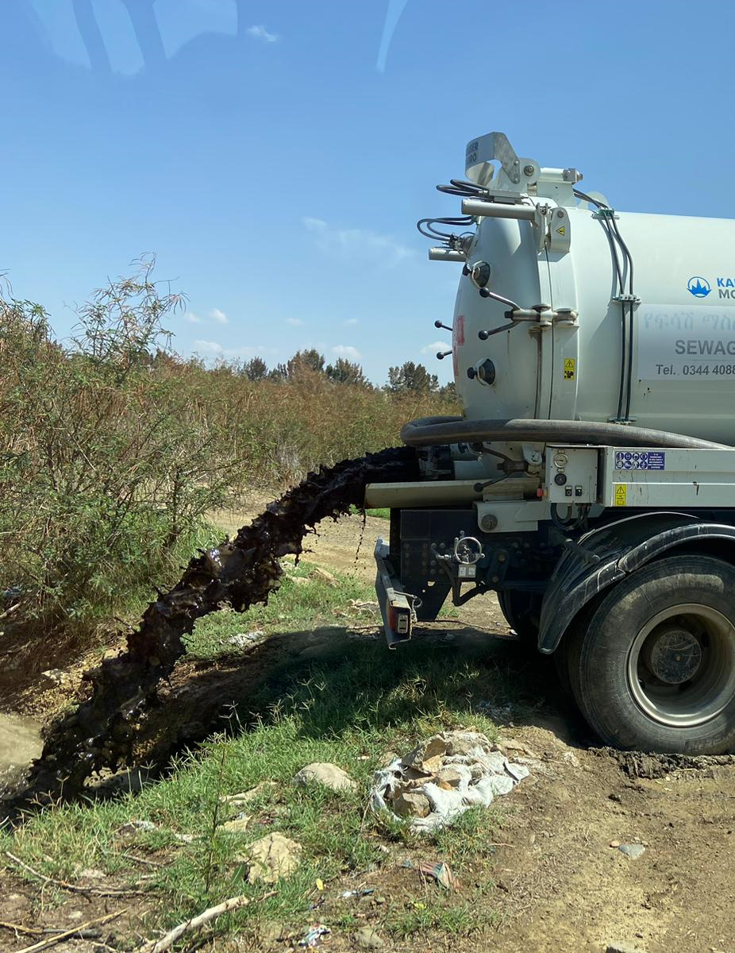
Josep Trincheria, IOM South Sudan
Francois Quick, MSF Amsterdam
Antonio Torres, IOM
Biserka Pop-Stefanija, MSF Amsterdam
Andy Bastable, Oxfam
Esther Shaylor, UNICEF innovation
Invited speakers
Pic credit: Jan Heeger, Netherlands Red Cross, Ethiopia
Notes:
Statements

Slide 5
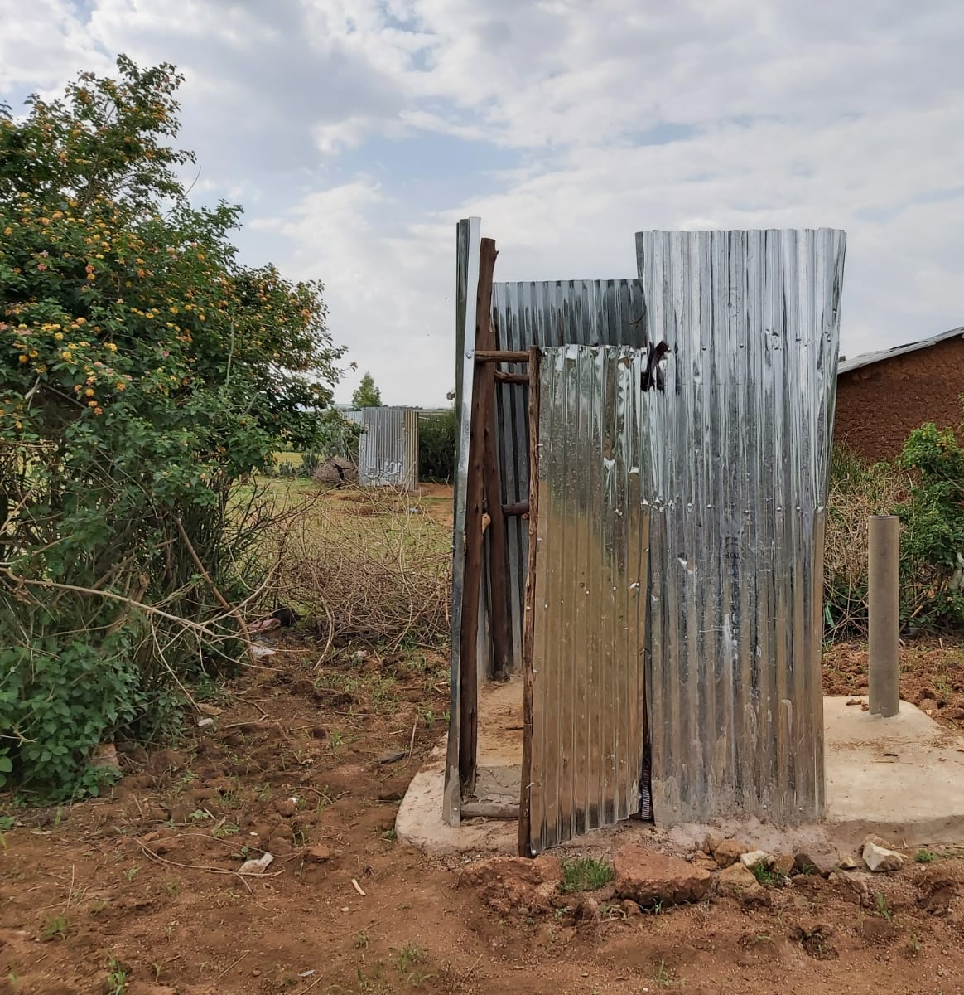
Do you experience reduced humanitarian funds in comparison with earlier years?
Does this lead to reduced budgets for sanitation, i.e., sanitation not being prioritized? Why?
Does this lead to less enthusiasm for full sanitation service chain activities?
Introduction of the problem
Pic credit: Roel Blesgraaf
Notes:
Statements

Slide 6
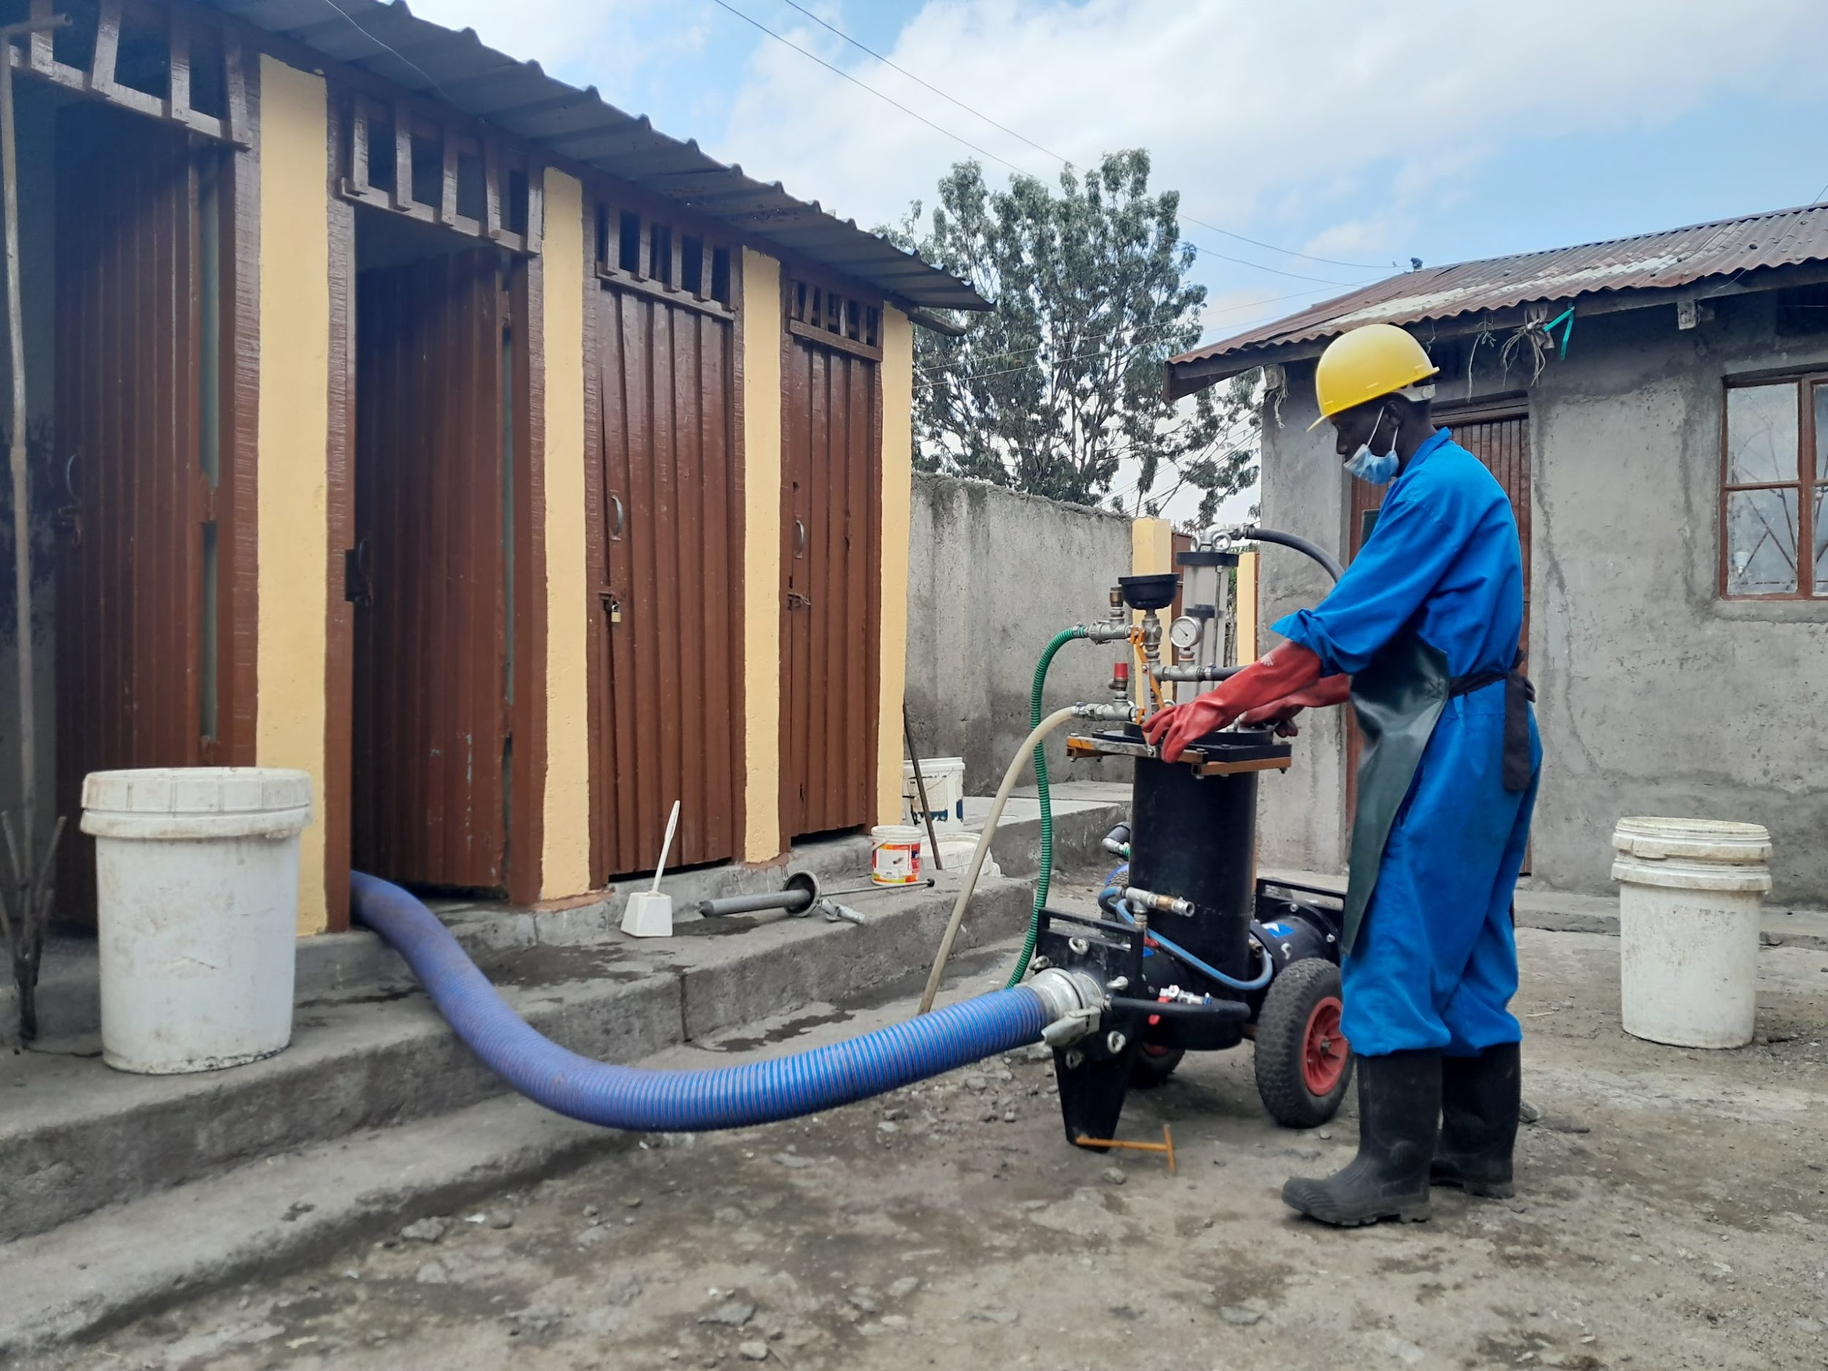
Reduced budgets have an extra strong impact on full-chain sanitation services, as these are still relatively new and not standardized within the WASH portfolio.
The real challenge to the quality of humanitarian sanitation services is the lack of expertise, it is not (yet) the lack of financial resources.
As most of the global community lacks safe sanitation services in non-emergency situations, it is too ambitious to try to achieve safe services in emergency situations.
Funds are available, but sanitation activities are not pitched good enough.
Is funding the real issue?
Pic credit: Practica Foundation, Burkina Faso

Slide 7
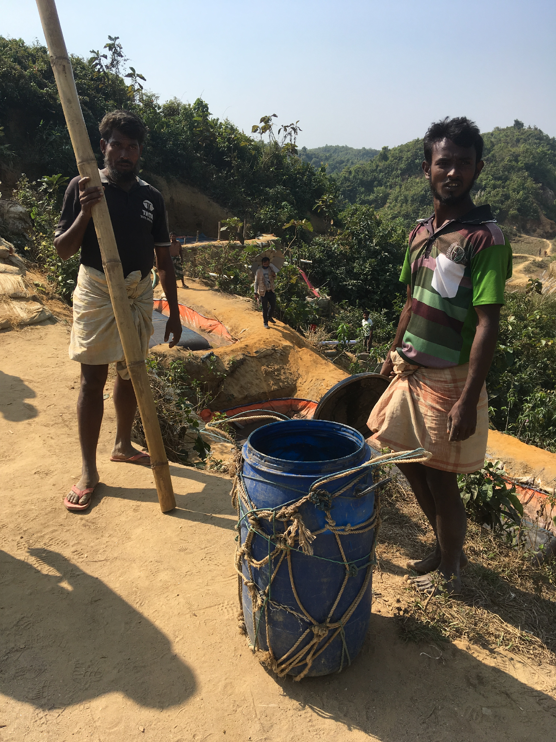
It would help to prioritize sanitation services, if the SPHERE standards would include guidance on full chain sanitation services more explicitly.
Humanitarian actors need to take a stronger stand in communicating that safe sanitation services require funds, and that if these funds are not available, the services will not be safe.
Nexus/world bank funds are the solution.
If safe sanitation working conditions can not be guaranteed, harm is done and activities should be terminated.
What should be done?
Pic credit: Marij Zwart
Notes:
If humanitarian actors can not guarantee safe sanitation worker conditions, the sanitation activities should be ended (even if this results in additional health-risks to the affected population).
Nexus funds/world bank funds can be better engaged to finance activities on long-term sanitation needs

Slide 8
Enable acute emergency fecal sludge management interventions to scale-up in the stabilization phase
FSM TWiG
FSM TWiG - Workstream 3 on Research, Capacity Building and Knowledge Management
TUFTS University, CAWST, Solidarités International
10.10.2023
Notes:
Catherine intro RECORD

Slide 9
Prioritization of FSM research gaps by the FSM TWiG

Slide 10
Identification of gaps: literature review
Gap Analysis in Emergency Water, Sanitation and Hygiene Promotion, Bastable, A. and Russell, L. Elrha (2013)
‘Faecal Sludge Management’. WASH in Emergencies | HIF Problem Exploration Report, Grange, C. Cardiff: ELRHA (2016)
Setting priorities for humanitarian water, sanitation, and hygiene research: a meeting report, D’Mello-Guyett, L., Yates, T., Bastable, A. et al. Confl Health 12, 22 (2018)
Preparing to be unprepared: Decision Making and the Use of Guidance on Sanitation Systems and Faecal Sludge Management in the First Phase of Rapid-Onset Emergencies, Huber, M. S. and Jennings, A., Elrha (2018)
Gaps in WASH in Humanitarian Response: 2021 Update, Lantagne, D., Yates, T., Ngasala, T. et al, Elrha: London (2021)

Slide 11
Identification of gaps: FSM TWiG survey
Gaps in FSM in emergencies, by FSM TWiG (2020)
39 respondents: FSM and sanitation practitioners with field experience

Slide 12
Prioritization process
 | User interface | Collection - Storage | On-site treatment | Conveyance | Centralized treatment | End use or disposal | Service chain
Environmental
Spatial
Economic
Political and/or Institutional
Social and/ or cultural
Temporal
Technical
Safety/ Health
General
79 gaps identified
Notes:
We identified 79 gaps and sorted them into a table.
We synthetized the table, rewriting and merging similar gaps, and removing those not focused on research.

Slide 13
Prioritization process
79 gaps identified
16 priority gaps
FSM TWiG workstream
Sector experts
7 sector priority gaps
Notes:
Over three meetings between February and March 2022, we reviewed the gaps with the workstream members
We improved the list of gaps by rewriting or removing gaps.
We agreed on a clean table with all relevant gaps was agreed on
and 16 gaps were selected as the most relevant or with higher priority
We sent the list of 16 gaps to sector experts (from or outside of the workstream), to vote for the 5 research priorities.
There were 15 respondents
We selected the first seven gaps as research priorities from the FSM TWiG, as they had more than 40% of voters.

Slide 14
Gaps prioritized
 | FSM TWiG research priorities
1 | Lack of treatment solutions for first phase emergencies (focus on turn key solutions, with short set up time and for different population sizes)
2 | Lack of understanding on how to adapt and readjust treatment solutions for each phase of humanitarian crises, building up on the previous phase
3 | Lack of experience and evidence for existing and promising treatment solutions adapted to humanitarian contexts
4 | Lack of understanding on expected performance of current treatment solutions
5 | Lack of evidence on performance of centralized and decentralized systems, for comparison for use in large camps
6 | Lack of evidence on operation and management models for first phase emergencies and long-term crises, considering high and low technology solutions and resource recovery
7 | Lack of framework/ decision-making tool to support the selection of appropriate solutions based on context, with a focus on treatment and disposal
Notes:
Discuss differences between priorities

Slide 15
Gaps prioritized
Research gaps 2:
Lack of understanding on how to adapt and readjust treatment solutions for each phase of humanitarian crises, building up on the previous phase
Objective of the research project:
Identify factors that should be considered when implementing fecal sludge management in acute emergency response in order to ease scale-up to the stabilization phase.
Notes:
FSM TWiG selected this gap, and is developing this question

Slide 16
Upcoming activities
Litterature Review
Key informant interviews
Case studies collection
Dissemination
Notes:
Catherine et Marine(Manage the Chat)
Share screen NOT in presentation mode,
ask participants to share in chat What design factors need to be considered when planning for a sustainable sanitation solution in an emergency response ?
Write answers as they appear in each “sticky note”
Once ideas have all been shared, copy/paste these sticky notes to next slide

Slide 17
How to be involved?
Being one of the Key Informants
Dedicate one hour for an interview (December 2023_ February 2024)
Share relevant resources
Contact us to be one of our case studies
Share existing resources
Support organisation of field visit (January_ August 2024)
Hoste a participatory workshop (January_ August 2024)

Slide 18
THANK YOU
Claire Papin Stammose : claire.papin-stammose@outlook.fr
Catherine Bourgault : Cbourgault@cawst.org

