Slide 1
The Humanitarian Sanitation Hub
Now Online

Slide 2
Have you ever heard of the SaniHub?
https://app.sli.do/event/fEQw6EL7VoYbde7daWuGqh
#5025726

Slide 3









Multi-Agency Sector Initiative
GWC FSM TWiG
Advisory Board

Slide 4
Aim
Meta platform and first go-to-point for sanitation and FSM practitioners with comprehensive and structured access to relevant knowledge and resources
Personal remote support for humanitarian WASH practitioners and clusters via a Helpdesk, supported by FSM TWiG members
Improved collaboration, increasing resource efficiency and quality of work through a sector-wide approach on knowledge management
To provide the basis for a wider WASH HUB (Roadmap Initiative 1.1)

Slide 5


sanihub.info
sanihub.info

Slide 6
Structure
Topic Entry Points
Project Cycle
Region/Country
Challenging Contexts
Technologies
Capacity Development
Wider Sanitation System
Common Questions
Answers to most frequently asked questions from humanitarian sanitation practitioners with links to key resources and tools
Help Desk
Direct personal remote support from a team of experts upon request
Migration of existing and upcoming sector tools into the platform
Collaboration with national WASH clusters/sector working groups
Continuous content development
Continuously answering Helpdesk requests

Slide 7

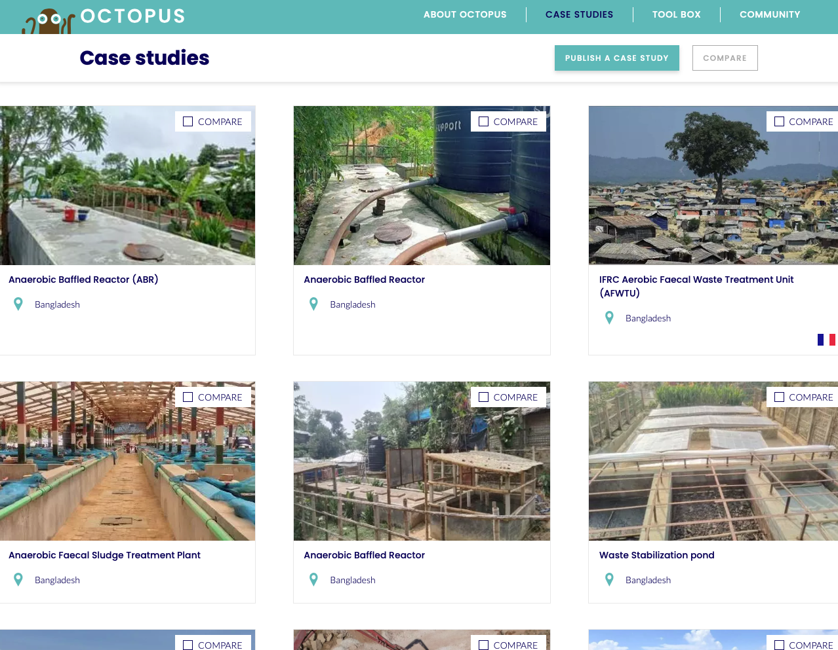

Integration of the Octopus Platform

Slide 8
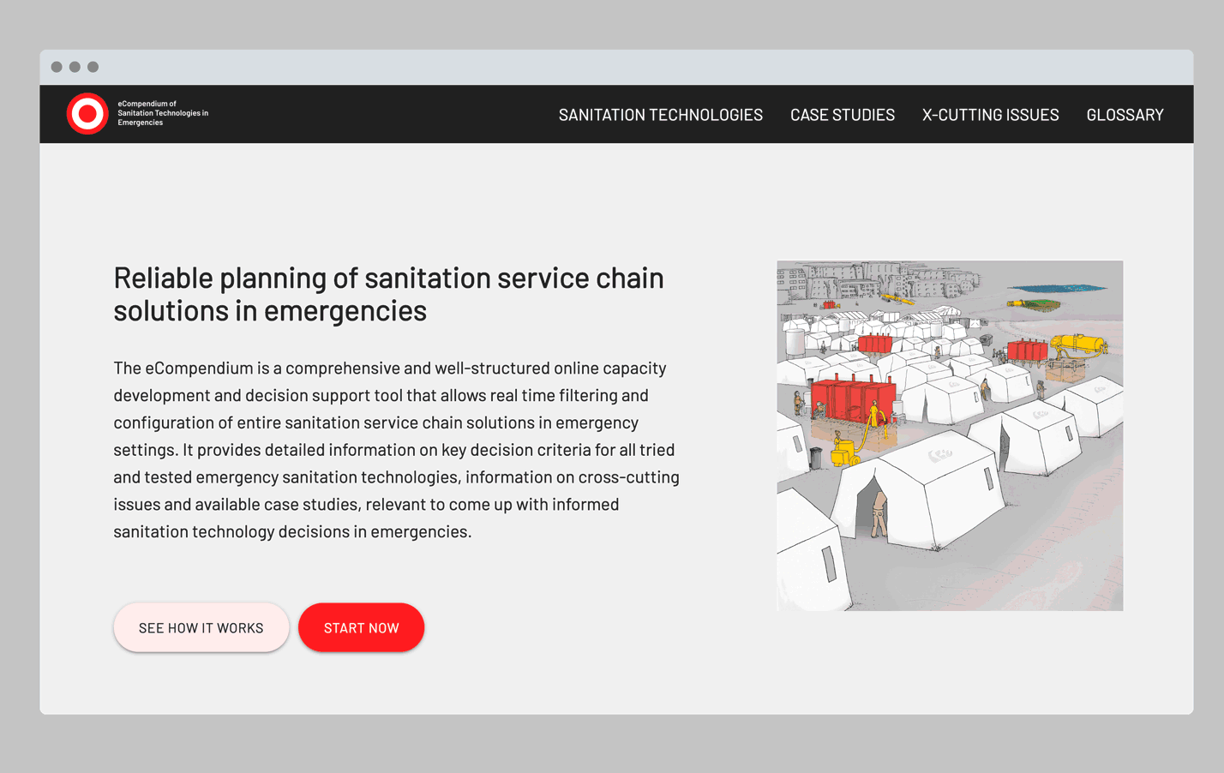
Integration of the Emergency Compendium
Migration of the Compendium platform until end of 2023
Linking technologies with existing humanitarian FSM case studies
Continuously adding existing practical information (designs, BoQs from different countries and contexts)

Slide 9



Integration of other relevant platforms
Decision support and planning tool
Tool to select emergency FSM treatment technologies

Slide 10


An Initiative from and for the Sector
Current platform is still a Beta Version
We need your support to improve the Hub
Contribute relevant practical resources
Review/develop existing or upcoming content
Tell us what is missing (or does not work)
Actively engage with us (through your organisation or national cluster)
sanihub.info
Keep in touch and join us on LinkedIn
info@.sanihub.info

