Slide 1
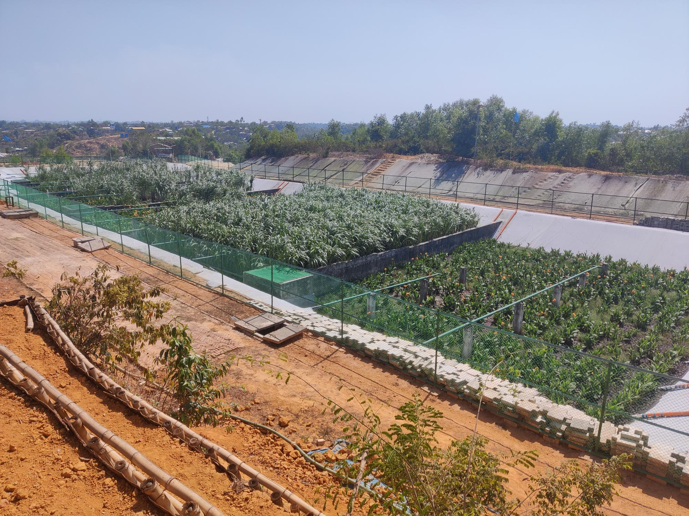
PLANTED DRYING BED
2020
2021
Camp 4 extension FSTP -1
Dewatering -Drying -Mineralization - Sanitizing fecal sludge

Slide 2
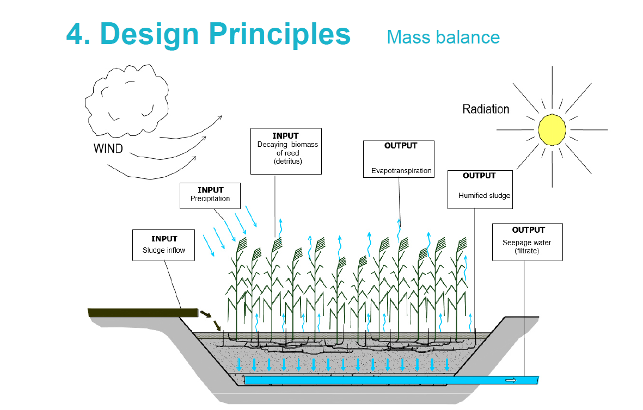
After 8 years of operation humified and stabilized sludge need to be removed and can be used for solid fertilizer , bioash, briquets etc

Slide 3
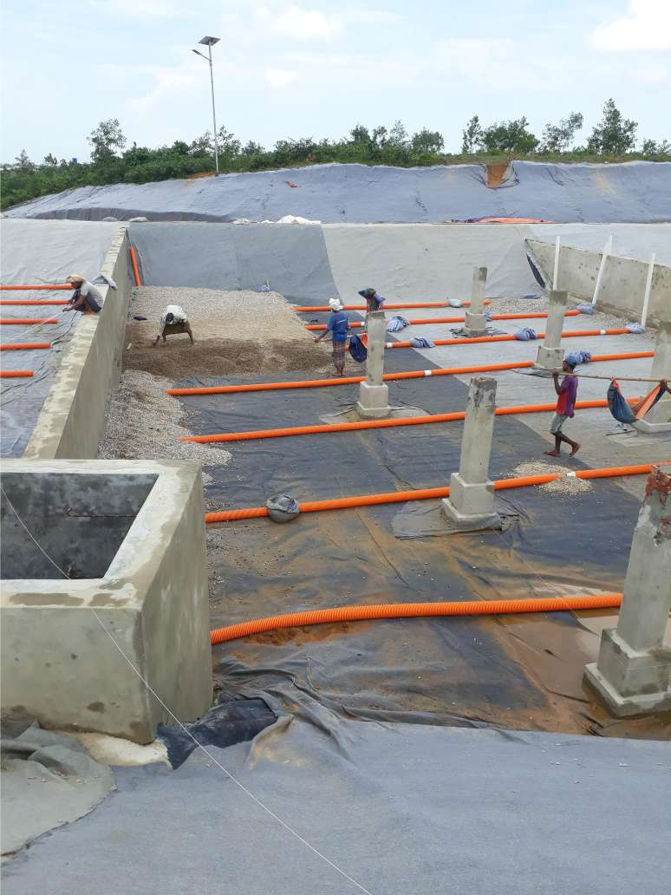
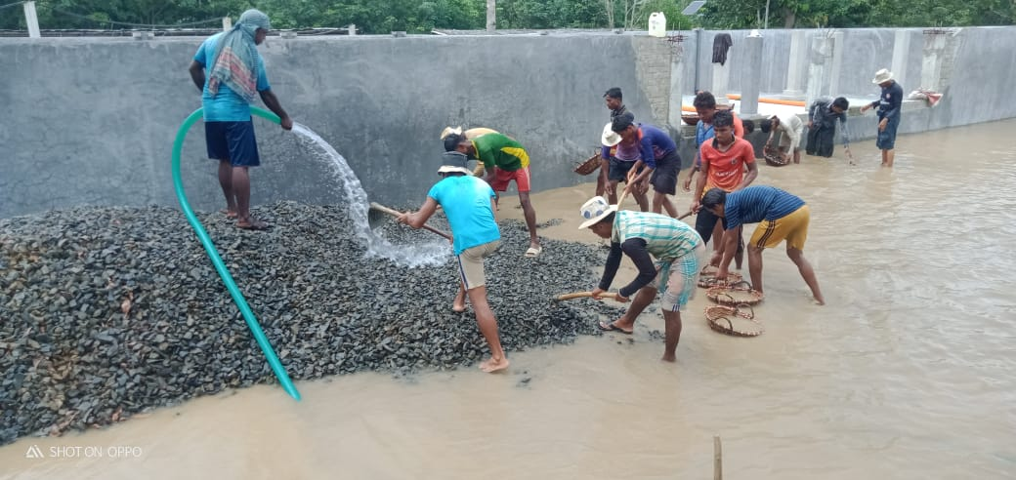
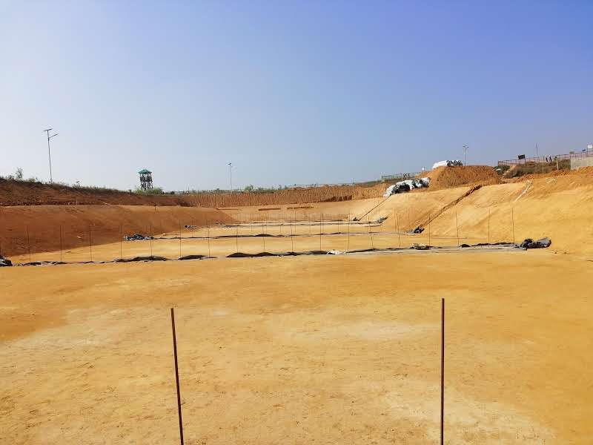
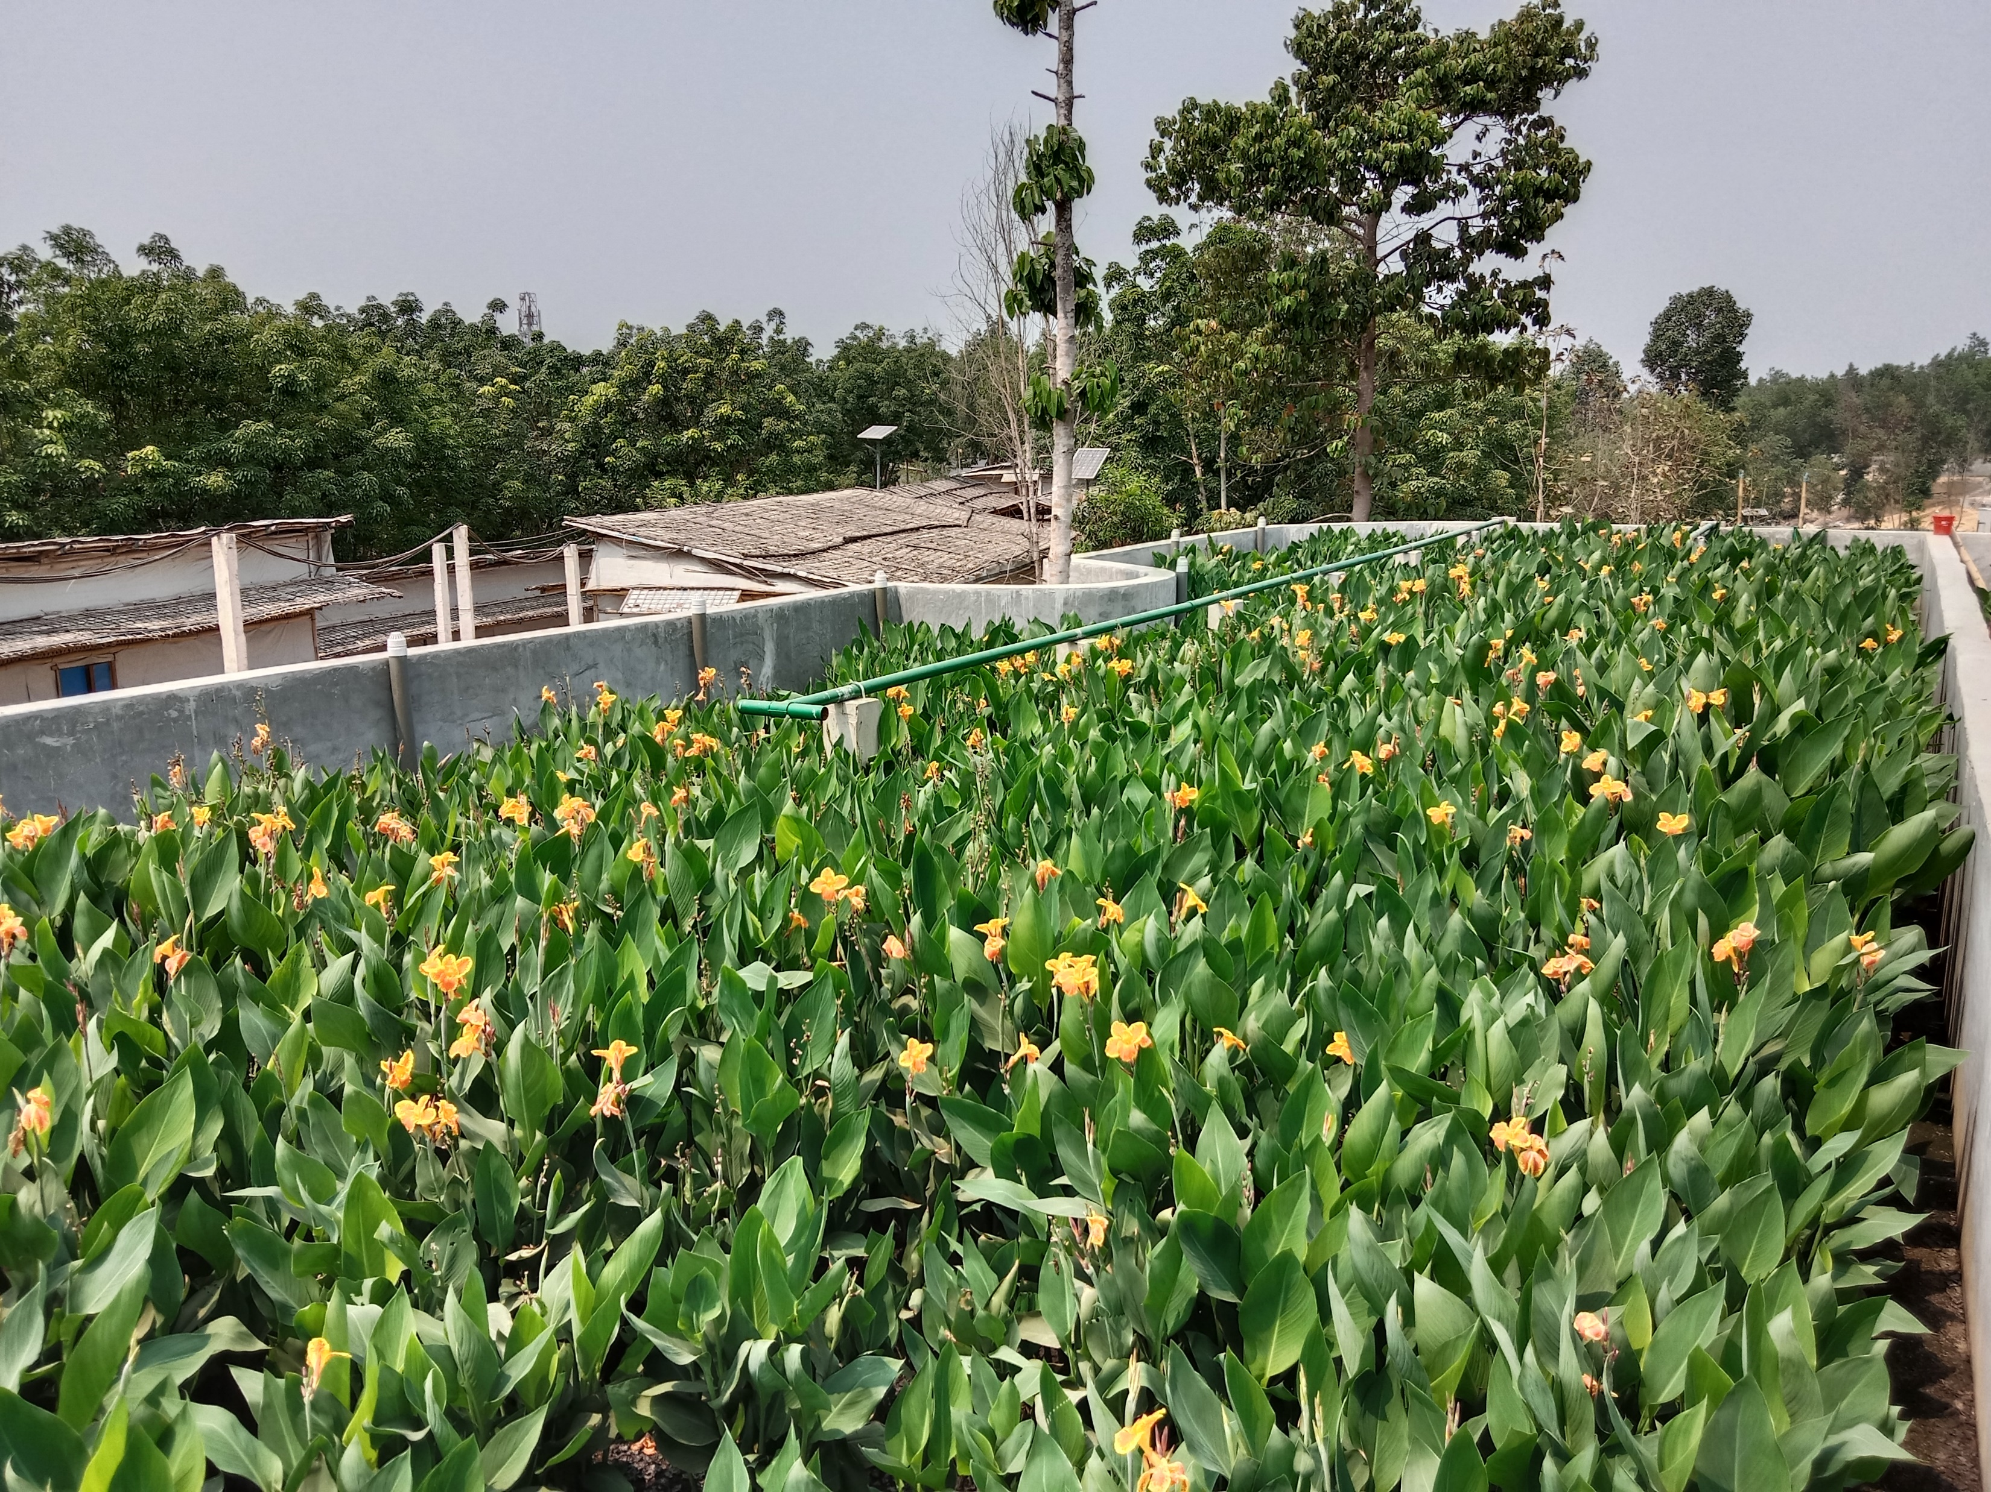
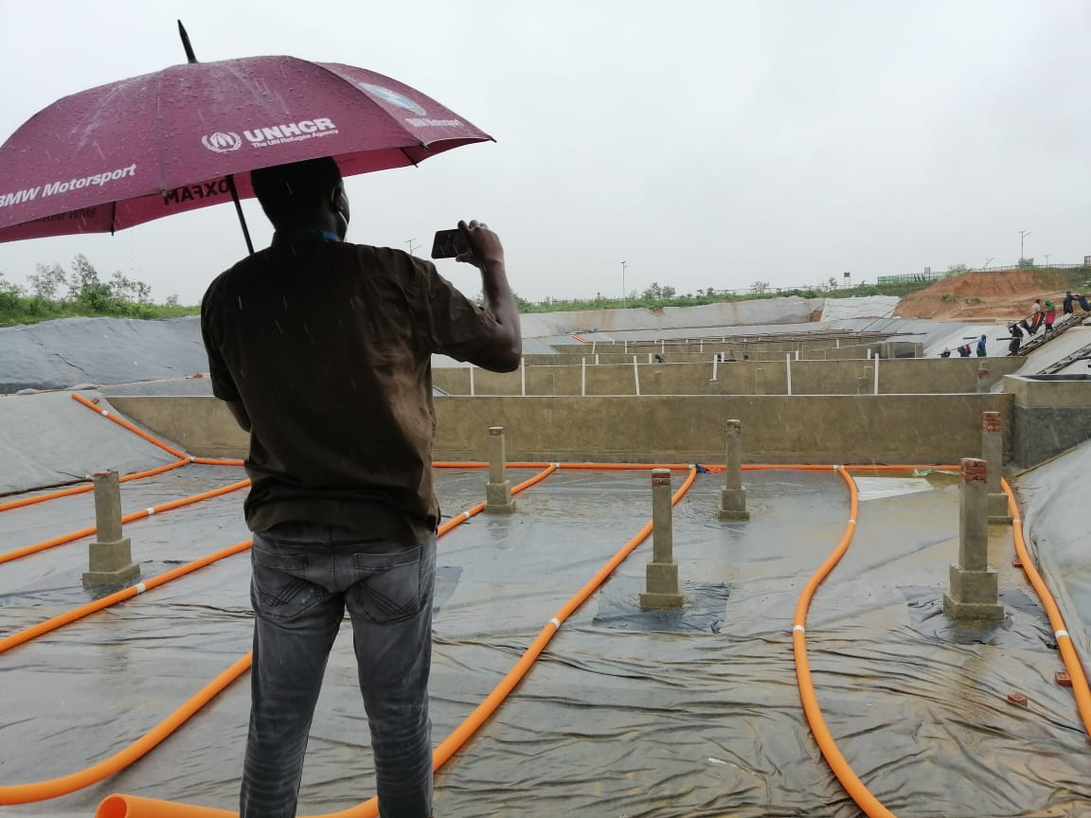
Construction steps
Excavation or construct containment , slope for drainage
Install one layer of impermeable liner (1.5mm PE ) , Geotextile layer
Install perforated drainage collection pipe
Install filer media/ Selection of right specification , Washing
Plantation

Slide 4
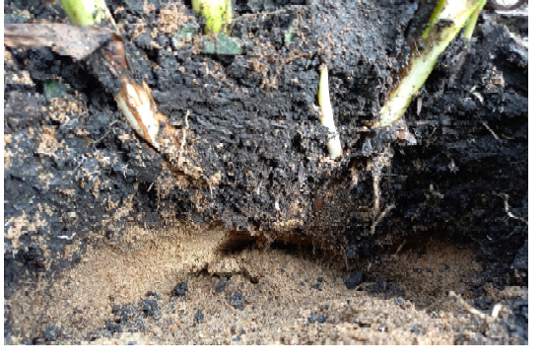
Function of plants
A macrophyte that is to be used in PDBs should have the following characteristics (De Maeseneer,1997):
• fast growing under diverse conditions;
• high transpiration capacity;
• tolerance to different water levels and drought conditions;
• tolerance to extremes of pH and salinity;
• deep growing rhizome and root system;
• ability to build new roots on the nodes when they become encased in sludge; and
• readily available, indigenous and non-invasive
Root System Cana Indica
Macrophytes therefore play an essential role in the following:
• Stabilising the beds to prevent media erosion and clogging, and improving the drainage;
• Increasing moisture loss (through evapotranspiration, in contrast to only evaporation in unplanted
drying beds);
• Providing a surface area for microbial growth within the sludge layer;
• Transferring oxygen to the sludge layer (i.e. within the rhizosphere); and
• Absorbing heavy metals and nutrients
The treatment of sludge in PDBs is achieved through a combination of physical and biochemical processes

Slide 5
The treatment of sludge in PDBs is achieved through a combination of physical and biochemical processes

Slide 6
efficiency of Planted Drying bed
FSTP -1 ( Camp 4 extension ) 2021 performance data

Slide 7
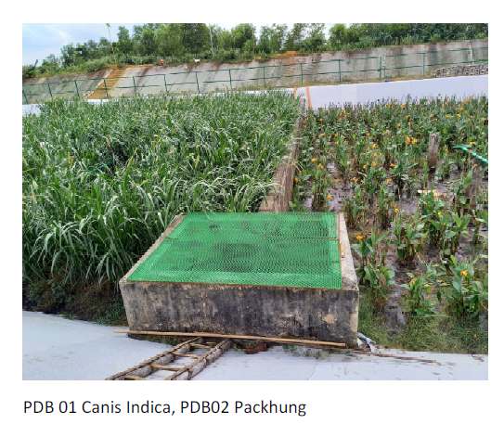
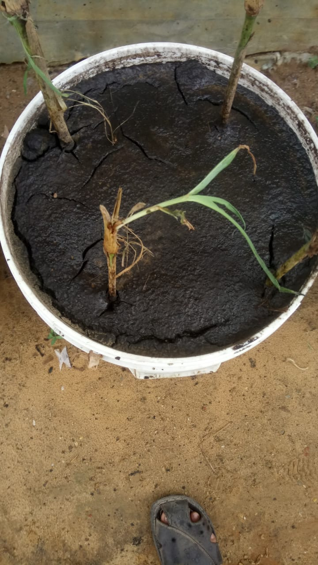
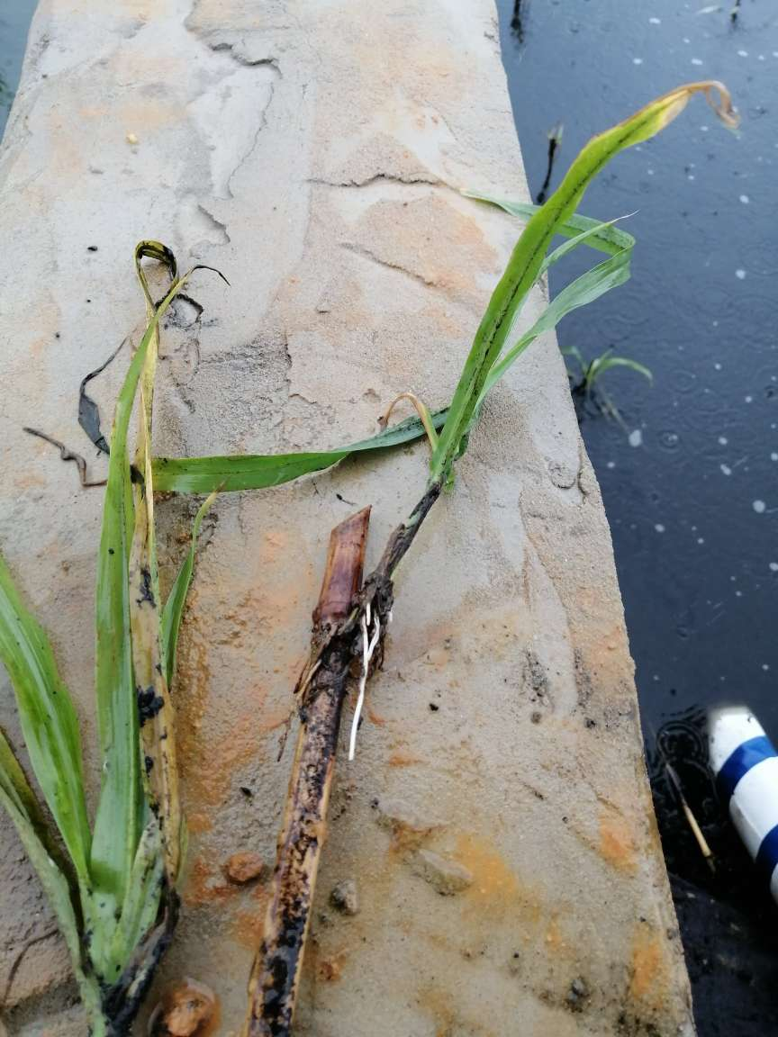
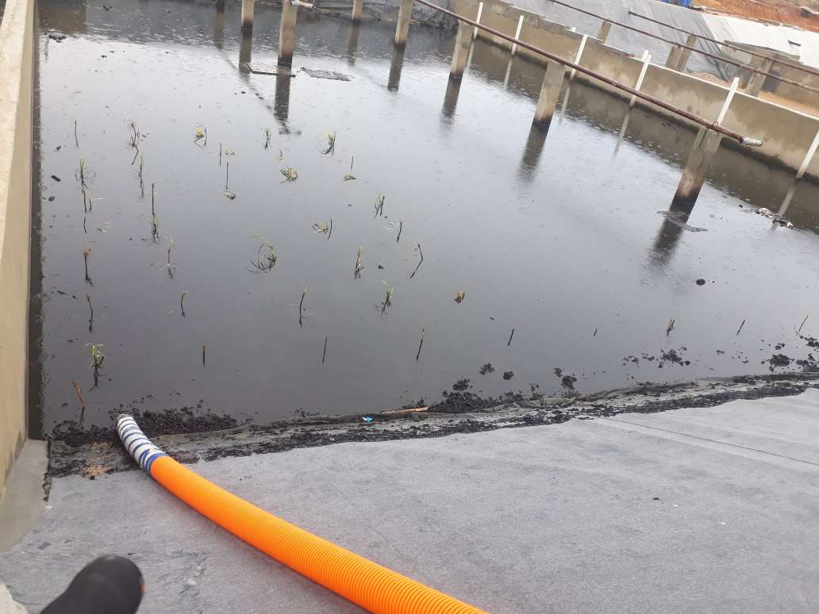
Main challenge to PDB is finding the locally available macrophytes which can survive and tolerate high and highly variable nutrient and organic levels also able to withstand the shocks associated with sludge loading and drying
Trial with Canna Indica ( Locally known as - Kolaboti )
Trial with Packchong -1 grass Origin-Thailand )

Slide 8
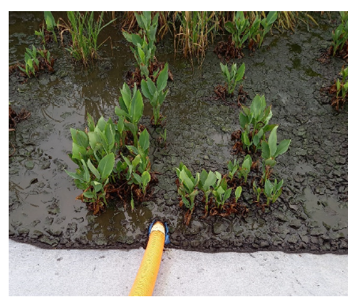
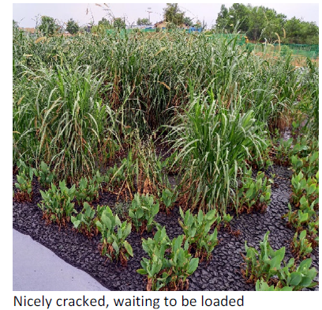
Challenges

Slide 9
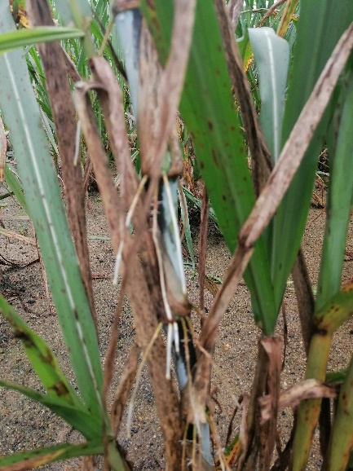
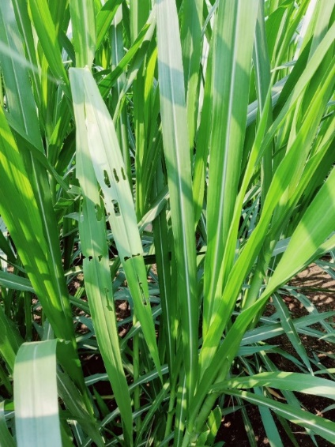

Slide 10
Challenges encountering from small scale FSTP’s in terms of capacity , treatment , solid sludge handling. ( Interim solutions ) / Group discussion
Capacity
Treatment Efficiency
Solid sludge handling

Slide 11
Contact -
Safwatul Haque Niloy
Email: sniloy@oxfam.org.uk

