Slide 1
Anaerobic Baffled Reactor , ABR Anaerobic Filter Reactor, AFR
Safwatul Haque Niloy
WASH Coordinator , OXFAM

Slide 3
Excreta
Fecal Sludge
Urine + Faeces
Excreta + Additional Input
Onsite containment
Collection
Transportation
Waste water
Treatment
Excreta+ Additional input
Sewer
Treatment
Notes:
https://www.youtube.com/watch?v=sMixJEwKec0

Slide 4
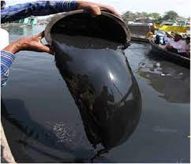
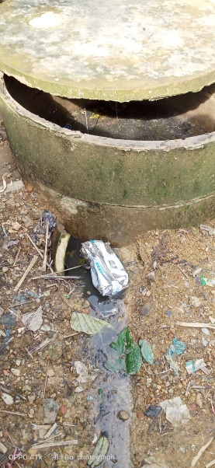
Why FS Treatment?
Suspended Solids | Suspended solids can lead to the development of sludge deposits and anaerobic conditions when untreated wastewater is discharged in the aquatic environment
Biodegradable Organics | Composed principally of proteins, carbohydrates, and fats, biodegradable organics are measured most commonly in terms of BOD (biochemical oxygen demand) and COD (chemical oxygen demand). If discharged untreated to the environment, their biological stabilization can lead to the depletion of natural oxygen resources and to the development of septic conditions
Pathogens | Communicable diseases can be transmitted by the pathogenic organisms that may be present in wastewater
Nutrients | Both nitrogen and phosphorus, along with carbon, are essential nutrients Yor growth. When discharged to the aquatic environment, these nutrients can lead to the growth of undesirable aquatic life. When discharged in excessive amounts on land, they can also lead to the pollution of groundwater.
++Heavy metals , dissolved organics

Slide 5
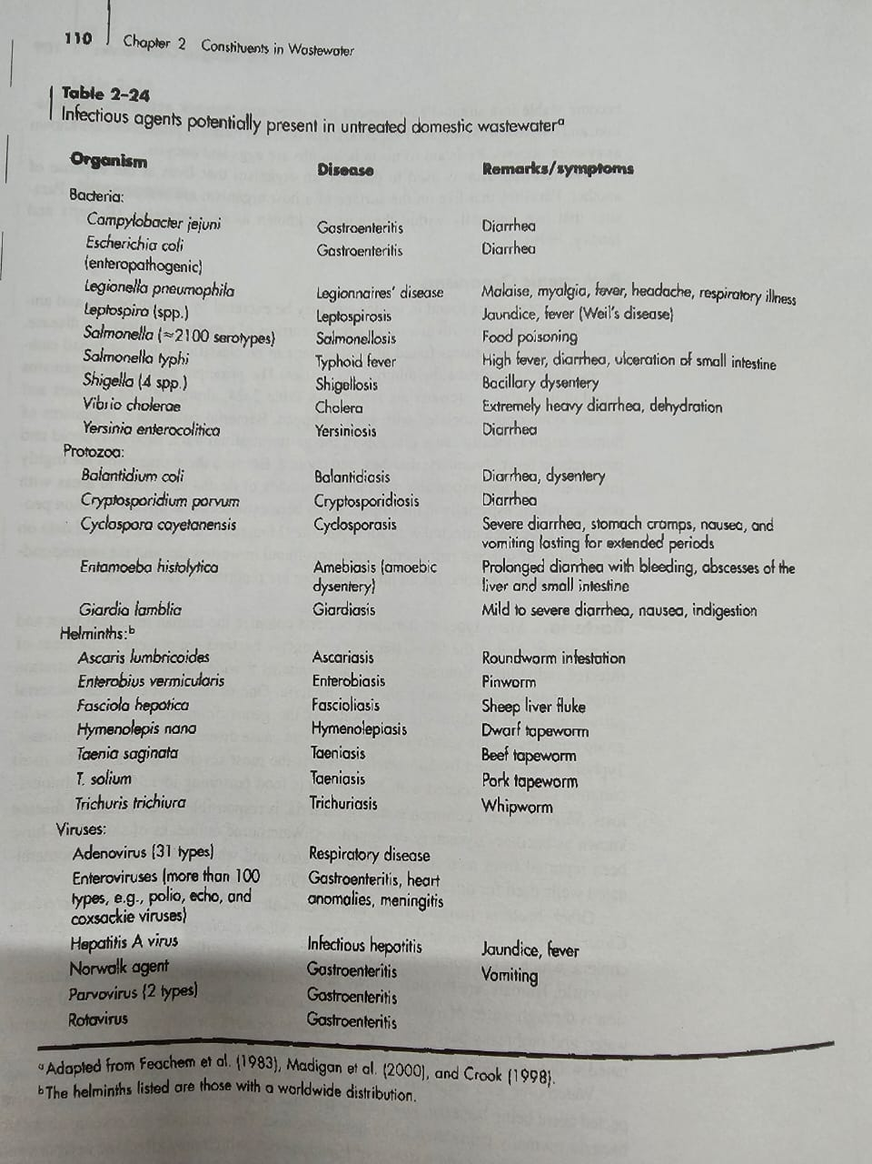

Slide 6
Fecal sludge is highly variable because of-
Contents- What is intake of the containment ( Excreta or Black water ? Mixed with grey water )
Emptying Frequency – Storage duration Effects the level of stabilization ( Fresh or Raw / partially Stabilized )
Mode of transportation
Technology of latrine containment
Quality of construction
Infiltration or storm water
Notes:
Relate with design failure

Slide 7
Do you know the design baseline of your FSTP’s .
What were the raw FS characterization result?

Slide 8
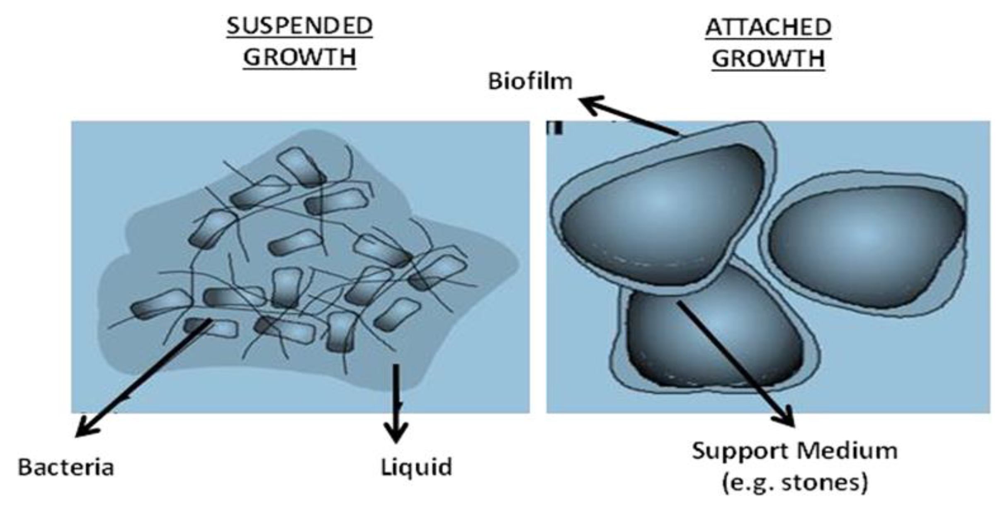
Type of biological treatment process
Suspended Growth
Biological treatment processes in which the microorganism responsible for the conversion of the organic mater or other constituents in the wastewater to gases and cell tissue are maintained in suspension within the liquid
Attached Growth
Biological| treatment processes in which the microorganisms responsible for the conversion of the organic matter or other constituents in the wastewater to gases and cell Tissue are attached to some inert medium, such as rocks, slag, or specially designed ceramic or plastic
https://www.mdpi.com/2071-1050/13/9/4656
Source- Metcalf and Eddy

Slide 9
Suspended Growth
Attached Growth
Activated Sludge process
Trickling Filters
Aerobic Process
Aerated Lagoons
Rotating Biological Contactors
Aerobic Digestions
Packed Bed Reactors
Anaerobic Process
Anaerobic packed and fluidized bed
Anaerobic Digestions

Slide 10
Anaerobic Digestion Process
The hydraulic retention time (average time water molecules stay in the system) has to be greater than the doubling time of microorganisms (time required to generate new cells) to increase bacterial activity and population size. Bacteria can easily be “washed out” of the system if the hydraulic retention time is shorter than the bacterial doubling time .
https://www.youtube.com/watch?v=UaYpri1xqlU
https://www.youtube.com/watch?v=hm9SRK22ccg&t=108s
Notes:
https://www.youtube.com/watch?v=UaYpri1xqlU

Slide 11
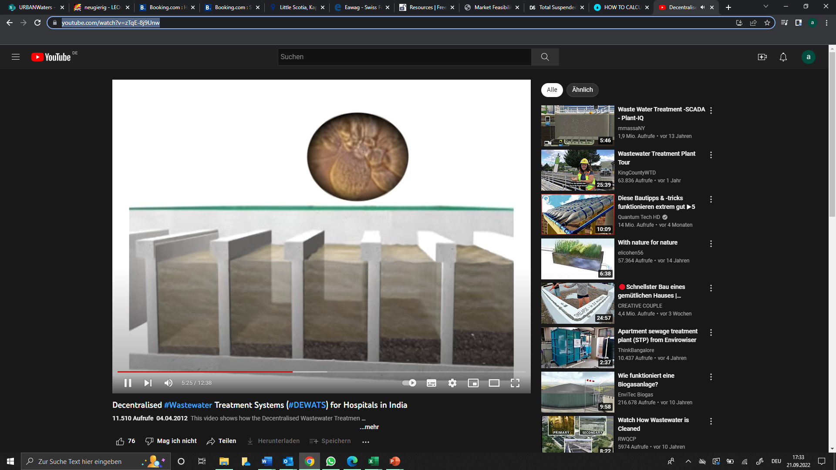
Anaerobic baffled reactor (ABR) & filter (AF)
https://www.youtube.com/watch?v=_FPsCJL5LIc
https://www.youtube.com/watch?v=zTqE-8j9Unw

Slide 12
WHAT IS AN ABR ?
The first “baffled reactors” were developed in 1981 in the USA (Stanford University by McCarthy et al.).
Sedimentation/floatation of solids
Anaerobic digestion of suspended & dissolved solids through contact with sludge
Anaerobic digestion (fermentation) of bottom sludge
Sedimentation of mineralised (stabilised) bottom sludge
Why uplfow
system has a lower risk of washing out the fixed biomass,
Better TS removal efficiency
Providing intensive contact between resident sludge and newly incoming liquid.

Slide 13
Anaerobic baffled reactor (ABR) & filter (AF)
Ventilation outlet
Inlet
Outlet
Settler
ABR upflow chambers
AF upflow chambers
Application principles:
Anaerobic wastewater treatment without electricity and chemical consumption
Suitable for sub- and tropical condition (<15°C only sedimentation but no bioactivity)
Suitable for removal or easy organic wastewater COD range 300 – 2.000 mg/l and a COD/BOD ration < 3
Typical COD and BOD reduction range 50 – 80% mainly depending on: inflow COD, temperature and HRT
Pathogen (E.coli) reduction 1 - 2 logs
Nutrient removal (NH4, N, P) < 10%
Source : Urban Waters , Andreas Schmidt

Slide 14
DESIGN PARAMETERS
Objective -
Remove suspended (and settleable) solids
•Remove organics (BOD, COD), 90 to 95%
Organicload< 6 kg/m³* d BOD ( Source- IHE training course )
A Steller is must be installed before ethe baffle chamber
Placing AFR for taking Raw sludge in Camp ? Is it a good idea?

Slide 15
HRT and SRT
Hydraulic Retention Time (HRT):
Hydraulic Retention Time refers to the average time that a liquid (e.g., water, wastewater) remains within a treatment system or a specific reactor.
Solid Retention Time ( SRT ) :
efers to the average time that solid particles (e.g., microorganisms, suspended solids) remain within a treatment system or a specific reactor.

Slide 16
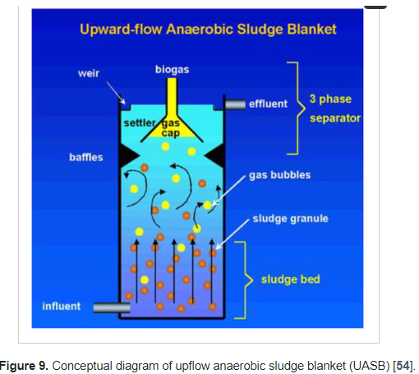
UASBR (Up flow anaerobic sludge blanket reactor)

Slide 17
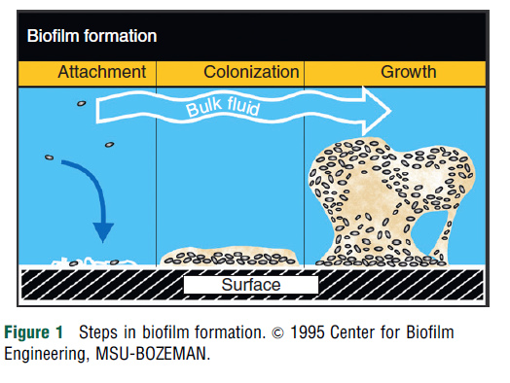
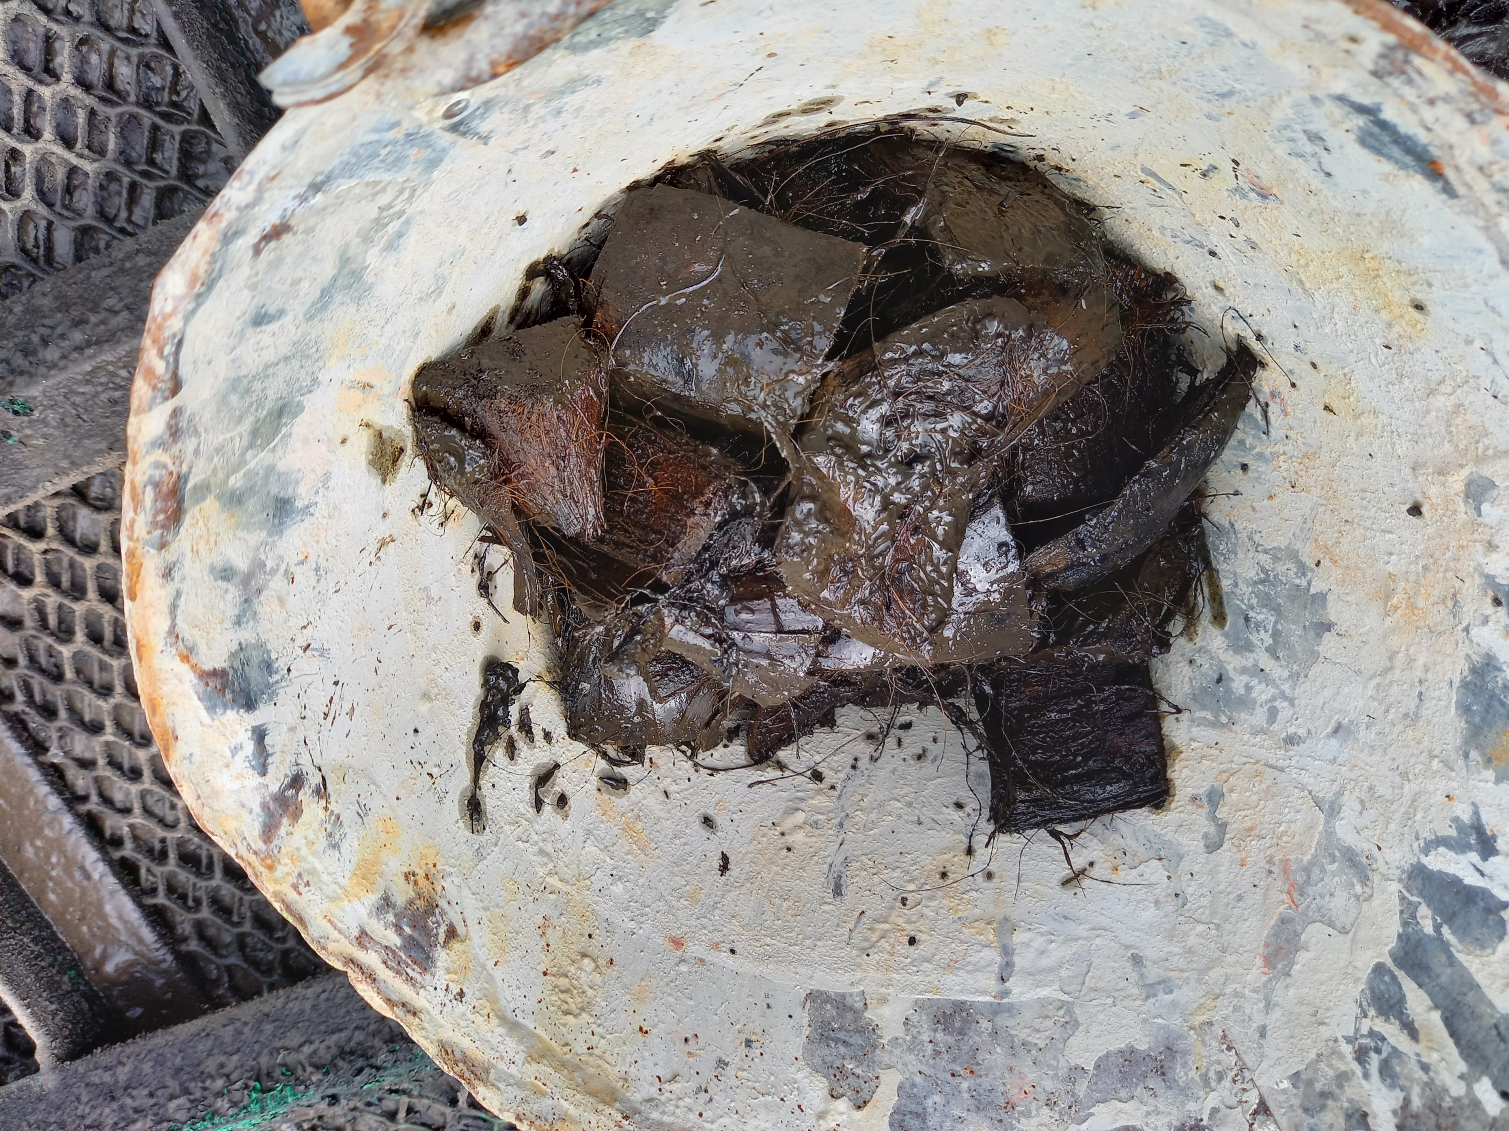
BIOFILM
The biofilm grows rapidly and when it becomes too thick to retain its grip on the media it washes off and is replaced by newly grown film. The washed off ("sloughed" off) film is settled out of the liquid stream to leave a highly purified effluent

Slide 18
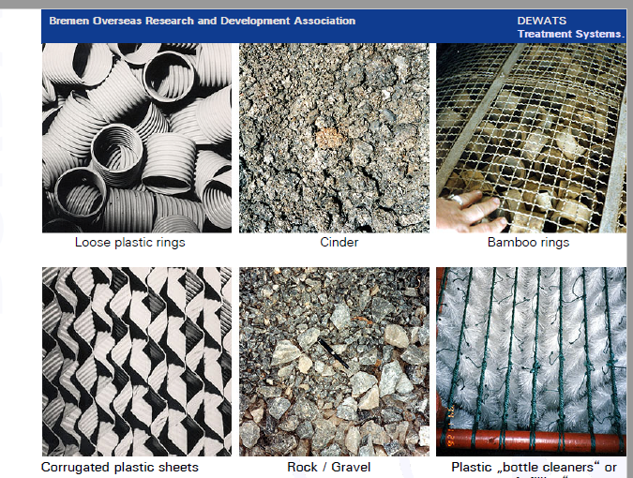

Slide 19
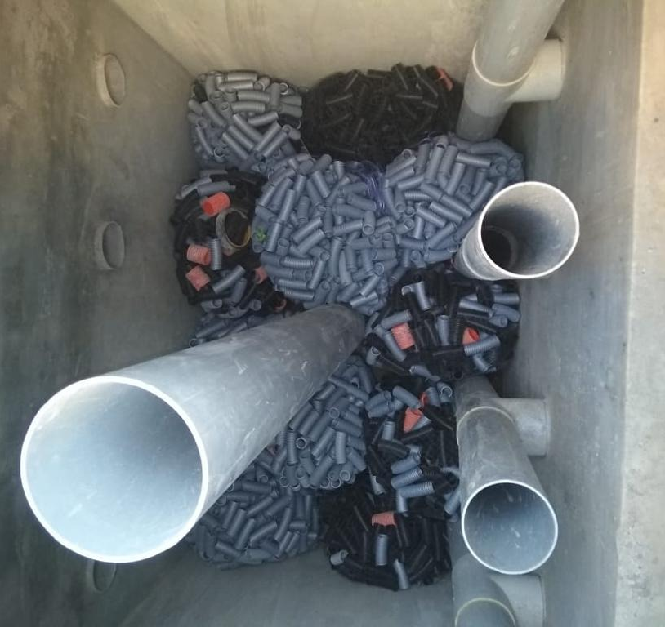
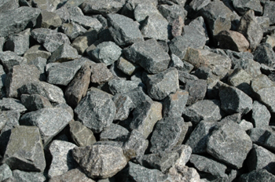
Which filter media in AFR ?

Slide 20
Camp Raw Sludge Characteristics
COD/ BOD ratio-2.76
COD range – 2000 mg/l
Typical COD and BOD reduction range 50 – 80% mainly depending on: inflow COD, temperature and HRT
Pathogen (E.coli) reduction 1 - 2 logs
Nutrient removal (NH4, N, P) < 10%

Slide 21
Advantages and Disadvantages
Advantages | Disadvantages
Separation of solids in the settler, or in the naturally formed bacteria flocs (“sludge blanket”), allows a long Sludge Retention Time (SRT) for thorough digestion. Meanwhile the liquid can circulate within a short Hydraulic Retention Time (HRT). | Desludging is necessary every year or at least after 2 years of operation. It is required even more often if the daily flow of Suspended Solids is high: generally, with a COD higher than about 3,000 mg/l and HRT lower than 3 days
Low sludge generation. | In-flow must be as constant and smooth as possible: due to short HR T, an ABR cannot be fed in batches.
No moving parts, no mechanical mixing, no filling material. | Sludge level must be regularly checked through manholes or lateral pipes.
HRT shorter than in biogas digesters allows to reduce the volume of the ABR and its land requirement (1 to 1.5 m2/daily flow m3).

Slide 22
How many of us control Uplfow velocity in the ABR / AFR?
The up-flow velocity of the baffled reactor, which should never be more than
1m/h ( DEWATS, BORDA )
Actual up-flow velocity is best below 0.9 m/h!!!If up-flow velocity is higher, adjust width and length ( Source – IHE )

Slide 23
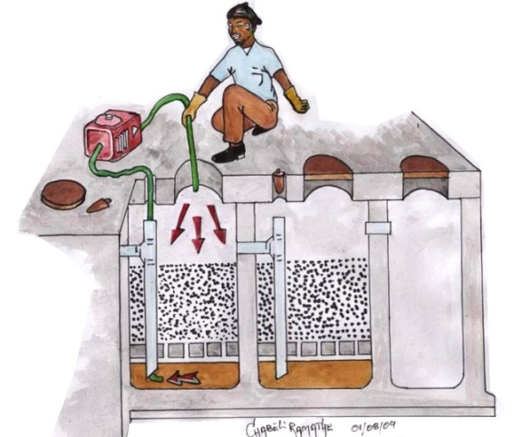
Desludging / Backwash
Desludging is necessary every year or at least after 2 years of operation.It is required even more often if the daily flow of Suspended Solids is high: generally with a COD higher than about 3,000 mg/l and HRT lower than 3 days.
Up to 5 l sludge volume are produced in the settler per kg of COD influent. Anaerobic digestion will reduce this volume by 40% for 2 years.About 1.5 l sludge volume are produced in the baffles; this amount decreases from each baffle to the next
Ref: UPM

Slide 24
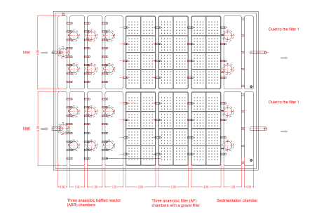
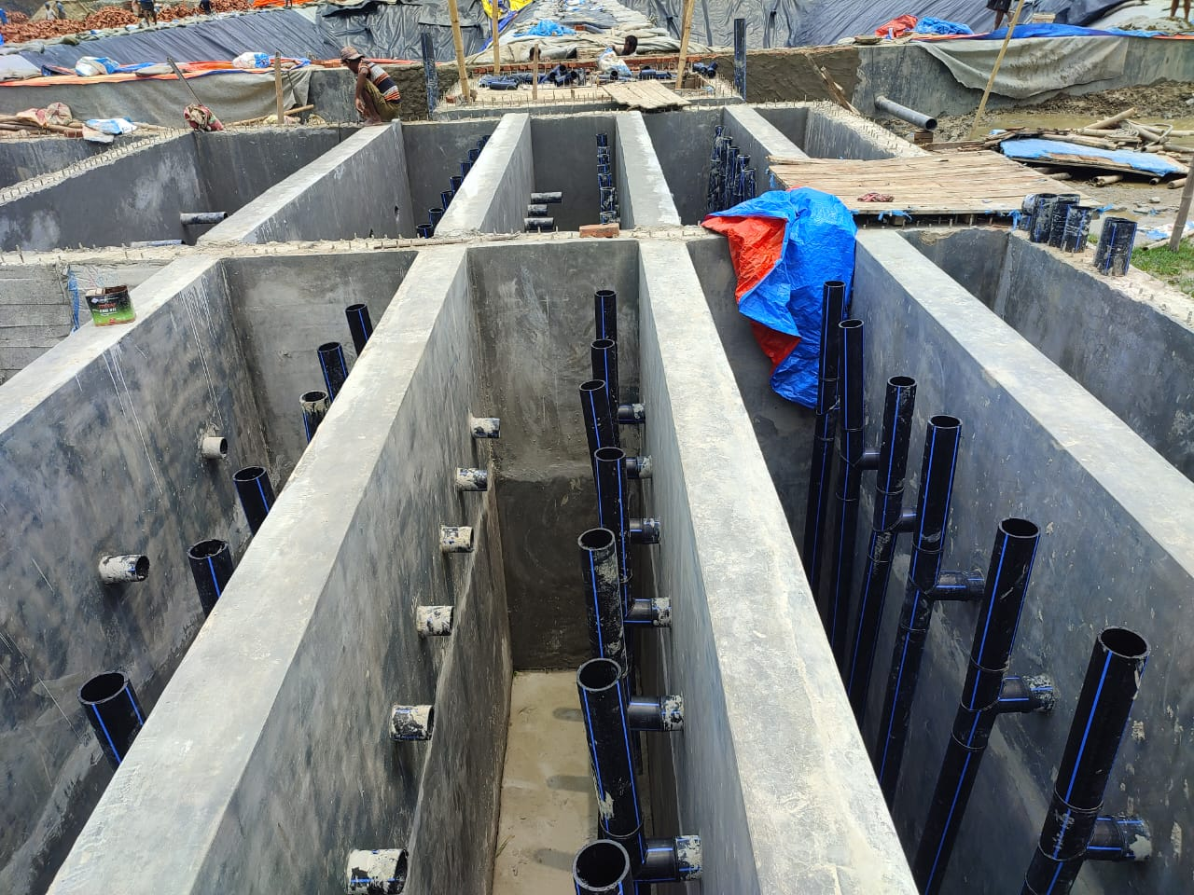
ABR+ AF

Slide 25
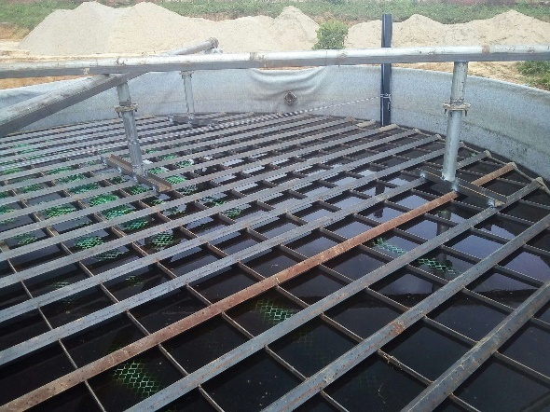
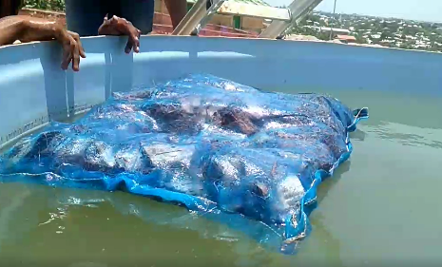
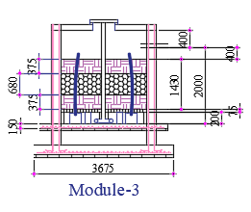
Floating Nature of Coco Husk Loosing effective contact with WW
3: Cocohusk bag floating
.127 PSI was calculated empirically . Around 50 Kg weight was needed to submerge one coco bag inside the water

Slide 26
Do we capture biogas from ABR/ AFR?
the study found that the suitable HRT and temperature that yielded the average maximum gas production rate of 11.78 L/d was at 3 days and temperature of 30.91°C
Feces + urine from 1 person produce about 15–27 l biogas / d in the ABR; or COD produced per person: 38g feces + 9g urine / d * 0.35 l methane / COD removed. ( UPM )
practical use
200 l biogas per 1 kg CODremoved
Source – Borada
Notes:
Experimentation on the anaerobic filter reactor for biogas production using rural domestic
Wastewater .IOP science

Slide 27
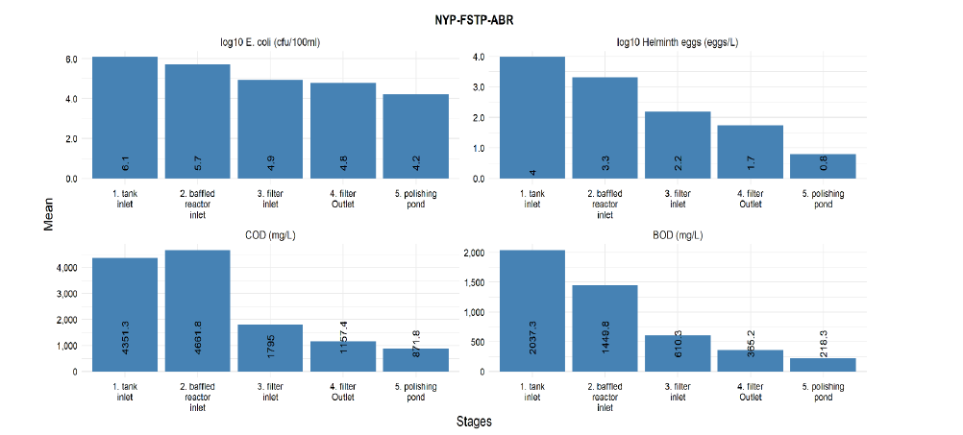
Case Study Performance Efficiency of ABR ( Camp 5 , 17 ) and FSTP 1-

Slide 28
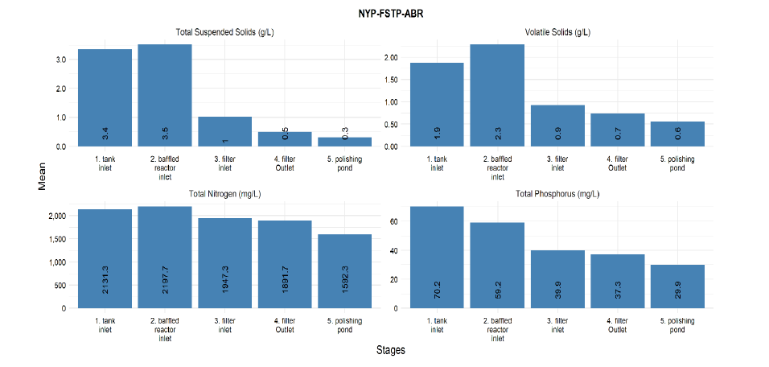

Slide 29
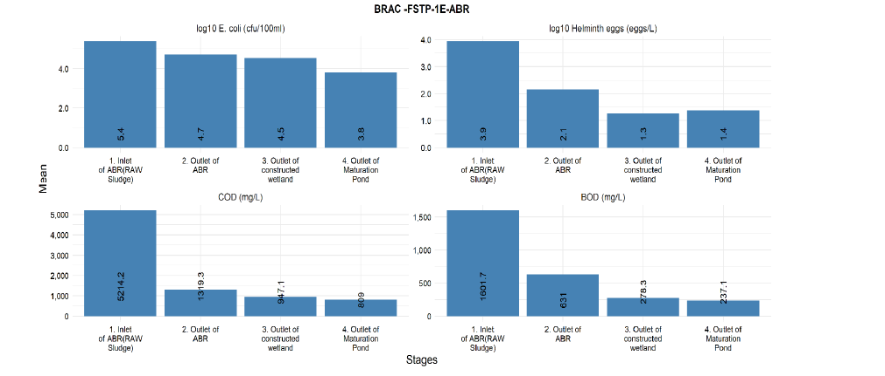

Slide 30
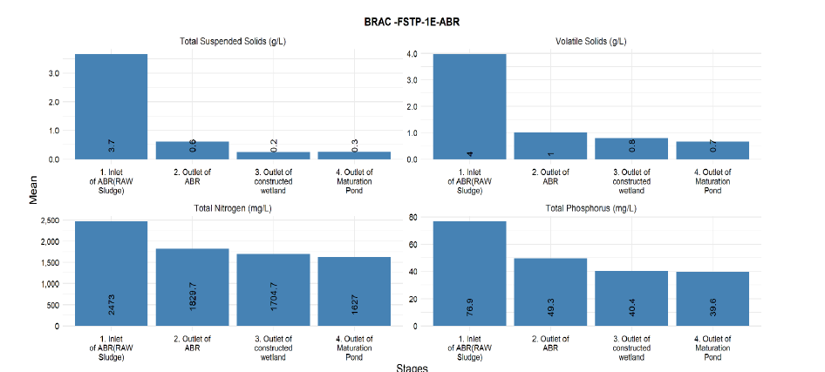

Slide 31
Camp 4 FSTP -1 ( Upflow Filter), upgraded to AFR
Average result summary – OXFAM C4 FSTP (October,2020- March,2021)
Facts
Influent flows were varying from the lagoon to upflow
The filter media might have shortcuts
Gas accumulation in the outlet pipes.
Frequent backwashing.
Stage | E coli | COD | BOD | TSS
Upflow Inlet | 87750 | 1090 | 315 | 0.38
Upflow outlet | 37127 | 864 | 160 | 0.18
% removal | 58% | 21% | 49% | 53%

Slide 32
Further Reading
IHE DELFT BRAC FSM Training ( ABR )
Anaerobic Baffled Reactor (ABR) Design Considerations for Faecal Sludge ( UPM )
BORDA’s DEWATS Practical Guide

Slide 33
Demo points
How an ABR + AF works
Necessity of maintain uplfow velocity
Sludge deposition and cleaning
Inlet pipes issue
Floating nature of cocohusk

