Slide 1
Feacal Sludge Treatment Technologies Overview
in Cox’s Bazar
Jafar Ikbal
WASH sector
jafar.ikbal@brac.net

Slide 2
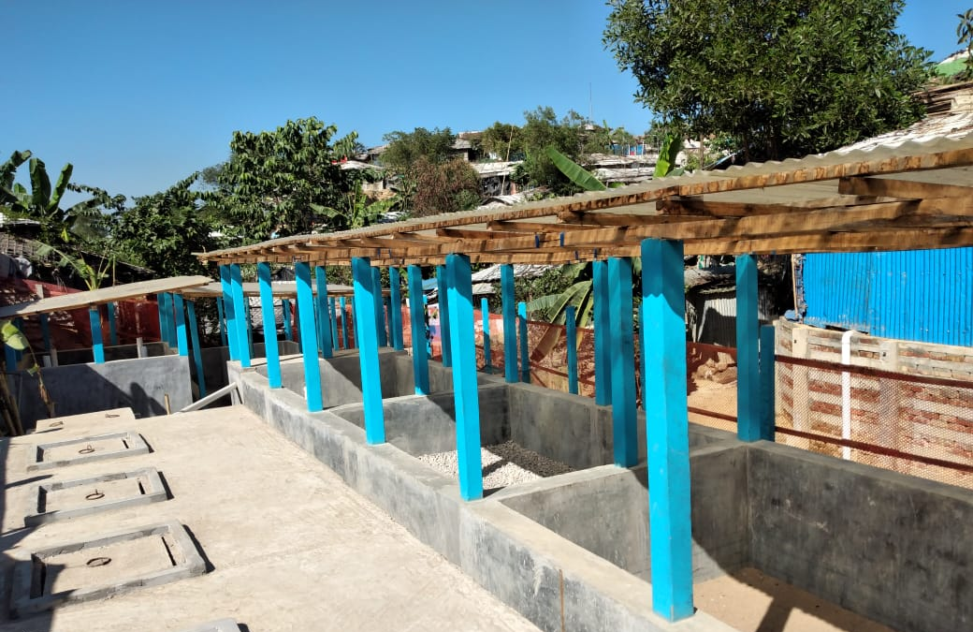
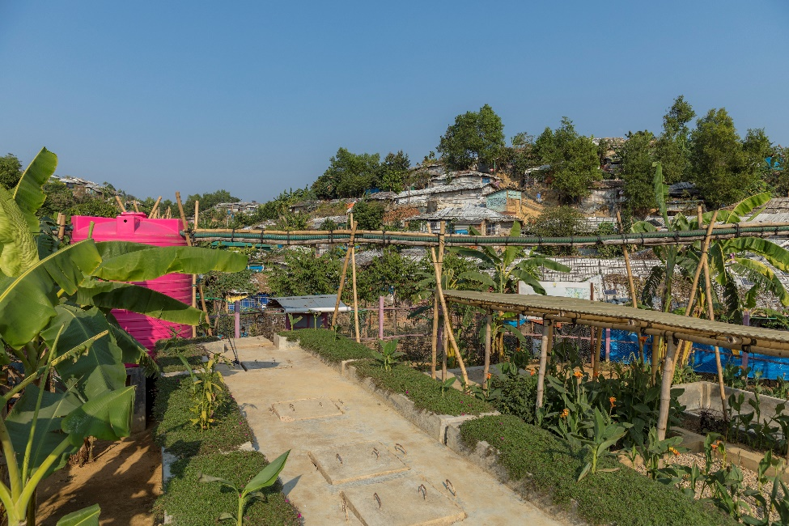
Anaerobic Baffled Reactor (ABR):
6 to 15 m3 per day
23% FSTPs are ABR
Treatment Component:
Drying bed
Anaerobic baffled reactor
Polishing pond
Advantage:
Moderately less area required (Avg. 49 m2/m3)
Low O & M cost
Effluent quality good than other treatment process
Disadvantage:
Moderately higher capex (Avg. 5,758 USD per m3)
Scalability Low
Low pathogen removal capacity

Slide 3
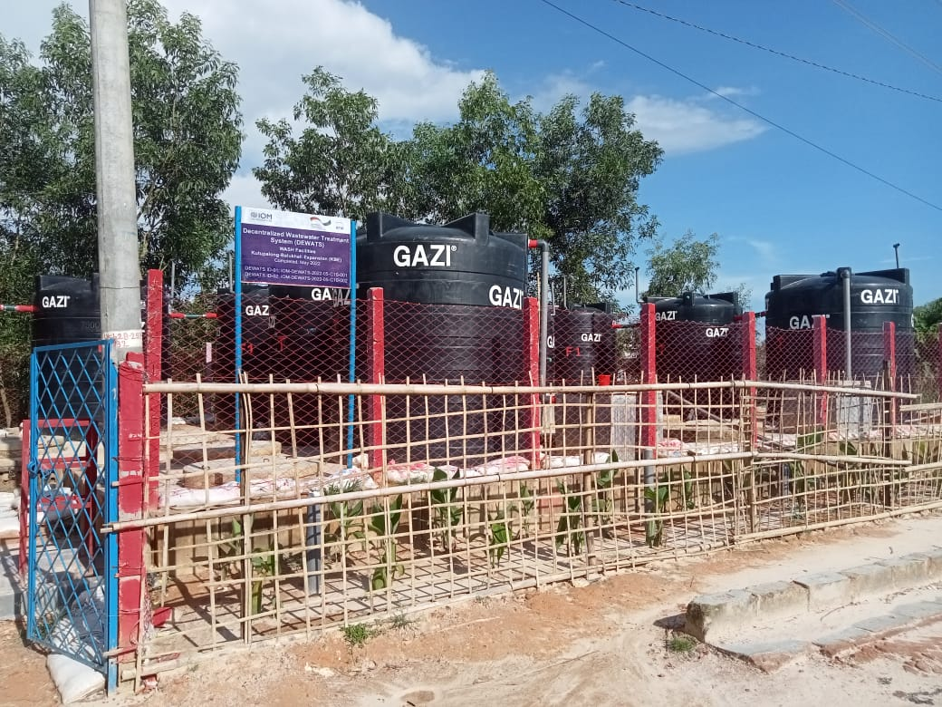
Decentralized waste water treatment system (DEWATS)
3 to 6 m3 per day
9%+ FSTPs are DEWATS
Treatment Component:
Settler tank
Up flow filter
Infiltration trench
Advantage:
Less area required (Avg. 29 m2/m3)
Low CAPEX & OPEX
Effluent quality good than other treatment process
Scalability high
Disadvantage:
Nitrogen and nitrate removal capacity low

Slide 4
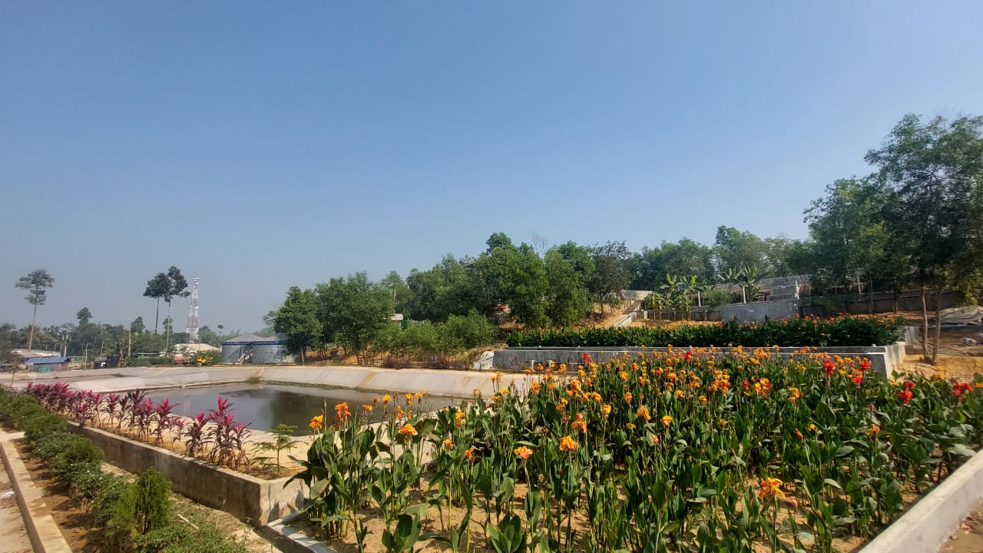
Mega FSTP 1 & 2
Mega FSTP 1
120 to 180 m3 per day
Treatment Component:
Planted drying beds
Anaerobic lagoon
Trickling filter
Constructed wetland (vertical and horizontal)
Anaerobic Filter Reactor
Polishing pond
Up Flow Filter
Advantage:
Low OPEX & whole life cost
Effluent quality consistently good than other treatment process
Disadvantage:
High CAPEX
Large footprint area required
Mega FSTP 2

Slide 5
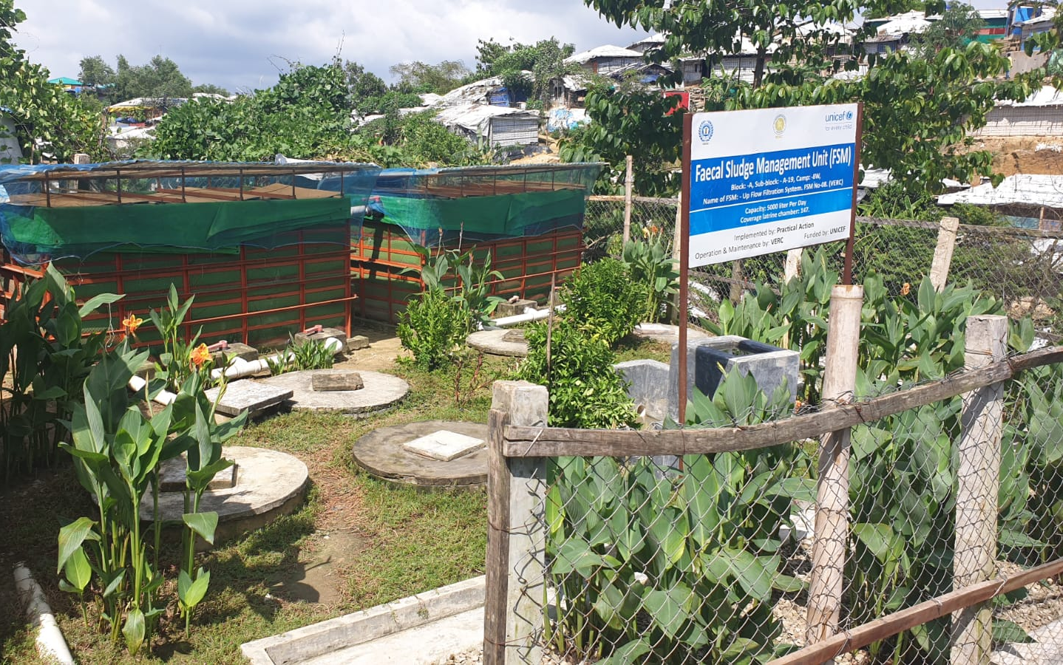
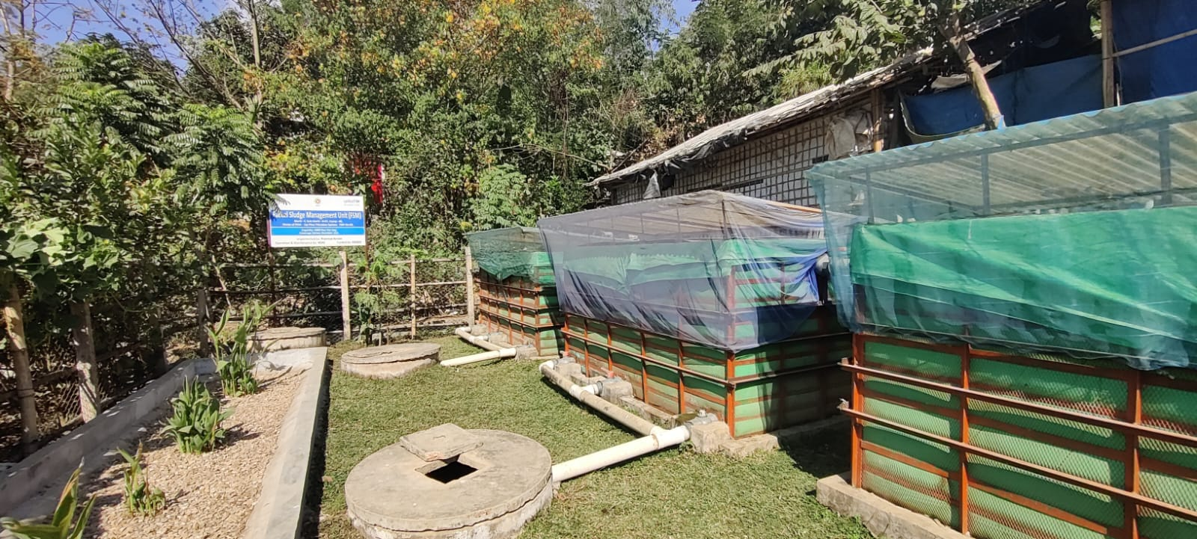
Up Flow Filter (UFF)
3 m3 per day
22% FSTPs are UFF
Treatment Component:
Settler tank
Filter
Planted Contructed Wetland
Advantage:
Less area required (Avg. 28 m2/m3)
Low OPEX
Scalability high
Disadvantage:
High CAPEX
Whole life cost moderately high

Slide 6
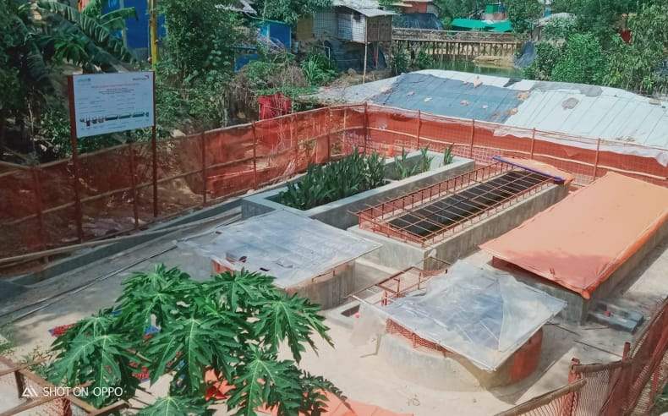
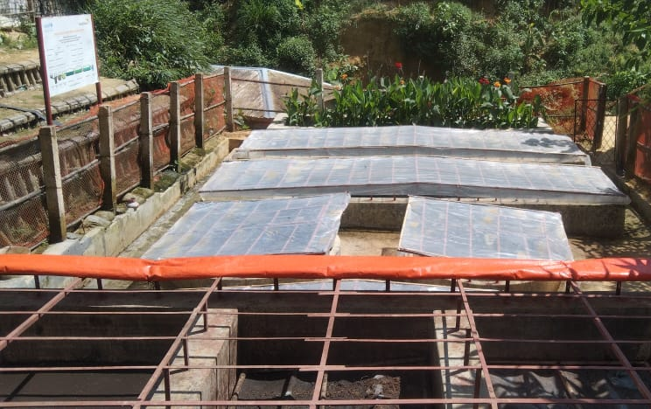
Waste Stabilization Pond (WSP)
2.5 to 5 m3 per day
6%+ FSTPs are WSP
Treatment Component:
Drying beds
Anaerobic pond
Facultative pond
Maturation pond
Plantation bed & Soak Well
Advantage:
Less area required (Avg. 13 m2/m3)
Moderately low OPEX
Effluent quality moderately good
Disadvantage:
Moderately high CAPEX
Scalability low

Slide 7
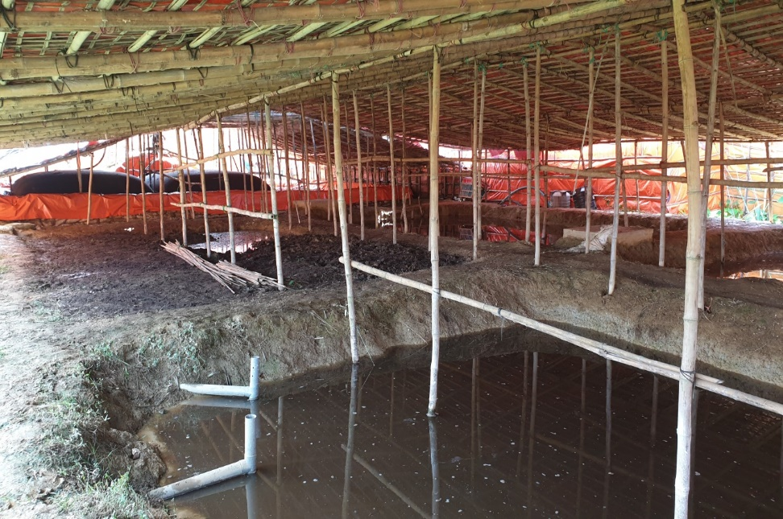
Lime Stabilization Pond (LSP)
5 to 10 m3 per day
14% FSTPs are LSP
Treatment Component:
Drying Bed
Lime lagoons/ stabilisation ponds
Polishing Pond
Advantage:
Moderately less area required (Avg. 47 m2/m3)
Low CAPEX
Disadvantage:
Effluent quality poor than other treatment process
Whole life cost high
Health and safety risk to the operators

