Slide 1
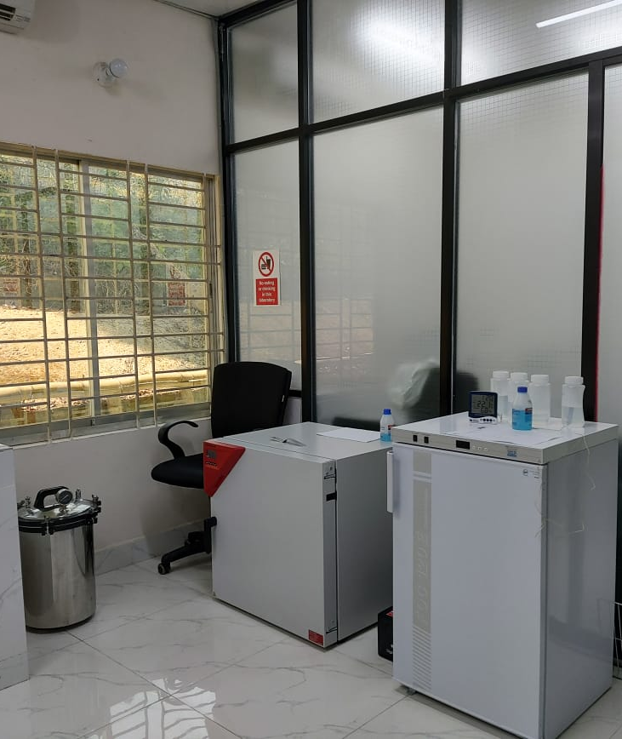
Sewage Discharge Quality Standard and Helminths
Wastewater Quality Testing Laboratory, Kutupalong, Cox’s Bazar

Slide 2
Dept. of Environment (DOE) Sewage Discharge Quality Standard in Bangladesh

Slide 3
Parameter | Unit | The Environment Conservation Rules, 1997, Ministry of Environment and Forest. Schedule 9- Standards for Sewage Discharge | The Environment Conservation Rules 2023, Ministry of Environment, Forest and Climate change. Schedule 3-Standards for Sewage Discharge
pH | - | - | 6 to 9
BOD | mg/L | 40 | 30
COD | mg/L | - | 125
Nitrate | mg/L | 250 | 50
Phosphate | mg/L | 35 | 15
Suspended Solids | mg/L | 100 | 100
Temperatue | °C | 30 | 30
Coliform | cfu/100 ml | 1000 | 1000
Oil & Grease | mg/L | - | 10

Slide 4
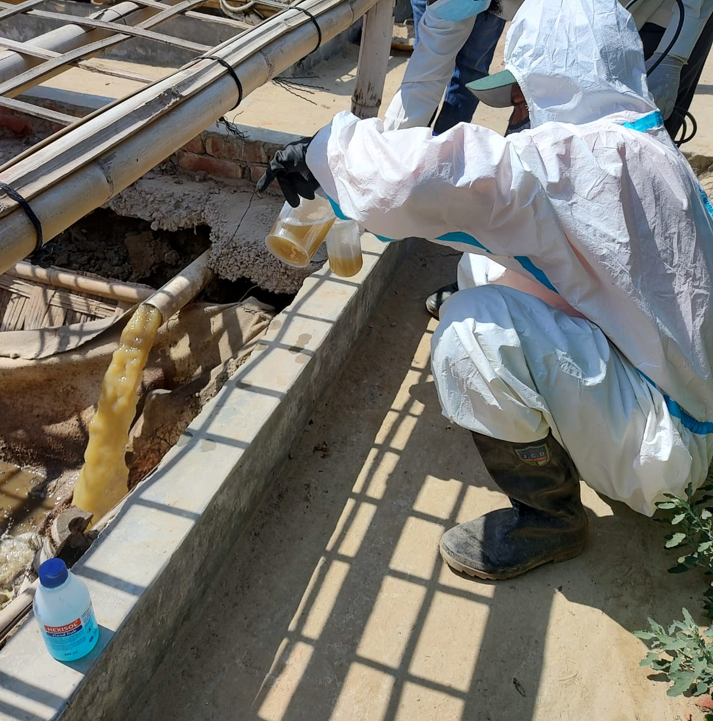
Global Sewage Discharge Quality Standard

Slide 5
 |  | High income |  |  | Upper middle income |  |  | Lower middle income
Parameter | Unit | EU | USA | Japan | Indonesia | Jordan | Ecuador | Bangladesh | Algeria | India
Year |  | 2018 | 2002 | 2015 | 2016 |  | 2015 | 2023 | 2015 | 2019
PH | - |  | 5.0-9.0 | 5.0-9.0 | 6.0-9.0 | 6.0-9.0 | 6.0-9.0 | 6.0– 9.0 | 5.5-8.5 | 5.5-9
Suspended Solids | Mg/L | 35 | 35 | 200 | 30 | 50-60 | 130 | 100 | 35 | 20
COD | Mg/L | 125 | 120 | 160 | 100 | 150 | 250 | 125 | 120 | 50
BOD | Mg/L | 25 | 40 | 160 | 30 | 60 | 100 | 30 | 35 | 10
T. Nitrogen (TN) | Mg/L | 10-15 | 10 |  |  |  | 15 |  |  | 10
T. Kjeldahl Nitrogen | Mg/L |  | 25
NH₄N | Mg/L |  | 1 | 40 | 10 | 5
Nitrates NO₃ | Mg N/L |  | 10 | 100 |  | 45 |  | 50
T. Phosphorus(TP) | Mg P/L | 2 | 1 | 16 |  | 15 | 10 | 35 | 10
Faecal coliforms | Cfu/100 mL |  | 1000 | 3000 | 3000 | 1000 | 10000 | 1000 |  | <230
Helminth eggs | Numbers/L |  |  |  |  | 1
E. coli | MPN/100 ml |  | 200

Slide 6
Importance of Sewage Discharge Maintenance

Slide 7
Public Health protection
Environmental Protection
Contribution to Safe Water Supply

Slide 8
pH
Imbalance Ecosystem
Harm Aquatic Organisms
Nutrients
Eutrophication
Altered Aquatic Food Chains
Oxygen Depletion

Slide 9
Coliform
Risks to Health
Waterborne Disease Outbreaks
BOD & COD
Oxygen Depletion
Water Contamination
Suspended Solids
Water Quality Degradation
Sedimentation Accumulation
Contaminant Transport
Nutrient Overloading- Eutrophication
Negative Ecological Impact

Slide 10
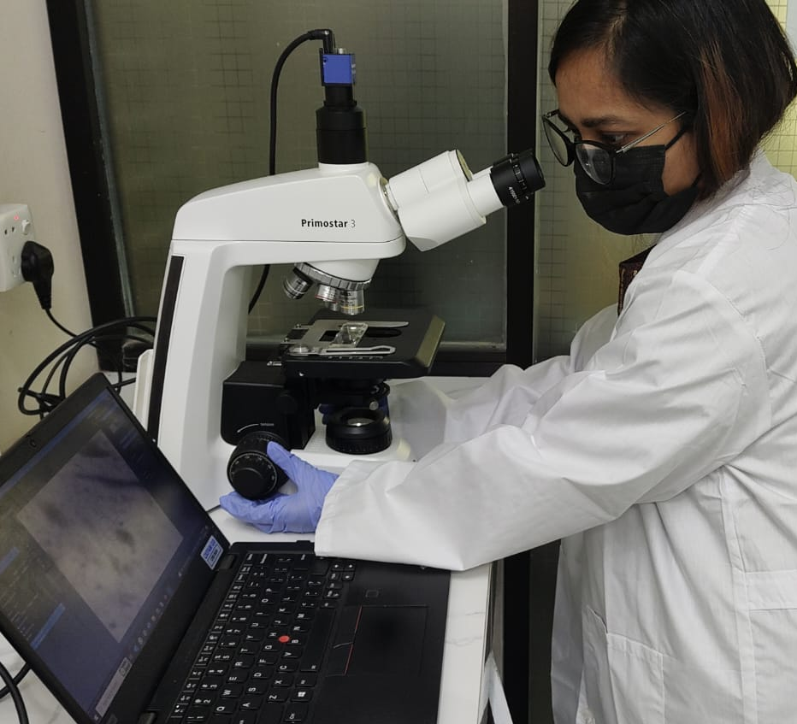
Helminths

Slide 11
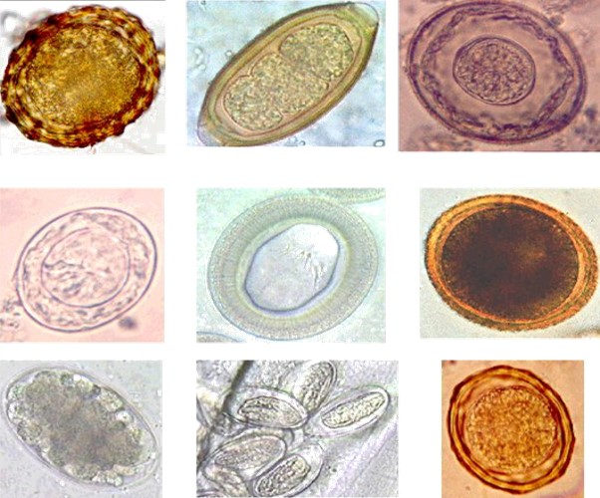
Parasitic worms
Infect humans, animals, and plants
Helminth infections- helminthiasis or intestinal worm infestations
Prevalent in areas with poor sanitation and limited access to clean water.
Infections can be transmitted through contaminated food, water, soil, or by direct contact with infected individuals or animals.
Helminth eggs have strong shell, protects them against adverse env conditions. survive in the environment for many months or years.

Slide 12
Public Health Protection
Malnutrition and Anemia
Impaired Growth and Development
Intestinal Disorders
Schistosomiasis
Immunological Effects
Environmental Protection
Contamination of water bodies, soil, and crops
Safe Reuse of Sludge

